Slide 1
Parables of the Mustard Seed & Yeast in the Dough

Slide 2
Scripture:
Matthew 13:31-33

Slide 3
Jesus told them another parable: “The Kingdom of God is like a mustard seed, which a man took and planted in his field.
Though it is the smallest of all seeds, yet when it grows, it is the largest of garden plants and becomes a tree, so that the birds come and perch in its branches.”
He told them still another parable: “The Kingdom of God is like yeast that a woman took and mixed into about sixty pounds of flour until it worked all through the dough.”

Slide 4
Though it is the smallest of all seeds, yet when it grows, it is the largest of garden plants and becomes a tree,

Slide 5
so that the birds come and perch in its branches.”
He told them still another parable:

Slide 6
“The Kingdom of God is like yeast that a woman took and mixed into about sixty pounds of flour until it worked all through the dough.”

Slide 7
Parables of the Mustard Seed & Yeast in the Dough

Slide 8
Today, we continue with the Kingdom of God series. We will study the 3rd and 4th of the seven parables in Matthew 13.

Slide 9
“Kingdom of God” is not a place we go — it is God’s rule taking root in our hearts and transforming our perspective and how we live.

Slide 10
The first two are the “Parable of the Soils” and “Parable of the Wheat and Tares.”

Slide 11
The Parable of the Four Soils tells us the four types of people and how they can all receive the Gospel.

Slide 12
The Parable of the Wheat and Tares tells us why God allows false Christians to remain for a while – to save more souls.

Slide 13
Strangely, Jesus did not give the explanations of the other five parables.

Slide 14
He seemed to be intentionally hiding their meanings from the general public.

Slide 15
Matt. 13:10-11 –
The disciples came to him and asked, “Why do you speak to the people in parables?”
11 He replied, “Because the knowledge of the secrets of the Kingdom of God has been given to you, but not to them.

Slide 16
He replied, “Because the knowledge of the secrets of the Kingdom of God has been given to you, but not to them.”

Slide 17
But to those who seek, He will reveal the meanings, just like what we are doing today.

Slide 18
The mustard seed and the yeast in the dough parables seem very similar on the surface.

Slide 19
But like the parables of the minas and talents, we will see deeper meanings when we compare them carefully.

Slide 20
With our modern knowledge of biology, we can see even more meanings in these parables.

Slide 21
The main idea: The Kingdom of God grows powerfully over time from the smallest faith and Gospel.

Slide 22
Both the mustard seed and the yeast in the dough show tremendous growth from the small things.

Slide 23
But they show us changes in two totally different ways:

Slide 24
Mustard Seed | Yeast in the Dough
Visible | Invisible
Outward | Inward
Surprising Growth | Total Transformation

Slide 25
Let’s first analyze the Parable of the Mustard Seed.

Slide 26
Mustard seed is used again later by Jesus to represent the growth of faith from the smallest bit:

Slide 27
Luke 17:6 -
Jesus replied, “If you have faith as small as a mustard seed,
you can say to this mulberry tree, ‘Be uprooted and planted in the sea,’ and it will obey you.

Slide 28
you can say to this mulberry tree, ‘Be uprooted and planted in the sea,’ and it will obey you.

Slide 29
The man who sowed the mustard seeds should represent God, the sower in the Parable of the Four Soils, too.

Slide 30
He is the true source of the Gospel and faith. He is the one who really plants faith in people.

Slide 31
The field represents his realm in this world, including His Church. The plants grow inside the Church.

Slide 32
Mustard seed is the Gospel and starting faith. It is small but has all the genes needed to form the plant.

Slide 33
The mustard trees are the mature Christians. They serve the community in general.

Slide 34
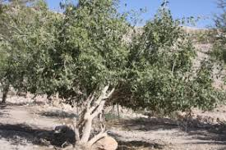
Mustard Tree
in the Middle East

Slide 35
Mature mustard trees provide food and shelter to birds and animals.

Slide 36
Jesus called us “the light and the salt of the world” (Matthew 5:13-16).

Slide 37
Today, many Christians and Christian groups are on the forefront of service.

Slide 38
They sacrifice their time, treasure, and talents to serve humanity – no matter who they are.

Slide 39
Serving others is the most important means of spreading the Christian faith.

Slide 40
“Preach the Gospel at all times. When necessary, use words.”
-- St Francis of Assisi

Slide 41
So the mustard seed parable is not hard to understand. Living it out may be hard, though.

Slide 42
Do you have a heart willing to sacrifice yourself for others or for a greater cause?

Slide 43
This is not about dying for others, but to give up something such as your time, talent, and wealth for others.

Slide 44
John 12:24 - Very truly I tell you, unless a kernel of wheat falls to the ground and dies,

Slide 45
it remains only a single seed. But if it dies, it produces many seeds.

Slide 46
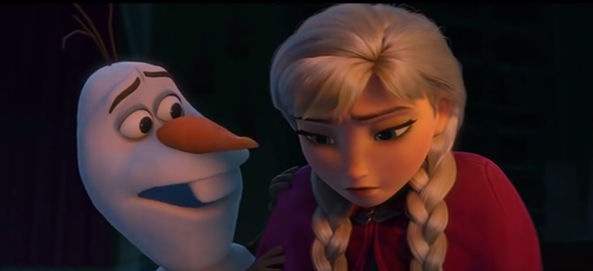
“True love is putting someone else’s needs before yours.”

Slide 47
The tiny mustard seed can grow into big plants if we nurture it properly.

Slide 48
If we are willing to let God do His work, Christians have great potential to grow and change the world.

Slide 49
The Yeast in the Dough parable, however, is far more perplexing.

Slide 50
Yeast is never mentioned in the Bible in a positive way.

Slide 51
酵母菌代表罪惡和邪惡的意圖。在某些以色列的節日中，他們不能食用發酵過的餅。

Slide 52
Yeast represents sin and evil intentions, and in some festivals, Israelites avoid leaven bread.

Slide 53
In fact, Passover is the meal that starts the seven-day Feast of the Unleavened Bread.

Slide 54
It is a reminder of the Israelites leaving the sinful world of Egypt behind.

Slide 55
Matt. 16:6 –
Jesus said, “Be on your guard against the yeast of the Pharisees and Sadducees.”

Slide 56
Jesus was referring to those religious teachers’ evil intentions and wrong teachings.

Slide 57
The bread-making woman should be referring to people. No surprise since they do the cooking.

Slide 58
Sin comes from people, not God. However, God may allow sin and suffering to last for a time.

Slide 59
And the flour, which comes from wheat, represents Christians.

Slide 60
Water, which is needed in the dough, represents the Holy Spirit working in us.

Slide 61
Flour = Christians
+ Water = Holy Spirit
+ Yeast = sin / evil .
Good-tasting bread?

Slide 62
How is that possible? Why is sin allowed among Christians, and how can we get something good from it?

Slide 63
To figure that out, we need to learn how to make bread.

Slide 64
How to make bread?
1. Flour mixed with water, yeast, a tiny bit of oil, salt, and sugar.

Slide 65
When flour is mixed with water, it turns into the elastic gluten when kneaded.

Slide 66
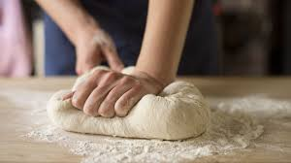

Slide 67
The yeast turns sugar into CO₂ and breaks down starch, protein, and fat into simpler molecules.

Slide 68
The CO₂ is trapped by the elastic gluten and the dough rises.

Slide 69
Give the yeast some time to grow and do its job and the dough will expand in size due to the air in it.

Slide 70
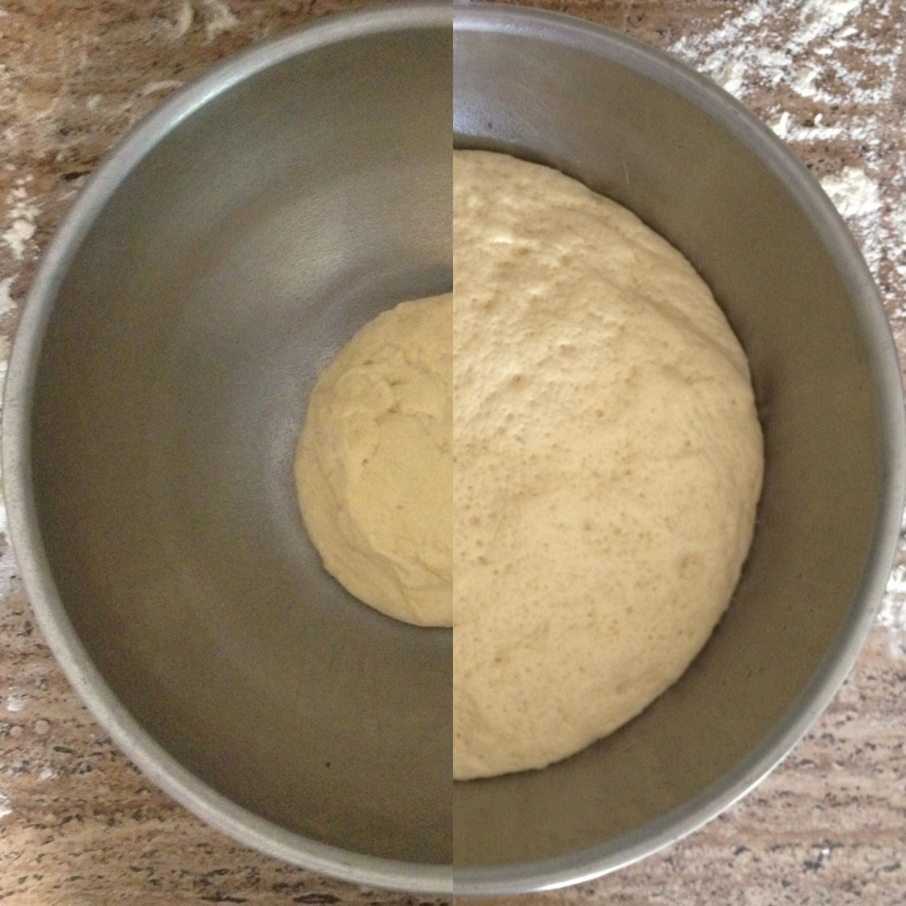

Slide 71
On the outside, the dough looks pretty much the same, just a lot bigger.

Slide 72
The dough becomes full of air and expands in size because the yeast digests the sugar in the flour and releases CO₂.

Slide 73
Then we divide up the dough into the right amounts and bake them into bread.

Slide 74
During baking, the bread changes color, but we can still see the original shape.

Slide 75
The really big changes happened inside the dough, on a molecular level, during the proofing process.

Slide 76
The yeast also transformed the protein, starch, and fats into something different.

Slide 77
CO₂ makes the bread fluffy. Ethanol gives it a bit of taste but is mostly evaporated during the baking process.

Slide 78
The baking process destroys the yeast and the ethanol but the bread tastes different as a result.

Slide 79
Different kinds of yeasts, cooking methods, and slightly different ingredients will produce different kinds of bread.

Slide 80
So yeast is a tool used by bakers to make a variety of tasty baked goods.

Slide 81
Yeast first makes CO₂ and then makes ethanol. So by controlling the proofing time, we can control the amount of alcohol.

Slide 82
Similarly, God works through different kinds of sins and sufferings to shape Christians with different characteristics and gifts.

Slide 83
Some are hardy Christians able to fight. Some are soft and sweet who bring comfort to others.

Slide 84
Unlike the mustard seed, the yeast doesn’t alter the dough's appearance much, but it completely transforms it.

Slide 85
This kind of complete transformation is not as visible because it is inward, but one can really taste it afterward.

Slide 86
Yeast shows how something small and hidden can spread and affect everything.

Slide 87
In life, sin and suffering spread — but God works through them to transform us

Slide 88
Our transformation often happens through how we respond to others’ sins toward us, through God’s work and grace.

Slide 89
God can and does work through the bad things in life to make us better. That is one of the most amazing things about the Christian life.

Slide 90
Once we realize these, we will never see sin and suffering the same. We won’t be controlled by our emotions in the same way.

Slide 91
This is the perspective of a mature Christian. We can have real joy and hope in the midst of difficulties and suffering.

Slide 92
We may not see much growth right now. But God is working — both outwardly and inwardly.

Slide 93
Also, in the parable Jesus said explicitly that the amount of flour is about 60 lbs.

Slide 94
That’s a lot of flour – can feed maybe 100 people. There’s a reason for him to tell us the amount.

Slide 95
The works of sin and the resulting Christian growth are never done in isolation.

Slide 96
The spread of sin and suffering usually comes from interaction with other people.

Slide 97
Yes, there’s sin and suffering among people in the Church, too. Don’t be surprised. God is at work here also.

Slide 98
In the washing machine allegory, we talked about how the Church is like a washing machine.

Slide 99
And how the dirty cloths, which represent sinful Christians, help cleanse each other.

Slide 100
Romans 8:28 - And we know that in all things God works for the good of those who love him,
who have been called according to his purpose.

Slide 101
who have been called according to his purpose.

Slide 102
In the end, you will turn into great bread. Those sins and sufferings will be gone for good.

Slide 103
God uses sin and suffering to transform Christians, but if we stay with Him, He will destroy sin and remove suffering in due time.

Slide 104
Are you struggling with sin or going through suffering? God is making you into good bread.

Slide 105
It may be a long and painful process but do not give up!

Slide 106
You may not understand everything God is doing right now… but that does not mean He is not working.

Slide 107
God is already at work in our lives.
The question is: will you let Him finish His work in you?

