Slide 1
The Parable of the Wheat & Tares

Slide 2
Scripture:
Matthew 13: 24-30

Slide 3
Jesus told them another parable: “The kingdom of heaven is like a man who sowed good seed in his field.
But while everyone was sleeping, his enemy came and sowed weeds among the wheat, and went away. When the wheat sprouted and formed heads, then the weeds also appeared.
“The owner’s servants came to him and said, ‘Sir, didn’t you sow good seed in your field? Where then did the weeds come from?’
“‘An enemy did this, ’ he replied.
“The servants asked him, ‘Do you want us to go and pull them up?’
“‘No, ’ he answered, ‘because while you are pulling the weeds, you may uproot the wheat with them. Let both grow together until the harvest. At that time I will tell the harvesters: First collect the weeds and tie them in bundles to be burned; then gather the wheat and bring it into my barn.’”

Slide 4
But while everyone was sleeping, his enemy came and sowed weeds among the wheat, and went away.

Slide 5
When the wheat sprouted and formed heads, then the weeds also appeared.

Slide 6
“The owner’s servants came to him and said, ‘Sir, didn’t you sow good seed in your field?

Slide 7
Where then did the weeds come from?’
“‘An enemy did this, ’ he replied.

Slide 8
“The servants asked him, ‘Do you want us to go and pull them up?’

Slide 9
“‘No, ’ he answered, ‘because while you are pulling the weeds, you may uproot the wheat with them.

Slide 10
Let both grow together until the harvest. At that time I will tell the harvesters:

Slide 11
First collect the weeds and tie them in bundles to be burned; then gather the wheat and bring it into my barn.’”

Slide 12
The Parable of the Wheat & Tares

Slide 13
Have you ever been hurt by someone in church and wondered, “Why is God allowing this?”

Slide 14
Why doesn’t God just get rid of evil or fake Christians and wrong teachings in the Church right now?

Slide 15
Could it be that this is all part of God’s plan?

Slide 16
Today we continue with the Kingdom of God series. We will study the second of the seven parables in Matthew 13.

Slide 17
“Kingdom of God” is not a place we go — it is God’s rule taking root in our hearts and transforming our perspective and how we live.

Slide 18
The Seven Parables of the Kingdom of God:
1. The Four Soils
2. Wheat & Tares
3. The Mustard Seed
4. Yeast in the Dough
5. Hidden Treasure
6. Precious Pearl
7. The Fishes

Slide 19
4. The Yeast in the Dough
5. Hidden Treasure in the Field
6. The Precious Pearl
7. The Good and Bad Fishes

Slide 20
Last time we studied the Parable of the Four Soils, which tells us the four types of people and how they can all receive the Gospel.

Slide 21
Recap of the soils:
1. The path - the hard surface allowed the exposed seeds to be eaten immediately.

Slide 22
2. The rocky soil – no real soil, so it does not allow the roots to take hold, and so the plants die from the lack of nutrients.

Slide 23
3. Thorny places - seeds get choked by earthly things so they do not touch the soil and sprout.

Slide 24
4. The good soil – seeds are protected, roots can grow and get nutrients, and then the plants grow and bear fruit.

Slide 25
But as we found out, all three bad soil types can be turned into good soil by God with the help of caring Christians.

Slide 26
Today we will study the Parable of the Wheat and Tares.

Slide 27
Today’s question: Why doesn’t God remove the evil and fake Christians inside the church now?

Slide 28
The answer from this parable: God allows good and evil to grow together for now so that more people can be saved.

Slide 29
Weeds take up nutrients that could have gone to growing the food crop, thereby possibly reducing crop yields.

Slide 30
Tares are a kind of weeds, and they look like wheat until they both reach maturity.

Slide 31
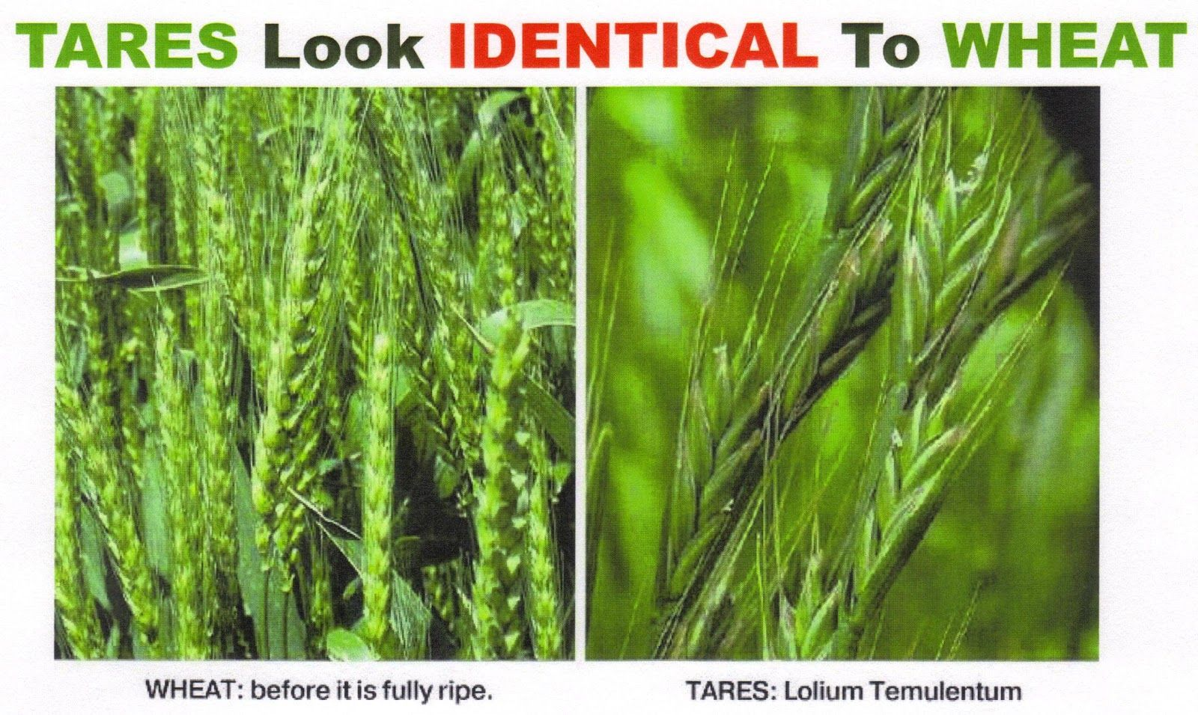
Wheat Tares

Slide 32
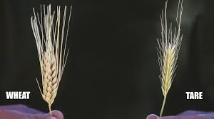
Wheat Tares

Slide 33
Farmers would carefully take out tares before they sow the seeds.
Notes:
Explain why:
Take up nutrients needed by wheat
Accidental removal of wheat when trying to get rid of tares

Slide 34
But his enemy threw tares into his field to deliberately hurt his crops and reduce the amount of harvest.

Slide 35
The farmer’s options:
Remove tares while growing
Remove tares at harvest time

Slide 36
Jesus said: do it at harvest time to avoid pulling up wheat.

Slide 37
The field represents the church where both true and false believers exist.

Slide 38
The enemy is the devil. He wants to get people away from God and destroy the Church.

Slide 39
Wheat represents true Christians. Tares represent false Christians with evil intentions.

Slide 40
They both exist in any church, and the devil wants to use false Christians to hurt real Christians.

Slide 41
2 Corinthians 11:13-15 -
For such people are false apostles, deceitful workers, masquerading as apostles of Christ.
And no wonder, for Satan himself masquerades as an angel of light. It is not surprising, then, if his servants also masquerade as servants of righteousness. Their end will be what their actions deserve.

Slide 42
And no wonder, for Satan himself masquerades as an angel of light. It is not surprising, then,
if his servants also masquerade as servants of righteousness. Their end will be what their actions deserve.

Slide 43
if his servants also masquerade as servants of righteousness. Their end will be what their actions deserve.

Slide 44
Tares can make people intoxicated and sick. It is a symbol of sin.

Slide 45
So these false Christians in Church can lead people away from God.

Slide 46
But it is often hard to tell these false Christians in Church, just like it’s hard to identify tares.

Slide 47
It’s relatively easy to show godly appearances and hide one’s true intentions for a while.

Slide 48
It’s hard to tell tares from wheat while they are growing. It’s easy once harvest time comes.

Slide 49
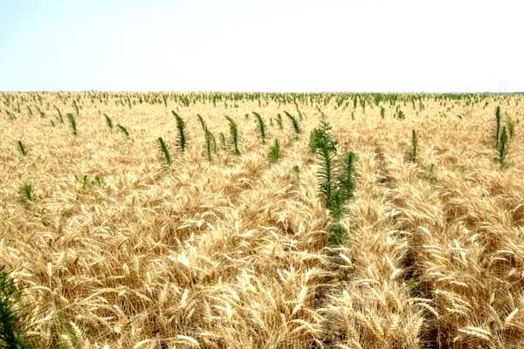
Tares stand out at harvest time...

Slide 50
Wheat turn brown when ripe. Tares are darker, nearly black.

Slide 51
Similarly, the best way to discern people is to see their fruits.

Slide 52
Matthew 7:17-18 - Likewise, every good tree bears good fruit, but a bad tree bears bad fruit.
A good tree cannot bear bad fruit, and a bad tree cannot bear good fruit.

Slide 53
A good tree cannot bear bad fruit, and a bad tree cannot bear good fruit.

Slide 54
Could those false Christians repent and turn to good?

Slide 55
In nature, tares can’t turn into wheat. But God can turn false Christians into true ones if that person is willing to be changed.

Slide 56
God lets people make such choices. He does not force people to go back to Him.

Slide 57
The time before final judgment is a time for repentance. Our God is a God of second chances.

Slide 58
Rev. 3:20 - Here I am! I stand at the door and knock. If anyone hears my voice and opens the door,
I will come in and eat with that person, and they with me.

Slide 59
I will come in and eat with that person, and they with me.

Slide 60
Furthermore, God can use bad elements in Church to help real Christians grow.

Slide 61
This was covered in many sermons, including the one on the Washing Machine Allegory.

Slide 62
But when the final judgment is here, the evil ones will be purged so they don’t do more harm.

Slide 63
God does not want people with evil intentions to inherit eternity.

Slide 64
A farmer must get rid of tares from the harvested wheat for two important reasons:

Slide 65
First, they want to prevent people from getting sick or even dying from eating tares.

Slide 66
Second, they don’t want tares to remain in the seed store and be sown in the field the next season.

Slide 67
So tares must be removed. The question is when to do it.

Slide 68
The two choices are:
1. Pull the tares during the growing season
2. Get rid of the tares at harvest time

Slide 69
The first choice uses labor when they are not as busy.

Slide 70
It does help preserve the soil’s nutrients for the wheat plants.

Slide 71
But Jesus did not want to do this because he was concerned about damaging the wheat.

Slide 72
When people try to impose judgment in the Church, it often hurts many people, both inside and outside the Church.

Slide 73
The Bible teaches us to let God be the judge and impose justice and judgment.

Slide 74
Because we don’t see the heart — but God does.

Slide 75
James 4:12 - There is only one Lawgiver and Judge, the one who is able to save and destroy.
But you—who are you to judge your neighbor?

Slide 76
But you — who are you to judge your neighbor?

Slide 77
The second option avoids damaging wheat, thereby helping maximize wheat output.

Slide 78
But it does need additional labor at a time when the farmers are very busy.

Slide 79
The soil must also be very good so the wheat still gets the nutrients they need despite the tares.

Slide 80
From this decision we can see God’s intentions.

Slide 81
He is patient and chooses to do more work at the end to guarantee maximum wheat production.

Slide 82
The soil, which represents the Church, can have enough nutrients because of God, and so having tares is not a problem.

Slide 83
Before the judgment time, God also gives false Christians chances to repent and return to Him.

Slide 84
2 Peter 3:9 - The Lord is not slow in keeping his promise, as some understand slowness.
Instead he is patient with you, not wanting anyone to perish, but everyone to come to repentance.

Slide 85
Instead he is patient with you, not wanting anyone to perish, but everyone to come to repentance.

Slide 86
In nature, tares can’t turn into wheat, but God can turn sinners into righteous children.

Slide 87
Ezekiel 36:26 -
I will give you a new heart and put a new spirit in you;
I will remove from you your heart of stone and give you a heart of flesh.

Slide 88
I will remove from you your heart of stone and give you a heart of flesh.

Slide 89
God is the best and final judge. He can clearly see people’s hearts.

Slide 90
Some seemingly “godly” Christians are false, and some rough Christians are sincere and true.

Slide 91
Don’t be frustrated when you see false Christians prosper. Judgment will come; it is just not here yet!

Slide 92
At judgment time, tares will be removed and destroyed.

Slide 93
Burned tares can become nutrients for the next crop.

Slide 94
God is the one doing the separation and burning of tares, not us.

Slide 95
In human history, Christians trying to judge others have resulted in many tragedies.

Slide 96
Examples:
The Spanish Inquisition
Salem Witch Hunt (in Massachusetts, USA)

Slide 97
Be patient and let God be the judge. He is the righteous judge who will not make mistakes.

Slide 98
But what if a Christian’s evil deeds are clearly visible? Are we to allow them to do damage to the Church & Christians?

Slide 99
In such a case, we are to confront that person with love and evidence:

Slide 100
Matthew 18:15-17 - Jesus said, “If your brother or sister sins, go and point out their fault, just between the two of you.

Slide 101
If they listen to you, you have won them over. But if they will not listen, take one or two others along,

Slide 102
so that ‘every matter may be established by the testimony of two or three witnesses.’

Slide 103
If they still refuse to listen, tell it to the church; and if they refuse to listen even to the church,

Slide 104
treat them as you would a pagan or a tax collector.”

Slide 105
Do not do this in a worldly way such as public accusations, humiliations, threats, or vengeance.

Slide 106
Disputes among Christians should be resolved lovingly within the Christian community, if possible.

Slide 107
God is patient — but the harvest is coming. What will you be - wheat or tares?

Slide 108
You don’t have to be perfect right now, but your heart needs to be right and seeking God.

Slide 109
Micah 6:8 –
He has shown you, O mortal, what is good.
And what does the Lord require of you?
To act justly and to love mercy and to walk humbly with your God.

Slide 110
To act justly and
to love mercy and
to walk humbly with your God.

Slide 111
To God, your pure heart and intentions are far more important than your achievements.

Slide 112
Matthew 25:21
“His master replied, ‘Well done, good and faithful servant!
You have been faithful with a few things; I will put you in charge of many things. Come and share your master’s happiness!’

Slide 113
You have been faithful with a few things; I will put you in charge of many things.
Come and share your master’s happiness!’

Slide 114
Come and share your master’s happiness!’

Slide 115
The Master did not say, “You smart and productive servant…”

Slide 116
Some of us started out as tares. We may have initially come to church or become Christians for the wrong reasons.

Slide 117
God is patient, but the harvest is coming. When it comes, there will be a separation of the wheat and tares.

Slide 118
So the question is not just what we say we are. The real question is: What are we becoming?

Slide 119
If you are not sure what you are, then repent and ask God to show you and make your heart right.

Slide 120
Our God is loving. He gives you choices and He gives you time to make the right decision.

Slide 121
Don’t wait, however, since you don’t know when is your last day!

Slide 122
“God has promised salvation to your repentance, but He has not promised tomorrow to your procrastination.”
– St. Augustine

Slide 123
See you all in the wheat storage in Heaven!

Slide 125
The following slides are unused technical info about tares. They will not be in sermon PPT but can be used in a Bible Study

Slide 126
All farmers have one goal: make the most money by producing as much good produce as possible.

Slide 127
Therefore farmers must:
Ensure good quality
Maximize crop yield
All done at the lowest cost possible

Slide 128
One of the biggest problems is weeds in the fields which could reduce crop quality and production.

Slide 129
Tares’ official name is Lolium temulentum. “Temulentum” means “getting drunk” in Latin.
Notes:
Explain why:
Take up nutrients needed by wheat
Accidental removal of wheat when trying to get rid of tares

Slide 130
Tares are often infected with poisonous fungi. This can cause more illnesses also.

Slide 131
One can actually die from eating too much tares, just as sin can destroy one’s soul.

