Slide 1
The Good Samaritan

Slide 2
Scripture:
Luke 10:25-37

Slide 3
On one occasion a lawyer stood up to test Jesus. “Teacher,” he asked, “what must I do to inherit eternal life?”

Slide 4
“What is written in the Law?” he replied. “How do you read it?”

Slide 5
He said, “‘Love the Lord your God with all your heart and with all your soul and with all your strength and with all your mind’;

Slide 6
and, ‘Love your neighbor as yourself.’”

Slide 7
“You have answered correctly,” Jesus replied. “Do this and you will live.”

Slide 8
But he wanted to justify himself, so he asked Jesus, “And who is my neighbor?”

Slide 9
In reply Jesus said: “A man was going down from Jerusalem to Jericho, when he was attacked by robbers.

Slide 10
They stripped him of his clothes, beat him and went away, leaving him half dead.

Slide 11
A priest happened to be going down the same road, and when he saw the man, he passed by on the other side.

Slide 12
So too, a Levite, when he came to the place and saw him, passed by on the other side.

Slide 13
But a Samaritan, as he traveled, came where the man was; and when he saw him, he took pity on him.

Slide 14
He went to him and bandaged his wounds, pouring on oil and wine.

Slide 15
Then he put the man on his own donkey, brought him to an inn and took care of him.

Slide 16
The next day he took out two denarii and gave them to the innkeeper.

Slide 17
‘Look after him,’ he said, ‘and when I return, I will reimburse you for any extra expense you may have.’

Slide 18
“Which of these three do you think was a neighbor to the man who fell into the hands of robbers?”

Slide 19
The expert in the law replied, “The one who had mercy on him.”
Jesus told him, “Go and do likewise.”

Slide 20
The Good Samaritan

Slide 21
Have you ever walked past someone in need and later wondered if you should have stopped?

Slide 22
Most of us want to be kind people — but real kindness often comes at inconvenient times and requires sacrifice.

Slide 23
On a cold, rainy, and windy day, I saw a wet puppy in a Wendy’s restaurant.

Slide 24
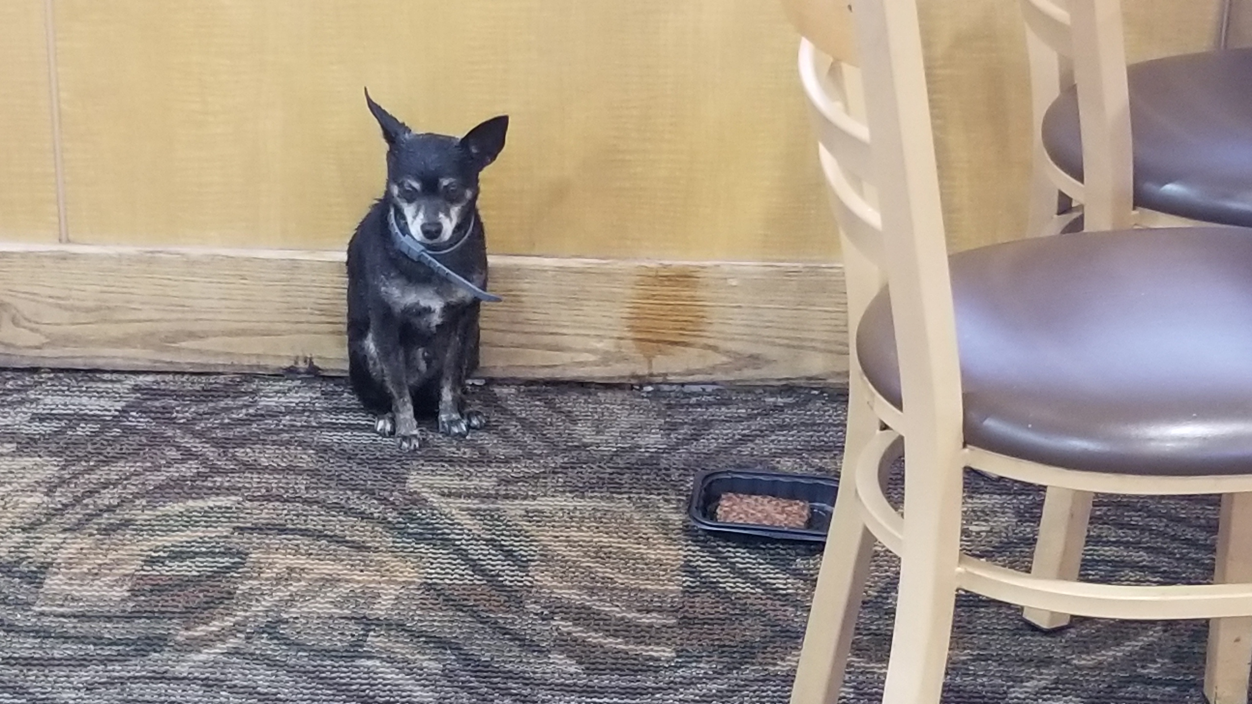

Slide 25
It was sitting straight, but shivering from being wet and cold. Next to it was a tray with a beef patty, but the dog did not touch it.

Slide 26
What happened next reminded me of the parable of the Good Samaritan.

Slide 27
A lawyer came to test Jesus by asking him a seemingly innocent question.

Slide 28
Maybe if Jesus gives a wrong or incomplete answer, Jesus can be attacked.

Slide 29
Lawyer’s question: “What must I do to inherit eternal life?”

Slide 30
Jesus asked for his opinions. He rarely did this to people who asked him questions.

Slide 31
The lawyer’s answer was very concise and complete. He was very well trained.

Slide 32
1. Love God completely, and
2. Love your neighbor as yourself.

Slide 33
Jesus’s response: You already know the answer; just go do it.

Slide 34
Deut. 6:5 - Love the Lord your God with all your heart and with all your soul and with all your strength.

Slide 35
That is the summary of the first four of the Ten Commandments.

Slide 36
Lev. 19:18 - “‘Do not seek revenge or bear a grudge against anyone among your people,

Slide 37
but love your neighbor as yourself. I am the Lord.’”

Slide 38
It is a good summary of commandments 5 to 10 and the Mosaic laws regarding interaction with others.

Slide 39
So the lawyer knew the spirit and intent of the law, but he had trouble executing it.

Slide 40
His question to Jesus: “Who is my neighbor?”
It’s a question of limiting whom he is required to love.

Slide 41
Loving others costs time, effort, and resources. He wanted to limit whom he needed to love so it would not be so costly to him.

Slide 42
Jesus got him to answer his own question by telling the audience the Parable of the Good Samaritan.

Slide 43
What was the purpose of telling this parable? Jesus always had a reason.

Slide 44
A common interpretation holds that Jesus wanted to show the difference between law and love.

Slide 45
Some people think he was attacking the Jewish legalism for missing the original point of the law.

Slide 46
He wanted to reveal the loving heart of God. This was not so obvious in the Old Testament.

Slide 47
Jesus might also want to show people how to implement the spirit of the law.

Slide 48
The lawyer knew the law, but maybe was trying to not do it because it is costly.

Slide 49
So let’s study the parable and see what we can learn from it.

Slide 50
The journey of these people is from Jerusalem to Jericho – 15 miles going east and mostly downhill.

Slide 51
It’d take maybe 6 to 8 hours by foot. Basically, it’s a whole-day trip.

Slide 52
The road was somewhat unsafe during Jesus’s times. There is a long stretch without towns.

Slide 53
The injured person was robbed of his clothes. He probably didn’t have much stuff with him.

Slide 54
The three persons who walked by:
1. The priest represented servants of God or ministers.

Slide 55
He would know the laws of God very well.

Slide 56
2. The Levite represented followers of God or Christians. He would also know God’s laws very well.

Slide 57
3. The Samaritan was part Jewish and part Gentile. They were people the Jews despised for not being pure.

Slide 58
They mixed Jewish and pagan traditions. He is not respected by those religious Jewish people.

Slide 59
He was not recognized as a religious expert, but he had the heart of God.

Slide 60
The Priest and Levite did see the injured man, but deliberately avoided going near him and touching him.

Slide 61
Their possible thinking:
If he is dead, then I'd violate the law if I touch him.

Slide 62
I will be unclean for a few days and cannot practice religious rituals and so affect my job.
Numbers 19:11-12

Slide 63
If he is not dead, then dealing with him may delay my trip.

Slide 64
The Ten Commandments tell me not to hurt other people, and so I'm not violating the Ten Commandments.

Slide 65
The Ten Commandments also do not say I have to help other people, so I'm not violating them.

Slide 66
So, if they don't bother with him, they still keep the law. Result: avoid that person. Don’t even find out if he is injured or dead.

Slide 67
They were not thinking of the victim at all. They were acting out of their self-interest to protect themselves.

Slide 68
Today, some people are afraid to help others because of liabilities or that the victims may claim that the helpers hurt them.

Slide 69
Today, we have the Good Samaritan Laws to protect people who help others from liability.

Slide 70
But here, it was more of an inconvenience that led them to not help the injured person.

Slide 71
But this Samaritan’s reaction was very different.

Slide 72
He must be on a journey - going east, away from Samaria.

Slide 73
He saw him and it was time to make the decision on what to do.

Slide 74
Three things that must have crossed his mind:
“Should I?”,
“Could I?”, and
“Am I willing?”

Slide 75
Should I?
It is Jewish territory, so that person is likely a Jew.

Slide 76
That Jew may be offended if I touch him.
Would I be accused of hurting him?

Slide 77
His conclusion: Helping people is always the right thing to do. The question is how.

Slide 78
Could I?
Yes, I can try to help him survive if he is not already dead.

Slide 79
Am I willing?
I would delay my trip a bit if I go help him.
His decision: yes, I am willing.

Slide 80
He took pity on the injured man - his heart moved and he made the decision to help.

Slide 81
He bandaged the injured man and poured oil and wine on the wound.

Slide 82
Why carry such heavy liquids? Maybe he was a trader selling oil and wine?

Slide 83
If so, then he was also a target of robbers too! So it was very dangerous to stop.

Slide 84
He took the injured man to an inn and took care of him. He spent time doing this and delayed his own trip.

Slide 85
He also spent money to take care of him. He left more money too – 2 denarii was 2 days of wages.

Slide 86
Loving and caring for people would costs you something – time, effort, and resources.

Slide 87
He promised the innkeeper to give him more on his return trip if needed.

Slide 88
So this is not a one-time engagement. He was really committed to helping that man.

Slide 89
Sometimes caring for people can take a long time and be quite costly.

Slide 90
This Samaritan, who probably didn’t know God’s teachings very well, actually had the heart of God.

Slide 91
The one considered an outsider turned out to be the true neighbor to the injured Jew.

Slide 92
There is another observation: The hero is someone the audience despises.

Slide 93
To Jesus’s listeners, the Samaritan was the last person they expected to be the hero.

Slide 94
We may not feel like extraordinary people, but when we love other people, we are heroes in God’s eyes.

Slide 95
Because we accomplished what God wanted us to do all along – Love God and love other people.

Slide 96
Now, let’s compare the lawyer and Jesus.

Slide 97
The lawyer asked,
“Who is my neighbor?”

Slide 98
He knew loving others costs something - time, effort, and resources. So he wanted to limit whom he needed to love.

Slide 99
God says “love your neighbor” but did not define who the neighbor is, and so he wanted to limit who the neighbor is.

Slide 100
Jesus’s teaching: Choose to be a neighbor to others and learn how to love your neighbor.

Slide 101
1. Love those around us and whom God puts in our path.

Slide 102
Even when our strength is limited, opportunities to love people still cross our path every day.

Slide 103
Sometimes, a short word of encouragement or a pat on the back is all it takes to make someone’s day.

Slide 104
Studies have shown that a sincere “Thank you” is more encouraging and memorable than a gift or money.

Slide 105
2. Choose to act. Do not only think about our own interests or obligations.

Slide 106
Our intentions lead to our actions. Our actions show others our true hearts and intentions.

Slide 107
We need to decide to love, and learn how to love and care for other people. That is the heart of God.

Slide 109
That puppy at Wendy's was wet and cold, and an employee probably brought it into the restaurant.

Slide 110
It was given a beef patty, but did not eat it. Was it good training? Or was it afraid to eat?

Slide 111
Finally, a girl broke the patty into small pieces and fed a piece to the puppy.

Slide 112
She took time to show love and made the puppy feel comfortable about eating the beef patty.

Slide 113
Maybe a restaurant worker brought in the puppy and gave it food, but did not know how to get it to eat.

Slide 114
Or maybe he had to go back to work and did not realize the puppy was not eating.

Slide 115
The employee did the right thing, but he did not go far enough.

Slide 116
The girl took time to care for the puppy and finally got it to eat.

Slide 117
She had to comfort the puppy to achieve the desired results. She knew how to love and did it.

Slide 118
But what if it was a hungry man outside the restaurant instead? How would people treat him?

Slide 119
Would we treat him better than how the employee and the girl treated the puppy?

Slide 120
Sadly, many people find it easier to love an animal than a fellow human being…

Slide 121
It may be due to fear, disdain, a feeling of superiority, or indifference.

Slide 122
We may even find it easier to donate money to help someone far away than to help someone in front of us.

Slide 123
There was a possibly homeless man sitting on the floor in front of a pick-up food place.

Slide 124
He was not asking for food, but based on where he sat, everyone could tell his intentions.

Slide 125
A person went to talk to him respectfully before going in to order his own food.

Slide 126
He patiently explained the menu to him and let him choose his food, and bought food for him and himself.

Slide 127
He gave that person a bit of dignity by explaining the food items and asking for his choices.

Slide 128
In such situations, we often avoid the interaction and just buy some cheap items without asking.

Slide 129
But sometimes human interaction is more important than physical food. He needed to feel dignity, too.

Slide 130
So we need to learn how to care for others too.

Slide 131
We need to have the right intentions and to follow the heart of God.

Slide 132
If the Word truly becomes flesh in us, people will experience God’s love through our actions —

Slide 133
just as the injured man experienced mercy through the Samaritan.

Slide 134
We can start with people around us, people we are obligated to help, and the people we know.

Slide 135
Then we can think about others near us, and then broaden out to people we don’t even know.

Slide 136
God will put people in your path for you to love and serve. Opportunities to love are often gifts from God.

Slide 137
Hebrews 13:2 –
Do not forget to show hospitality to strangers,

Slide 138
for by so doing some people have shown hospitality to angels without knowing it.

Slide 139
The question is not, ‘Who is my neighbor?’ but ‘Am I willing to be a neighbor to someone?’

Slide 140
May our actions show people the love of Jesus. That’s “the Word becoming flesh” being manifested in us.

Slide 141
May God bless us all.

