Slide 1
Word Becoming Flesh

Slide 2
Scripture:
John 1:1-14

Slide 3
In the beginning was the Word, and the Word was with God, and the Word was God. He was with God in the beginning.
Through him all things were made; without him nothing was made that has been made. In him was life, and that life was the light of all mankind. The light shines in the darkness, and the darkness has not overcome it. There was a man sent from God whose name was John. He came as a witness to testify concerning that light, so that through him all might believe. He himself was not the light; he came only as a witness to the light. The true light that gives light to everyone was coming into the world. He was in the world, and though the world was made through him, the world did not recognize him. He came to that which was his own, but his own did not receive him. Yet to all who did receive him, to those who believed in his name, he gave the right to become children of God — children born not of natural descent, nor of human decision or a husband’s will, but born of God. The Word became flesh and made his dwelling among us. We have seen his glory, the glory of the one and only Son, who came from the Father, full of grace and truth.

Slide 4
Through him all things were made; without him nothing was made that has been made.

Slide 5
In him was life, and that life was the light of all mankind. The light shines in the darkness, and the darkness has not overcome it.

Slide 6
There was a man sent from God whose name was John. He came as a witness to testify concerning that light, so that through him all might believe.

Slide 7
He himself was not the light; he came only as a witness to the light. The true light that gives light to everyone was coming into the world.

Slide 8
He was in the world, and though the world was made through him, the world did not recognize him. He came to that which was his own,

Slide 9
but his own did not receive him. Yet to all who did receive him, to those who believed in his name, he gave the right to become children of God -

Slide 10
children born not of natural descent, nor of human decision or a husband’s will, but born of God. The Word became flesh and made his dwelling among us.

Slide 11
We have seen his glory, the glory of the one and only Son, who came from the Father, full of grace and truth.

Slide 12
Word Becoming Flesh

Slide 13
This message was inspired by a sermon from Pastor Lon Wagner. I have adapted it slightly for our context.

Slide 14
As we prepare to celebrate Easter, let’s think about how strange this holiday is.

Slide 15
No other major religion in the world celebrates the death of its god or gods with such fanfare.

Slide 16
And when Jesus quietly rose from the dead, He did not use that opportunity to take over the world.

Slide 17
Instead, he taught a small group of disciples for a few weeks and then quietly left the Earth.

Slide 18
From there, these people and their followers spread the Gospel to the world, and that continues to this day.

Slide 19
The four gospels were written by people at the time to tell us the story of Jesus when he was on Earth.

Slide 20
Matthew focused on Jesus’s kingship. It was focused on the Jewish audience.

Slide 21
Mark focused on Jesus’s servanthood. It seemed to be aimed at Romans unfamiliar with Jewish matters.

Slide 22
Luke focused on Jesus’s humanity. Its beautiful narratives were attractive to the Greek audience.

Slide 23
John focused on Jesus’s deity and has many narratives and teachings not found in the other three gospels.

Slide 24
So why is the Gospel of John so different?

Slide 25
The target audience of John’s gospel is the Gentiles, influenced by Greek philosophy.

Slide 26
Alexander the Great had spread Greek culture to the region. The New Testament was originally all written in Greek.

Slide 27
John had a different focus – more on philosophy and theology and not on laws nor Jewish history.

Slide 28
John was written many years after the other three gospels,

Slide 29
and the detailed theological teachings may have been written to correct wrong teachings.

Slide 30
This is a lesson that we need to have culturally appropriate outreach so we can reach different people.

Slide 31
John 1:1 –
In the beginning was the Word, and the Word was with God, and the Word was God.

Slide 32
What is the “Word”?

Slide 33
The Greek word “Logos” meant the universal reason or truth behind the universe.

Slide 34
It exists in this world but is above the opposition and imperfections of this world.

Slide 35
"Truth" would be a good translation of it.

Slide 36
"Universal Intelligence" is what some people consider God.

Slide 37
In Chinese, we translate it as “tao” or “The Way”.

Slide 38
It is the underlying order of nature; the "flow".

Slide 39
Chinese philosophy about it is really confusing, probably because they didn't understand it either.

Slide 40
Confucius said he did not understand it, but the ancients knew it, and we have lost the knowledge of it.

Slide 41
Confucius said the Way is inside each one of us and we should know it. The Bible said God put eternity in our hearts.

Slide 42
Ecclesiastes 3:11 -- He has made everything beautiful in its time. He has also set eternity in the human heart;
yet no one can fathom what God has done from beginning to end.

Slide 43
yet no one can fathom what God has done from beginning to end.

Slide 44
The mysterious Way was gradually changed into folk religion known as Taoism.

Slide 45
Taoism has nothing to do with the real Truth. It’s just a mixture of legends, superstitions, and folk beliefs.

Slide 46
Bible says the universal, timeless truth is embodied in God.

Slide 47
God is the timeless universal intelligence. He is far above our understanding.

Slide 48
Old Testament shows the difficulty in leading people to follow an unseen deity.

Slide 49
He seemed similar to other false gods except without idols. Which probably made Him harder to follow.

Slide 50
The Israelites sometimes follow other gods, especially when their neighbors are stronger.

Slide 51
It seemed like quid pro quo between God and His people -- follow me and I'll protect you.

Slide 52
Teachings about God were twisted over time. Symbolism became the emphasis of their religion.

Slide 53
People used God’s teachings to benefit themselves. They appear pious to earn respect and authority.

Slide 54
And some over-interpreted God’s intentions and created new religious rules that God did not intend to have.

Slide 55
People became slaves to these religious rules.

Slide 56
For instance, some orthodox Jews cannot drive cars or even push elevator buttons on Saturdays.

Slide 57
All the while, the true emphasis was ignored -- love God and love people (e.g. the Good Samaritan story).

Slide 58
Faith became religious rules to follow and rituals to perform. Religious people found ways to profit from it also.

Slide 59
So, it was clear that the flawed human beings need to connect to God in a different way.

Slide 60
Jesus, the Word which became flesh, was God’s answer. Isaiah prophesied about Him in Isaiah 53 as the “Suffering Servant”.

Slide 61
But why becoming flesh? Why become one of us? How did that help?

Slide 62
Matthew 1:23 -- “The virgin will conceive and give birth to a son, and they will call him Immanuel” ( “God with us”).

Slide 63
By becoming human, he can be with us and better connect with us and show people His ways.

Slide 64
A short story can best illustrate the need for God to appear like us.

Slide 65
During a snowstorm, a man heard a baby bird’s cry outside his house.

Slide 66
The baby bird had fallen out of its nest and would freeze to death if not returned to the protected nest.

Slide 67
He tried to grab the baby bird, but it kept running away because it thought the man was trying to eat it.

Slide 68
The man then realized that if he were also a bird and could tell the baby bird that he was trying to help, the baby might listen.

Slide 69
Jesus is the God who turned into human being to tell us about God and how to return to Him.

Slide 70
He taught people by doing and by living out an example for people to follow.

Slide 71
He showed us how He understands us and our struggles.

Slide 72
Jesus grew up in a poor working family. He worked to support his family, including many siblings.

Slide 73
He created new symbolisms that are more easily understood and practiced.

Slide 74
Baptism - only once in life, represents His death and resurrection.

Slide 75
Communion – reminder of His sacrifice for us and His healing and forgiveness; it is periodic and easy to do.

Slide 76
These rituals represent things that can only happen to real human beings.

Slide 77
In contrast, Old Testament rituals were very burdensome, costly, and hard to understand.

Slide 78
Old Testament rituals were designed for scholars to study. Jesus’s rituals were created for commoners to practice.

Slide 79
Jesus showed us how to live a godly life, how to love other people, how to stand up to false teachers, etc.

Slide 80
But to do that, God had to take on human form and live among us for a time. That’s the Word becoming flesh.

Slide 81
Incarnation did not end with Jesus. The Word continues becoming visible through believers.

Slide 82
The Book of Acts is the only unfinished book in the Bible. We are still writing it today.

Slide 83
Is the Word becoming flesh in you?

Slide 84
Do you show the light of Jesus through you?

Slide 85
Can people see the fruit of the Spirit in you?

Slide 86
Do you love God and love people as Jesus did?

Slide 87
People can't see your heart, but they can see your heart indirectly through your actions.

Slide 88
Are you able to teach the Word in ways people can understand?

Slide 89
“Preach the gospel always. When necessary, use words”
– St. Francis

Slide 90
Most people would not go to church or study the Bible until conversion. They see Jesus through Christians.

Slide 91
In the 19th century, Christian missionaries set up hospitals in Taiwan and planted the seeds of Christianity there.

Slide 92
Canadian missionary George Leslie Mackay set up the first hospital and university in Taiwan.

Slide 93
Even today, foreign missionaries still serve poor people in Taiwan.

Slide 94
Father Giuseppe Didone served in Taiwan for 35 years at the St. Mary's Hospital in Taiwan.

Slide 95
In 2020, when he saw how Italy was hurt by coronavirus, he asked people for donations to help his homeland.

Slide 96
This is when people learned about the missionaries’ story and the hospitals they built to serve the poor.

Slide 97
Some missionaries who were kicked out of communist China in 1952 went to a poor area in eastern Taiwan.

Slide 98
Many served the Taiwanese people for decades. They did not take money from the poor.

Slide 99
Some missionaries chose to be buried in Taiwan, their adopted home.

Slide 100
So tens of thousands of Taiwanese people donated US$4 million in one week when the story spread.

Slide 101
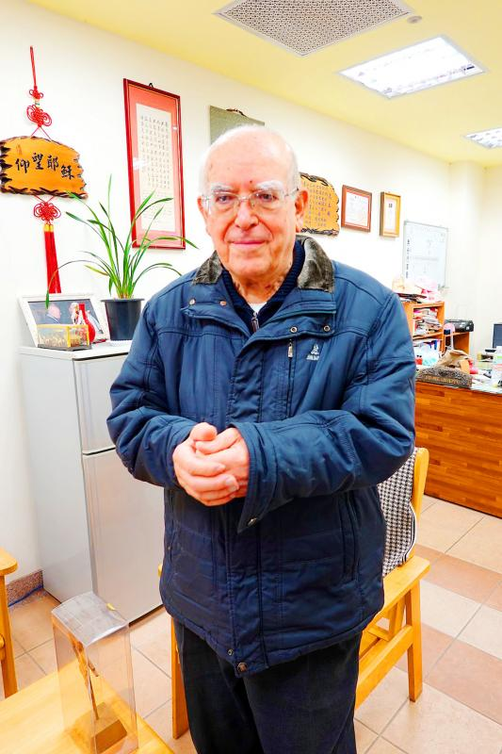
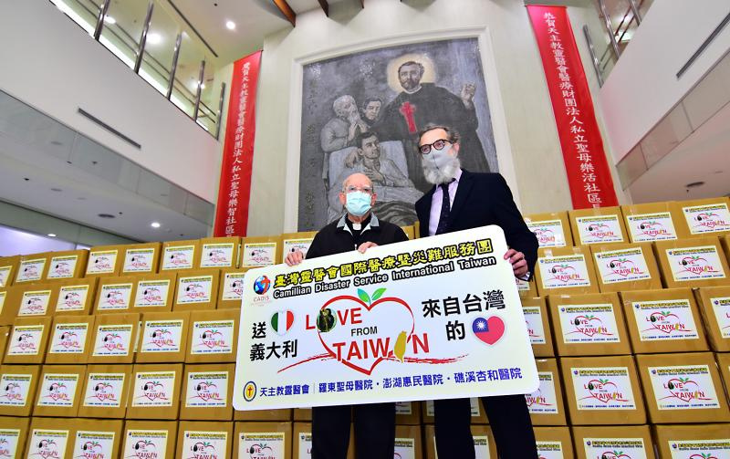

Slide 102
Some people donated money to thank the missionaries for the kindness they received decades ago.

Slide 103
People donated because they saw how these missionaries loved Taiwanese people so much.

Slide 104
These missionaries showed the Taiwanese people the sacrificial love of Christ.

Slide 105
That’s why people were eager to donate to help Italy. Father Didone and others showed them the love of Christ.

Slide 106
We are not perfect, and we will never be. But God can use us and let people see Jesus through our love.

Slide 107
When we are willing to let God do that, He will change us gradually, and the Word will become flesh in us.

Slide 108
Matthew 5:14 - “You are the light of the world.
A town built on a hill cannot be hidden.”

Slide 109
That verse could be you. Let your light shine. May the Lord bless you all.

