Slide 1
The Donuts Allegory

Slide 2
Scripture:
Romans 8:18–28

Slide 3
I consider that our present sufferings are not worth comparing with the glory that will be revealed in us.
For the creation waits in eager expectation for the children of God to be revealed. For the creation was subjected to frustration, not by its own choice, but by the will of the one who subjected it, in hope that the creation itself will be liberated from its bondage to decay and brought into the freedom and glory of the children of God.
We know that the whole creation has been groaning as in the pains of childbirth right up to the present time. Not only so, but we ourselves, who have the firstfruits of the Spirit, groan inwardly as we wait eagerly for our adoption to sonship, the redemption of our bodies. For in this hope we were saved. But hope that is seen is no hope at all. Who hopes for what they already have? But if we hope for what we do not yet have, we wait for it patiently.
In the same way, the Spirit helps us in our weakness. We do not know what we ought to pray for, but the Spirit himself intercedes for us through wordless groans. And he who searches our hearts knows the mind of the Spirit, because the Spirit intercedes for God’s people in accordance with the will of God.
And we know that in all things God works for the good of those who love him, who have been called according to his purpose.

Slide 4
For the creation waits in eager expectation for the children of God to be revealed.
For the creation was subjected to frustration, not by its own choice, but by the will of the one who subjected it, in hope that the creation itself will be liberated from its bondage to decay and brought into the freedom and glory of the children of God.
We know that the whole creation has been groaning as in the pains of childbirth right up to the present time. Not only so, but we ourselves, who have the firstfruits of the Spirit, groan inwardly as we wait eagerly for our adoption to sonship, the redemption of our bodies. For in this hope we were saved. But hope that is seen is no hope at all. Who hopes for what they already have? But if we hope for what we do not yet have, we wait for it patiently.
In the same way, the Spirit helps us in our weakness. We do not know what we ought to pray for, but the Spirit himself intercedes for us through wordless groans. And he who searches our hearts knows the mind of the Spirit, because the Spirit intercedes for God’s people in accordance with the will of God.
And we know that in all things God works for the good of those who love him, who have been called according to his purpose.

Slide 5
For the creation was subjected to frustration, not by its own choice, but by the will of the one who subjected it,
in hope that the creation itself will be liberated from its bondage to decay and brought into the freedom and glory of the children of God.
We know that the whole creation has been groaning as in the pains of childbirth right up to the present time. Not only so, but we ourselves, who have the firstfruits of the Spirit, groan inwardly as we wait eagerly for our adoption to sonship, the redemption of our bodies. For in this hope we were saved. But hope that is seen is no hope at all. Who hopes for what they already have? But if we hope for what we do not yet have, we wait for it patiently.
In the same way, the Spirit helps us in our weakness. We do not know what we ought to pray for, but the Spirit himself intercedes for us through wordless groans. And he who searches our hearts knows the mind of the Spirit, because the Spirit intercedes for God’s people in accordance with the will of God.
And we know that in all things God works for the good of those who love him, who have been called according to his purpose.

Slide 6
in hope that the creation itself will be liberated from its bondage to decay and brought into the freedom and glory of the children of God.
We know that the whole creation has been groaning as in the pains of childbirth right up to the present time. Not only so, but we ourselves, who have the firstfruits of the Spirit, groan inwardly as we wait eagerly for our adoption to sonship, the redemption of our bodies. For in this hope we were saved. But hope that is seen is no hope at all. Who hopes for what they already have? But if we hope for what we do not yet have, we wait for it patiently.
In the same way, the Spirit helps us in our weakness. We do not know what we ought to pray for, but the Spirit himself intercedes for us through wordless groans. And he who searches our hearts knows the mind of the Spirit, because the Spirit intercedes for God’s people in accordance with the will of God.
And we know that in all things God works for the good of those who love him, who have been called according to his purpose.

Slide 7
We know that the whole creation has been groaning as in the pains of childbirth right up to the present time. Not only so, but we ourselves, who have the firstfruits of the Spirit, groan inwardly as we wait eagerly for our adoption to sonship, the redemption of our bodies. For in this hope we were saved. But hope that is seen is no hope at all. Who hopes for what they already have? But if we hope for what we do not yet have, we wait for it patiently.
In the same way, the Spirit helps us in our weakness. We do not know what we ought to pray for, but the Spirit himself intercedes for us through wordless groans. And he who searches our hearts knows the mind of the Spirit, because the Spirit intercedes for God’s people in accordance with the will of God.
And we know that in all things God works for the good of those who love him, who have been called according to his purpose.

Slide 8
Not only so, but we ourselves, who have the firstfruits of the Spirit, groan inwardly as we wait eagerly for our adoption to sonship, the redemption of our bodies.

Slide 9
For in this hope we were saved. But hope that is seen is no hope at all. Who hopes for what they already have? But if we hope for what we do not yet have, we wait for it patiently.
In the same way, the Spirit helps us in our weakness. We do not know what we ought to pray for, but the Spirit himself intercedes for us through wordless groans. And he who searches our hearts knows the mind of the Spirit, because the Spirit intercedes for God’s people in accordance with the will of God.
And we know that in all things God works for the good of those who love him, who have been called according to his purpose.

Slide 10
But if we hope for what we do not yet have, we wait for it patiently.
In the same way, the Spirit helps us in our weakness. We do not know what we ought to pray for, but the Spirit himself intercedes for us through wordless groans. And he who searches our hearts knows the mind of the Spirit, because the Spirit intercedes for God’s people in accordance with the will of God.
And we know that in all things God works for the good of those who love him, who have been called according to his purpose.

Slide 11
In the same way, the Spirit helps us in our weakness. We do not know what we ought to pray for, but the Spirit himself intercedes for us through wordless groans.

Slide 12
And he who searches our hearts knows the mind of the Spirit, because the Spirit intercedes for God’s people in accordance with the will of God.

Slide 13
And we know that in all things God works for the good of those who love him, who have been called according to his purpose.

Slide 14
The Donuts Allegory

Slide 15
Donuts are one of the cleverest food items ever invented by man.

Slide 16
It has very few simple ingredients, is simple to make, and is soft all around.

Slide 17
After the basic donut is made, we can make almost unlimited varieties by adding different toppings.

Slide 18
Krispy Kreme puts an automatic donut-making machine in each store so you can see how the basic donut is made.

Slide 19
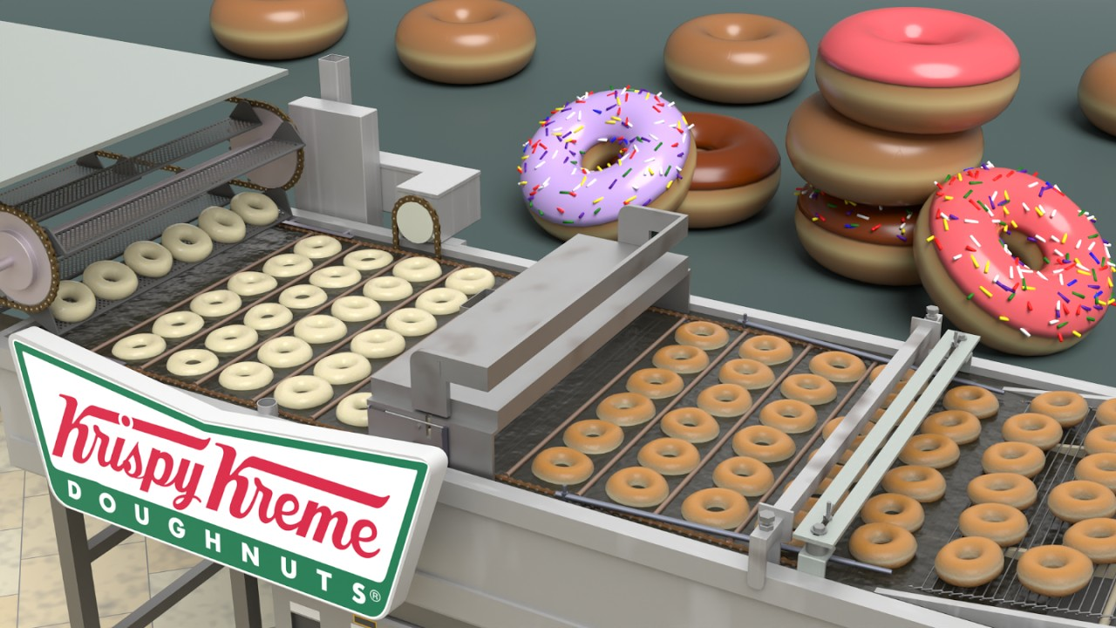

Slide 20
Can’t live without donuts? I found you can get a miniature version of that machine for only $761.

Slide 21
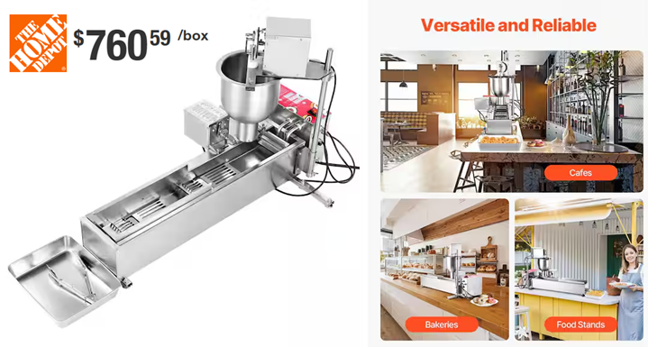

Slide 22
One day, I heard an allegory about how we are like donuts and how God makes us better Christians.

Slide 23
One day, a man smelled something nice in the house. His wife was making donuts.

Slide 24
She said she is using the best ingredients to make the best donuts possible.

Slide 25
When the donuts were made, he ate one, and it was indeed wonderful.

Slide 26
He said, “These are wonderful. Wouldn’t it be even better if the hole is also filled with dough so I have more to enjoy?”

Slide 27
His wife replied, “You foolish man, don’t you know it is because of the hole that the donut tastes good?

Slide 28
If there’s no hole, either the donut would be overcooked and hard on the outside, or undercooked with raw dough inside.”

Slide 29
So let’s study how to make donuts and see what it teaches us about life.

Slide 30
How to make donuts?
First, mix flour with water, yeast, salt, sugar, egg, and oil

Slide 31
When flour is mixed with water, it turns into elastic gluten when kneaded.

Slide 32
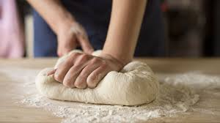

Slide 33
The yeast converts sugar into CO₂ and breaks down starch, protein, and fat into more basic molecules.

Slide 34
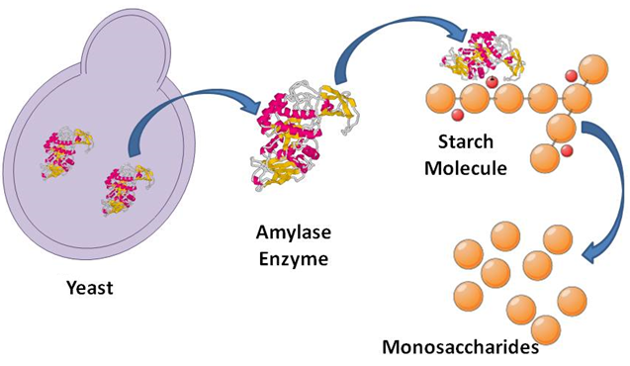

Slide 35
The elastic gluten traps the carbon dioxide (CO₂), and the dough rises.

Slide 36
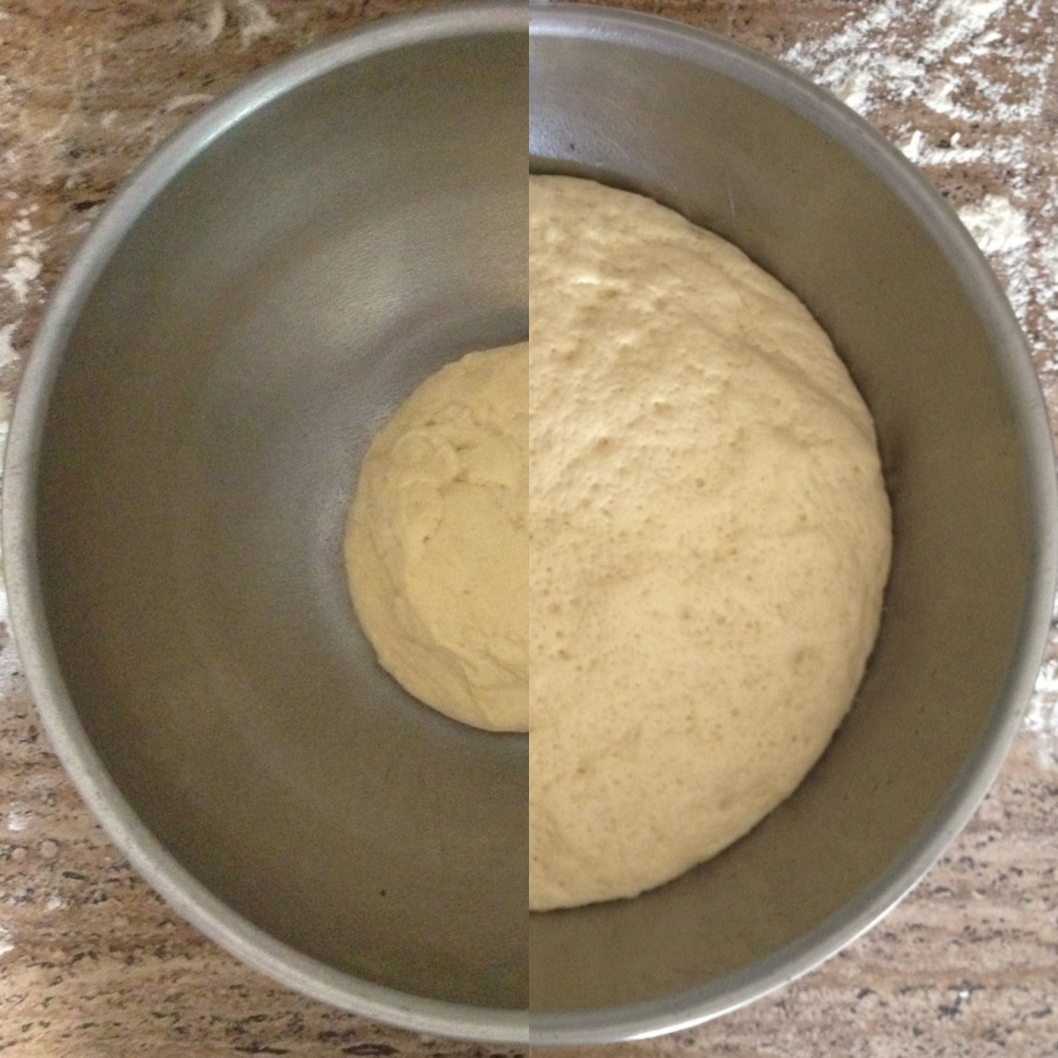
Before
Fermentation
After
Fermentation

Slide 37
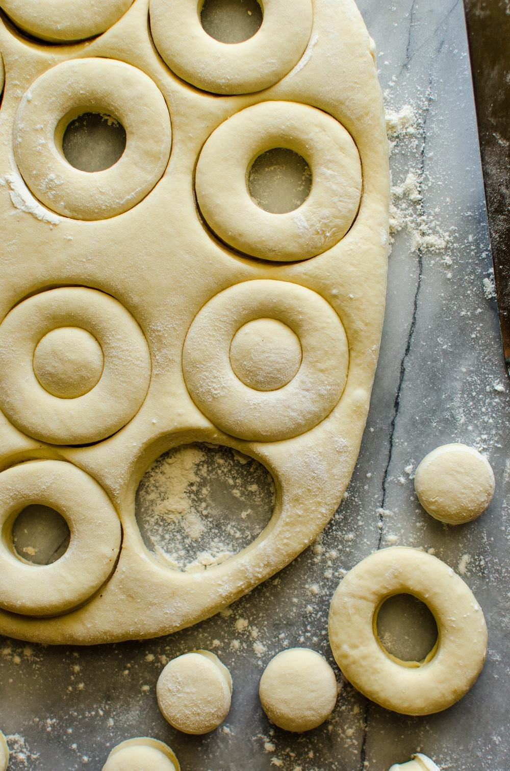
Cut the dough into the donut shape.

Slide 38
After cutting the dough into shape, let it rest a bit so it puffs up even more and becomes softer.

Slide 39
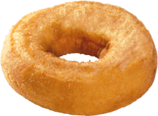
When the dough with the hole is fried, it turns into fluffy donuts.

Slide 40
The donut can be soft because the hole allows heat to get to all parts quickly and evenly.

Slide 41
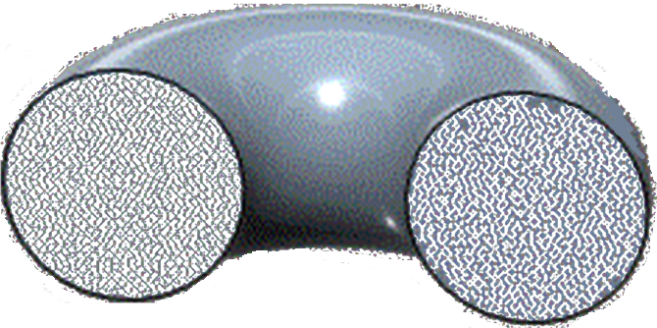

Slide 42
Without the hole, a donut won’t be as fluffy and soft. It won’t taste like a donut that we like.

Slide 43
Our lives are like donuts. God made us with the best ingredients.

Slide 44
God gave us qualities such as love, reasoning, bravery, endurance, and most importantly, a desire to find Him.

Slide 45
But there is a hole in each of the donuts, and most of us don’t like that.

Slide 46
There are “holes” that some of us would like filled:

Slide 47
Poverty
Illnesses
Losses
Failures
Abuses
Turmoil

Slide 48
But just like the holes in donuts, these deficiencies can make us better.

Slide 49
Where do these holes come from? Why is there suffering in this world?

Slide 50
We live in a sinful world full of evil and people seeking to benefit themselves at the expense of others.

Slide 51
Although God doesn’t cause our sufferings, He allows them to happen because He can use them to help us grow.

Slide 52
We can withstand the losses and deficiencies in life, and they can make us better Christians.

Slide 53
However, not all sufferings produce visible growth or have clear answers.

Slide 54
We like to have answers for our suffering, but in some cases, we won’t get answers while on Earth.

Slide 55
This is when FAITH comes in. We can trust in God even when we don’t get all the answers immediately.

Slide 56
Maybe FAITH is the hardest lesson of all. We need to trust that God is with us even in our sufferings.

Slide 57
Our pains and losses are real while we are on Earth, but we need to remember there’s a life beyond this earthly one.

Slide 58
Eternity is real, and God uses this earthly life with all its losses and sufferings to prepare us for the eternal life with Him.

Slide 59
What can these holes bring us?

Slide 60
1. Perseverance – Do not give up on yourself, others, and various things so easily.

Slide 61
James 1:2-4 -
Consider it pure joy, my brothers and sisters, whenever you face trials of many kinds,
because you know that the testing of your faith produces perseverance. Let perseverance finish its work so that you may be mature and complete, not lacking anything.

Slide 62
because you know that the testing of your faith produces perseverance.
Let perseverance finish its work so that you may be mature and complete, not lacking anything.

Slide 63
Let perseverance finish its work so that you may be mature and complete, not lacking anything.

Slide 64
America named its latest Mars rover Perseverance because it is a long and challenging journey.

Slide 65
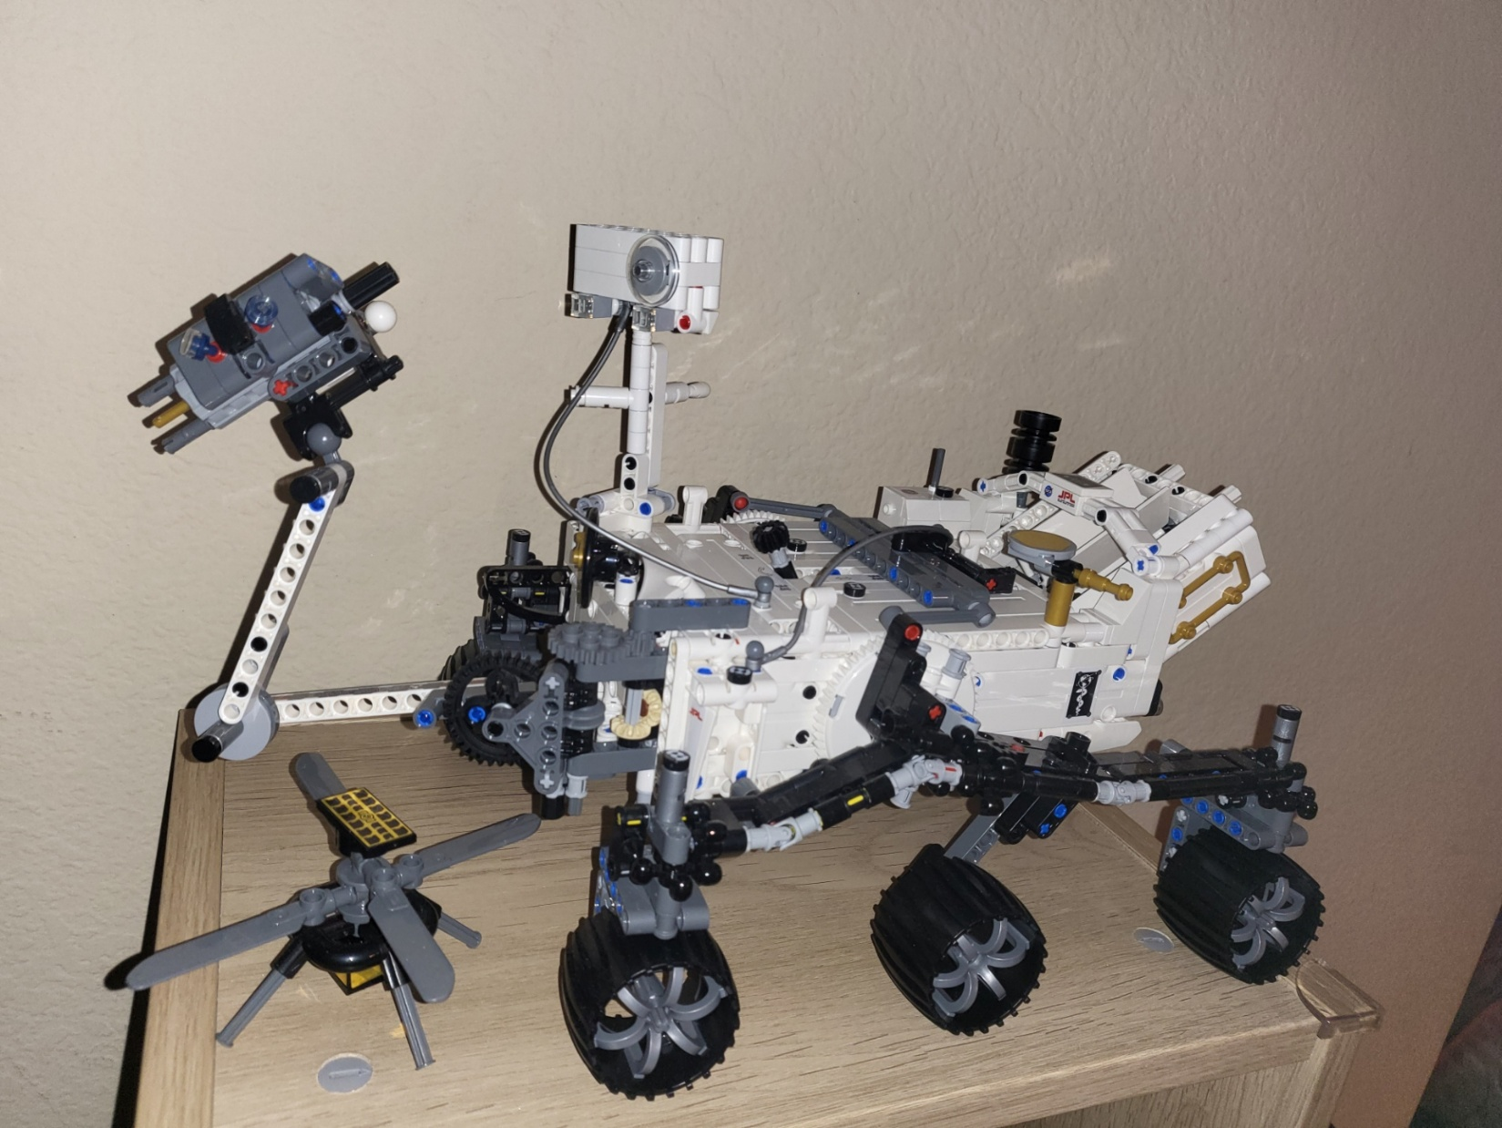
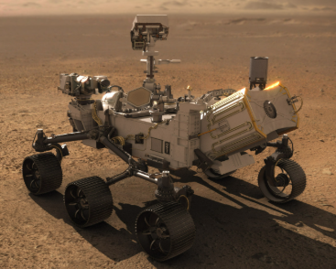

Slide 66
2. Endurance – Can endure the pain and still not lose faith and hope.

Slide 67
Romans 5:3-4 - Not only so, but we also glory in our sufferings, because we know that
suffering produces perseverance; perseverance, character; and character, hope.

Slide 68
suffering produces perseverance; perseverance, character; and character, hope.

Slide 69
3. Faith and reliance on God – Believe that God loves you and you can count on Him.

Slide 70
2 Corinthians 12:7-9 -
In order to keep me from becoming conceited, I was given a thorn in my flesh,
a messenger of Satan, to torment me. Three times I pleaded with the Lord to take it away from me. But he said to me, “My grace is sufficient for you, for my power is made perfect in weakness.” Therefore I will boast all the more gladly about my weaknesses, so that Christ’s power may rest on me.

Slide 71
a messenger of Satan, to torment me. Three times I pleaded with the Lord to take it away from me.

Slide 72
But he said to me, “My grace is sufficient for you, for my power is made perfect in weakness.”

Slide 73
Therefore I will boast all the more gladly about my weaknesses, so that Christ’s power may rest on me.

Slide 74
4. Compassion and encouragement to others – Healed people can best heal people.

Slide 75
Once a TV crew wanted to see if people are compassionate. They put a sad-looking dog by the street.

Slide 76
Most people walked by without a second look. Some patted the dog without doing more.

Slide 77
A homeless man walked by, patted the dog, and went to a store to get food for it.

Slide 78
The TV crew then showed themselves and asked why he fed the dog.

Slide 79
He said he is hungry often so he knows how the dog feels. He didn’t want to dog to suffer like he does.

Slide 80
So we can relate better to others who suffer because we have been through similar circumstances ourselves.

Slide 81
5. Humility – We see ourselves as who we really are – imperfect beings who need God.

Slide 82
1 Corinthians 1:28-29 -
God chose the lowly things of this world and the despised things --
and the things that are not -to nullify the things that are, so that no one may boast before him.

Slide 83
and the things that are not - to nullify the things that are, so that no one may boast before him.

Slide 84
What can help us get those benefits?

Slide 85
1. The Right Perspective: See things as they really are – from God’s perspective.

Slide 86
Earthly life is a place where God shapes us for eternity.

Slide 87
Earthly life is illusory and temporary. The afterlife is real and eternal.

Slide 88
2 Cor. 4:16-17 - Therefore we do not lose heart. Though outwardly we are wasting away, yet
inwardly we are being renewed day by day.
For our light and momentary troubles are achieving for us an eternal glory that far outweighs them all.

Slide 89
For our light and momentary troubles are achieving for us an eternal glory that far outweighs them all.

Slide 90
2. The Right Attitude – Face these with joy and hope, not anger or sadness.

Slide 91
3. Contentment – Be happy with what you have and avoid being envious of others.

Slide 92
Philippians 4:10-13 -
I rejoiced greatly in the Lord that at last you renewed your concern for me.
Indeed, you were concerned, but you had no opportunity to show it. 11 I am not saying this because I am in need, for I have learned to be content whatever the circumstances. 12 I know what it is to be in need, and I know what it is to have plenty. I have learned the secret of being content in any and every situation, whether well fed or hungry, whether living in plenty or in want. I can do all this through him who gives me strength.

Slide 93
Indeed, you were concerned, but you had no opportunity to show it.

Slide 94
I am not saying this because I am in need, for I have learned to be content whatever the circumstances.
I know what it is to be in need, and I know what it is to have plenty. I have learned the secret of being content in any and every situation, whether well fed or hungry, whether living in plenty or in want. I can do all this through him who gives me strength.

Slide 95
I know what it is to be in need, and I know what it is to have plenty.

Slide 96
I have learned the secret of being content in any and every situation, whether well fed or hungry, whether living in plenty or in want.
I can do all this through him who gives me strength.

Slide 97
I can do all this through him who gives me strength.

Slide 98
4. Hope – helps us endure and keep our faith.

Slide 99
5. Faith – Believe that God has the best intentions for you.

Slide 100
Romans 8:28 - And we know that in all things God works for the good of those who love him,
who have been called according to his purpose.

Slide 101
who have been called according to his purpose.

Slide 102
Jeremiah 29:11 -
“For I know the plans I have for you,” declares the Lord,
“plans to prosper you and not to harm you, plans to give you hope and a future.

Slide 103
“plans to prosper you and not to harm you, plans to give you hope and a future.”

Slide 104
We need to believe that God’s timing and methods are better than ours.

Slide 105
If we allow God to work in us, even the holes in our lives can become places where His grace reaches us more deeply.

Slide 106
Not all pain and suffering are parts of God’s design — but He never wastes what He allows to happen to us.

Slide 107
And don’t let the losses or imperfections of your life make you think you do not have God’s love.

Slide 108
His love, like the proper parental love, is unconditional and sacrificial.

Slide 109
God does not love us because we are strong or complete. He loves us while we are still being shaped.

Slide 110
His efforts to shape us and prepare us for eternity are one way He shows His love for us.

Slide 111
When we see the holes in our lives, remember that God can use them to make us better donuts.

Slide 112
When we have that realization, then all the pain and suffering are easier to endure.

Slide 113
May the Lord bless us all.

