Slide 1
It's a Wonderful Life

Slide 2
Scripture:
Romans 12:1-2

Slide 3
Therefore, I urge you, brothers and sisters, in view of God’s mercy, to offer your bodies as a living sacrifice, holy and pleasing to God—
this is your true and proper worship. Do not conform to the pattern of this world, but be transformed by the renewing of your mind. Then you will be able to test and approve what God’s will is—his good, pleasing and perfect will.

Slide 4
this is your true and proper worship. Do not conform to the pattern of this world, but be transformed by the renewing of your mind.

Slide 5
Then you will be able to test and approve what God’s will is — his good, pleasing and perfect will.

Slide 6
It's a Wonderful Life

Slide 7
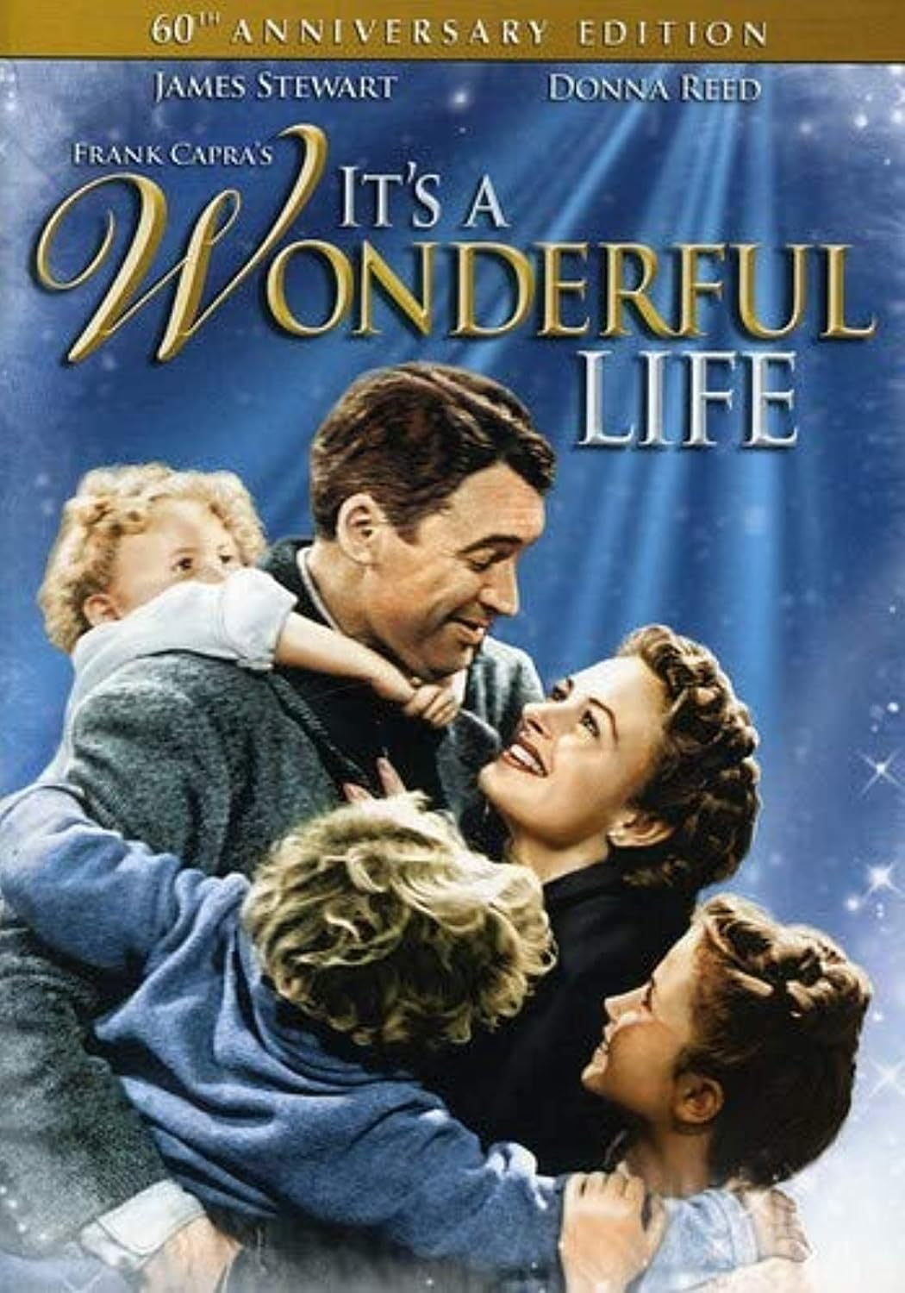
It's a Wonderful Life is voted one of the most inspiring film of the past 100 years.

Slide 8
Although this is a modern movie, it functions very much like a parable — a story that helps us see the truth we often miss about our own lives.

Slide 9
George Bailey is a good-hearted kid, born to a banker who loves to help people.

Slide 10
At age 12, he saved his brother's life, but lost hearing in one ear.

Slide 11
At his graduation, his father died, and he had to take over the savings & loan, so he did not go to college.

Slide 12
Savings & Loans is (S&L) like a kind of bank that specializes in taking people’s deposits and issues home mortgage.

Slide 13
He agreed to take over the S&L so that the wealthy but evil banker would not destroy his father's goal of helping people get homes in the same city.

Slide 14
Four years later, he got married. While going to their honeymoon, a run on the banks occurred so they had to use all their money to save the S&L.

Slide 15
They used up all their money to save the S&L. So they rebuilt an abandoned house and made it their home. They had four kids.

Slide 16
One day, their S&L got into trouble and they needed money urgently.

Slide 17
When he could not raise the funds, he thought about killing himself to get the insurance money.

Slide 18
God sent angel Lawrence to help George, but Lawrence was not good at convincing George.

Slide 19
George said he wished he had never been born. Lawrence followed that and brought him to a world where George was never born.

Slide 20
It was a horrible world. The town was changed for the worse. Thousands of people died because George was never born to change the world.

Slide 21
Lawrence told George he really had a wonderful life, and George wished and came back to his original world.

Slide 22
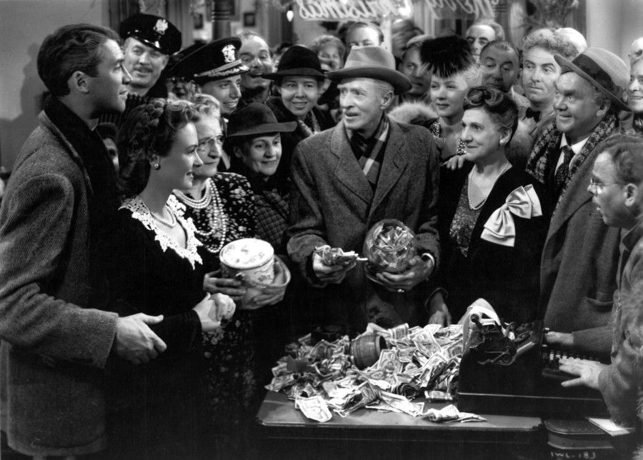
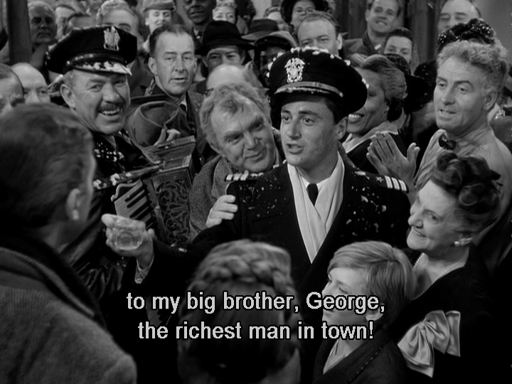
Meanwhile, people heard about his needs and came to donate money to help him.

Slide 23
George finally realized that he was truly blessed and people love him because he had lived to help them.

Slide 24
This movie was voted one of the most inspiring movies of the last century for a good reason. It is the story of many of us.

Slide 25
It taught me many valuable lessons that I am grateful to have learned at a young age. It helped change my perspective on life.

Slide 26
To the world, George may not be a success. He wasn't rich and didn't get to pursue and fulfill his dreams.

Slide 27
He believed in his father's dream of helping people own their own homes, and he worked to make that dream a reality.

Slide 28
The first lesson from this movie: we don’t have complete control of our lives. Actually, nobody does. But we can make the best of it.

Slide 29
For most of us, it seems we are trapped in our circumstances. And most of us hate that, but feel we had no way out.

Slide 30
Those circumstances prevent us from doing what we want and occupy the best times of our lives.

Slide 31
George had a goal: to help people own their own homes instead of paying rent to an evil landlord.

Slide 32
It was not his original goal, but he decided to take it on after his father died.

Slide 33
He could have chosen to abandon the S&L, but he decided to carry on his father’s dreams and help people.

Slide 34
Galatians 5:13 - You, my brothers and sisters, were called to be free. But do not use your freedom to indulge the flesh; rather, serve one another humbly in love.

Slide 35
To achieve that goal, he gave up his desire to attend college immediately and travel around the world.

Slide 36
When his brother Harry finished college, he allowed Harry to pursue Harry’s own dreams and continued to run the S&L himself.

Slide 37
We can see his frustration about it, but he never gave up on this nobler goal.

Slide 38
George was a selfless person. That's a personal quality we should all adopt because that's how Christ was.

Slide 39
George sacrificed himself to help others, just like Jesus sacrificed Himself to save us.

Slide 40
John 15:13 - Greater love has no one than this: to lay down one’s life for one’s friends.

Slide 41
Those circumstances are what God uses to shape us into better Christians, and therefore, we can be joyful and even thankful for them.

Slide 42
Even when we don't get to pursue and fulfill our own dreams, we can have a wonderful life, just as George did.

Slide 43
Maybe George would not be as happy if he had pursued his dream of traveling. He may not have the family he had.

Slide 44
Many people pursue their dreams only to realize that they miss the most essential things in life when it's too late.

Slide 45
At their deathbed, many people wish they had spent more time with family instead of focusing on making money.

Slide 46
The second lesson: our choices and actions have a profound impact on others.

Slide 47
He chose to take over his father's S&L because he didn't want the evil banker and landlord to continue to exploit people.

Slide 48
Philippians 2:4 –
Not looking to your own interests but each of you to the interests of the others.

Slide 49
What George did not realize was that the circumstances that trapped him were what God used to help many other people.

Slide 50
The board tapped George to run the S&L. He made many loans that helped people get their own homes.

Slide 51
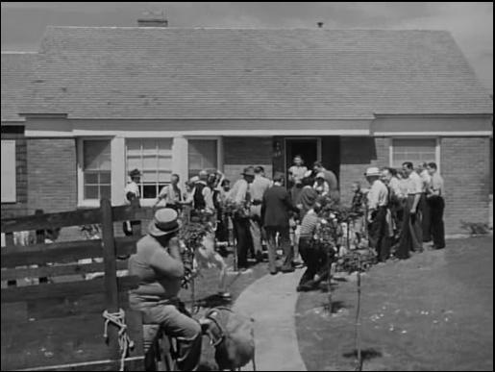
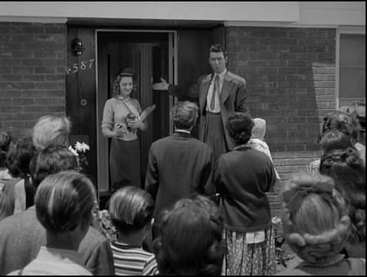
New home move-in ceremony

Slide 52
They’d say, “Bread, that this house may never know hunger. Salt, that life may always have flavor. And wine, that joy and prosperity may reign forever.”

Slide 53
Each home purchased means a family is freed from the rental trap and becomes stronger financially.

Slide 54
George's S&L helped many people get their own homes. He directly helped those families to live better lives.

Slide 55
Even other renters probably benefited somewhat because the landlords had to improve their rental properties to prevent tenants from leaving.

Slide 56
When people own their own homes, they save money on rent, allowing them to live better.

Slide 57
The appreciation of home values also means they have more money to spend and save for retirement.

Slide 58
More spending means more economic growth, and the whole town becomes wealthier, people live better, and crime probably goes down as well.

Slide 59
This is how George made the town a better place, but he did not realize his positive impact on the community.

Slide 60
But George wasn‘t happy because he wasn’t wealthy. He showed it when he kicked his car door after his wealthy friend left.

Slide 61
Most of us are not wealthy, and we are not happy about it. But that doesn't mean we cannot have a fulfilling life.

Slide 62
Does money bring happiness? According to studies -- No. It gives us more options, but not always happiness.

Slide 63
I often wondered: What can a small person like me do to make the world a better place?

Slide 64
George saving his brother meant he also saved thousands of soldiers, because his brother had saved them during the war.

Slide 65
Only when he visited the world without him can the audience see the impact of his work.

Slide 66
We refer to this phenomenon as the "butterfly effect" — one small action can have significant consequences elsewhere.

Slide 67
In the movie, George still didn't seem to get it at that time. He just wanted to have his good life back.

Slide 68
He finally realized how much impact he had on other people when people came to donate money to help him.

Slide 69
For most of us, that moment will not come while we are on Earth. But it will surely come in Heaven.

Slide 70
Third, in the midst of the worst crisis, he decided not to turn to evil when that seemed like it could solve his problems.

Slide 71
We are all tempted by evil at some point in our lives. George is no exception. But he stood firm.

Slide 72
Finally, even the tragedies in his life benefited him.

Slide 73
Losing his hearing in one ear meant he didn't have to fight in the military. He got to spend those few years with his family.

Slide 74
In Chinese, we have a short phrase for this: How do you know it's not a blessing when Mr. Sai lost his horse?

Slide 75
It’s a short story of how one’s losses became gains and how one’s gains can become losses.

Slide 76
As Christians, we have a loving God who can use our trials and tribulations to bring us blessings and lessons.

Slide 77
Jeremiah 29:11 - For I know the plans I have for you,” declares the Lord, “plans to prosper you and not to harm you, plans to give you hope and a future.

Slide 78
Romans 8:28 - And we know that in all things God works for the good of those who love him, who have been called according to his purpose.

Slide 79
Without trusting God’s redemptive purposes, suffering often feels meaningless and losses final.

Slide 80
So what can we learn from this inspiring movie? What is a “Wonderful Life”?

Slide 81
A wonderful life is not a successful life by the world’s standards, but a faithful life shaped by God for the good of others.

Slide 82
First, we don't have control over our circumstances, but we can know that God is with us and choose our responses.

Slide 83
Isaiah 41:10 –
So do not fear, for I am with you; do not be dismayed, for I am your God.
I will strengthen you and help you; I will uphold you with my righteous right hand.

Slide 84
I will strengthen you and help you; I will uphold you with my righteous right hand.

Slide 85
Second, if we remain faithful to our decisions and actions, we can accomplish great things for God and for others.

Slide 86
Ephesians 2:10 - For we are God’s handiwork, created in Christ Jesus to do good works, which God prepared in advance for us to do.

Slide 87
Third, even when we encounter losses, God can turn them into good, but we may not see it at that time.

Slide 88
Genesis 50:19-20 –
But Joseph said to them, “Don’t be afraid. Am I in the place of God? You intended to harm me,
but God intended it for good to accomplish what is now being done, the saving of many lives.

Slide 89
but God intended it for good to accomplish what is now being done, the saving of many lives.

Slide 90
Ultimately, all our impacts will be recognized and assessed in due time. For most of us, that time will be in Heaven.

Slide 91
Remember, you are never too old to make a difference. God wants to see how you use your time, talents, and treasures to do His work and love others.

Slide 92
When we are younger, we don't have as many talents and treasures, and so time is mostly what we can give.

Slide 93
We can volunteer to do things for God and others. We can take the time to care for others — we'll gain valuable experience as we do so.

Slide 94
We can learn how to love and care for others – this may be the most valuable thing we know.

Slide 95
Once we are more established, we will have all three, so we can do the most for God.

Slide 96
As we get older, we have less strength than young people, but we can do many other things because we have more talents, experiences, and treasures.

Slide 97
As we get older, our most important asset may be our experiences (a kind of talent). We should focus on sharing our experiences—teaching, sharing, and caring.

Slide 98
If we can’t fully use our treasures ourselves to do God's work, we can give our treasures to those who can do the job, and God will credit us also.

Slide 99
When we do work for God, no matter how small, it is treasured in God's eyes. Do not look down on menial work.

Slide 100
Our lives have been planned by God. True happiness and eternal rewards come when you follow God and live it to the fullest.

Slide 101
One day in Heaven, we'll meet all those whom we have helped. Those would be glorious meetings of great joy and satisfaction.

Slide 102
At that time, we'll realize that we did have a wonderful life. But we'll be happier if we recognize it today and start living and appreciating it.

Slide 103
We hope you can understand and enjoy a wonderful life in Christ while on this Earth. May God bless you all.

