Slide 1
Overcoming Adversity 3:
Treasure in the
Earthen Vessel

Slide 2
Scripture:
2 Corinthians 4:7-10

Slide 3
But we have this treasure in jars of clay to show that this all-surpassing power is from God and not from us.
We are hard pressed on every side, but not crushed; perplexed, but not in despair; persecuted, but not abandoned; struck down, but not destroyed. We always carry around in our body the death of Jesus, so that the life of Jesus may also be revealed in our body.

Slide 4
We are hard pressed on every side, but not crushed; perplexed, but not in despair; persecuted, but not abandoned; struck down,

Slide 5
but not destroyed. We always carry around in our body the death of Jesus, so that the life of Jesus may also be revealed in our body.

Slide 6
Overcoming Adversity 3:
Treasure in the
Earthen Vessel

Slide 7
One of the most famous parables regarding our relationship with God is “the potter and the clay”.

Slide 8
Jeremiah 18:1-4 -
This is the word that came to Jeremiah from the Lord:
“Go down to the potter’s house, and there I will give you my message.” 3 So I went down to the potter’s house, and I saw him working at the wheel. 4 But the pot he was shaping from the clay was marred in his hands; so the potter formed it into another pot, shaping it as seemed best to him.

Slide 9
“Go down to the potter’s house, and there I will give you my message.”
So I went down to the potter’s house, and I saw him working at the wheel. 4 But the pot he was shaping from the clay was marred in his hands; so the potter formed it into another pot, shaping it as seemed best to him.

Slide 10
So I went down to the potter’s house, and I saw him working at the wheel.

Slide 11
But the pot he was shaping from the clay was marred in his hands;
so the potter formed it into another pot, shaping it as seemed best to him.

Slide 12
so the potter formed it into another pot, shaping it as seemed best to him.

Slide 13
Earthen vessels like pots may not be particularly attractive, but they were very useful in Jesus’s days.

Slide 14
Pottery allowed the storage of food, which was necessary for survival.

Slide 15
Also, pottery can preserve non-food items. Dead Sea Scrolls were preserved in pots.

Slide 16
Therefore, it seems pottery is crucial to human civilization, and God uses it to describe us.

Slide 17
The pottery-making process teaches us a lot about Christians’ growth.

Slide 18
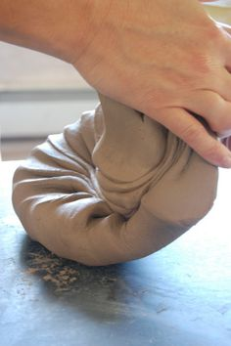
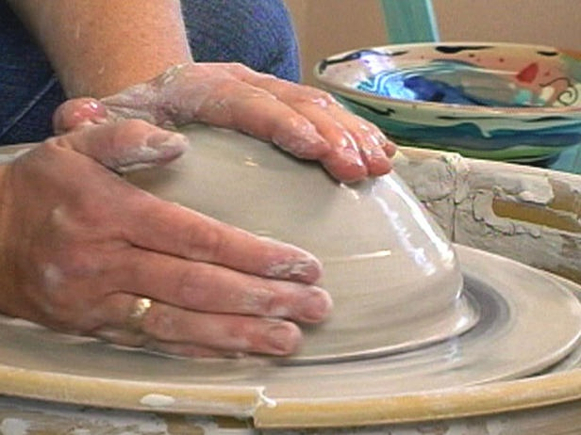
1. Pottery clay is given water and softened by kneading.

Slide 19
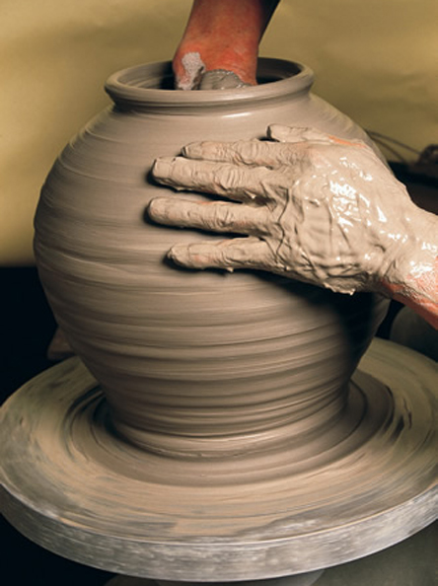
2. Then it is formed into the desired shape by the potter.

Slide 20
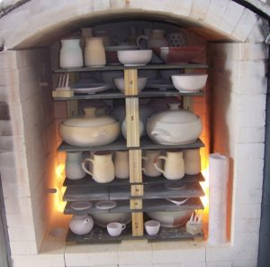
3. The shaped clay is then air-dried and then fired in the kiln.

Slide 21
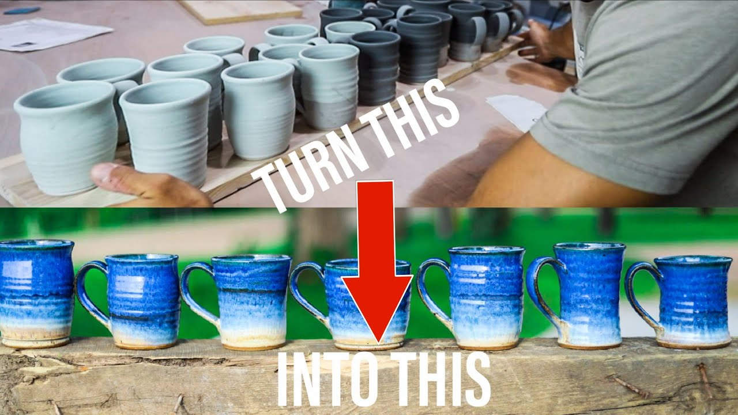
4. If needed, the potter can glaze it to make it shiny and
waterproof.

Slide 22
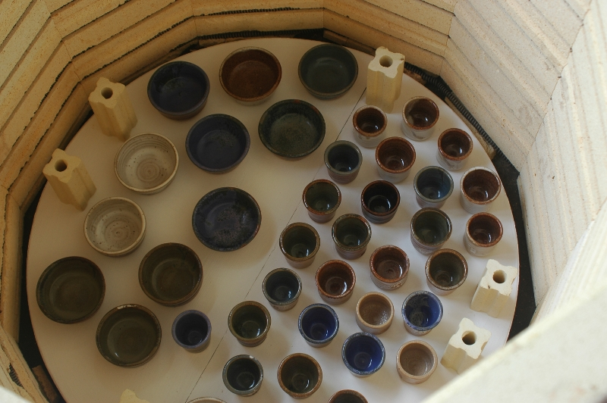
5. It is then fired again to finish the glazing.

Slide 23
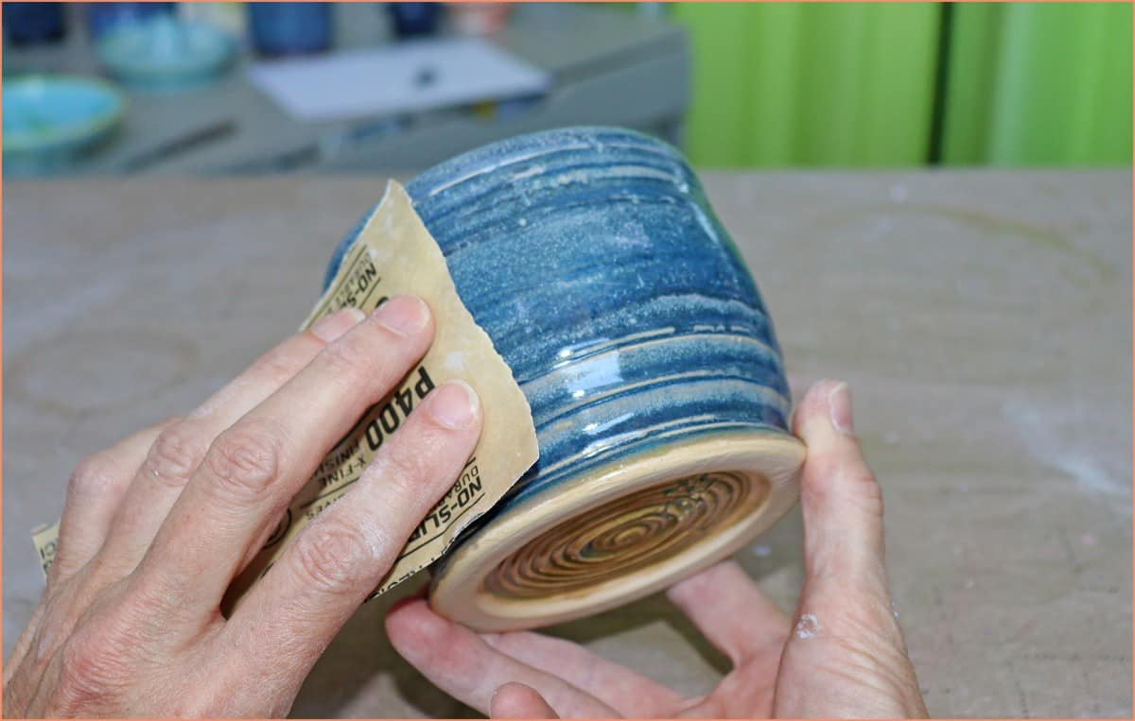
6. The potter then sands the pottery to make it smooth.

Slide 24
Similarly, we need to go through the firing, glazing, and sanding processes to become good vessels.

Slide 25
There is much we can learn from the pottery-making process.

Slide 26
Water is added so that the clay is softened, and can be kneaded and formed into
shape.

Slide 27
Water represents the Holy Spirit of God, who was sent to guide and comfort us.

Slide 28
Water makes the kneading process possible and much, much easier.

Slide 29
Similarly, the Holy Spirit makes the molding of us into useful vessels possible.

Slide 30
Clay has to be kneaded and shaped. This is a very time-consuming and tiresome process.

Slide 31
If the clay has awareness, it must be a very confusing and painful time.

Slide 32
“Something is happening to me, and I don’t know why and what I will become…”

Slide 33
We may not know what vessel God wants to shape us into.

Slide 34
Sometimes we can only wait, as John the Baptist did.

Slide 35
Oftentimes, when we are being shaped, we experience pain but don’t know why.

Slide 36
Like Apostle Paul in the last sermon, we can ask the Lord, but we may not get the answer we want.

Slide 37
He asked God to take away his pain, and God said “no”.

Slide 38
2 Cor. 12:9a - But he said to me, “My grace is sufficient for you, for my power is made perfect in weakness.”

Slide 39
That’s not the answer Paul wanted, but he came to realize that it was the best thing for him.

Slide 40
The clay was fired in the kiln and made into a proper vessel.

Slide 41
The firing process causes a chemical reaction: weaker ionic bonds were replaced by the stronger covalent bonds.

Slide 42
[clay]-OH + OH-[clay]→ [clay]-O-[clay] + H₂O
This reaction made the clay dry, hard, and stronger.

Slide 43
Similarly, the trials we face can profoundly change us and make us stronger.

Slide 44
Romans 5:3-5 -
Not only so, but we also glory in our sufferings,
because we know that suffering produces perseverance; perseverance, character; and character, hope. And hope does not put us to shame, because God’s love has been poured out into our hearts through the Holy Spirit, who has been given to us.

Slide 45
because we know that suffering produces perseverance;

Slide 46
perseverance, character;
and character, hope. And hope does not put us to shame,

Slide 47
because God’s love has been poured out into our hearts through the Holy Spirit, who has been given to us.

Slide 48
Persecutions and setbacks made us stronger, wiser, and more able to do greater things.

Slide 49
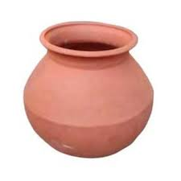
The firing process turns the clay into an earthen vessel.

Slide 50
To become a useful vessel for God, we need to go through the transformation by fire.

Slide 51
The “fire” comes from many sources: the devil, people, nature, and ourselves.

Slide 52
Sometimes it goes through the firing process several times to add glazing, color, and reflections.

Slide 53
So a vessel destined for greatness has to endure more firings.

Slide 54
Are you undergoing hardship? Maybe you are being prepared to do something great!

Slide 55
“When Heaven is about to place a great responsibility on a person, it will first test their will,
strain their muscles and bones, starve their body, leave them destitute, and thwart their endeavors.”

Slide 56
strain their muscles and bones, starve their body, leave them destitute, and thwart their endeavors.” - Mencius

Slide 57
Now comes the strangest thing about this Bible passage.

Slide 58
People used these vessels to hold and protect things.

Slide 59
The Bible talks about a “treasure” that is kept inside the vessel to protect the vessel.

Slide 60
With this “treasure”, the vessel can last longer and do more over its lifetime.

Slide 61
It is the Holy Spirit, our Comforter, Counselor, and the source of our true strength from God.

Slide 62
He helps to protect us from breaking under stress or shock.

Slide 63
Its greatness is revealed only in our weakness – that we don’t break when we should be broken.

Slide 64
John 14:16-17 – Jesus said, “And I will ask the Father, and he will give you another advocate
to help you and be with you forever — the Spirit of truth.
The world cannot accept him, because it neither sees him nor knows him. But you know him, for he lives with you and will be in you.

Slide 65
to help you and be with you forever — the Spirit of truth.
The world cannot accept him,

Slide 66
because it neither sees him nor knows him. But you know him, for he lives with you and will be in you.

Slide 67
“Advocate” is someone who stands up to help defend another person or to promote another person’s interests.

Slide 68
The original Greek word is parakletos, meaning a person called to be with another person.

Slide 69
It is also someone to help another person deal with things or situations, like a lawyer.

Slide 70
So the Holy Spirit is sent to be with us and help us. This vessel is not strong enough in itself.

Slide 71
God made you a strong vessel and sent the Holy Spirit to make you even stronger.

Slide 72
“Advocate” is also sometimes translated as “Comforter” – one who brings comfort to others.

Slide 73
The Holy Spirit also comforts us because our pain and suffering can sometimes almost break us.

Slide 74
Sometimes our pain is so unbearable that only God can comfort us.

Slide 75
But the vessel needs to decide whether to hold that treasure within it.

Slide 76
The Holy Spirit is gentle. He will not come in and stay with us if we don’t want Him in our lives.

Slide 77
The Holy Spirit was already there when you were molded into a vessel for God.

Slide 78
But if you want to be a strong vessel, you need to consistently keep the Holy Spirit in your life.

Slide 79
He will make you stronger and more able to endure all the difficulties in the journey to Heaven.

Slide 80
An analogy: Nowadays, we have vaccines to help protect us from COVID.

Slide 81
It doesn’t prevent you from getting the virus, but it nearly completely prevents the most severe cases.

Slide 82
You should still take precautions such as wearing masks and washing hands, but with less worry.

Slide 83
The risk of side effects is much lower than the risk of catching COVID, so why refuse?

Slide 84
Vaccines help us withstand the attacks of the virus. The Holy Spirit does that on the spiritual side.

Slide 85
2 Corinthians 4:10
is a strange verse about the death and life of Jesus.

Slide 86
“We always carry around in our body the death of Jesus, so that the life of Jesus may also be revealed in our body.”

Slide 87
What is the death of Jesus?
His crucifixion.

Slide 88
It is the greatest shame.
It is also the greatest humility.

Slide 89
It is also the expression of the greatest love.

Slide 90
It was done for the benefit of other people - us.

Slide 91
What is the life of Jesus?
His resurrection.

Slide 92
His resurrection is the true victory over sin and death that saved humanity.

Slide 93
For us, it gives a new life that is justified, eternal, and full of God’s power.

Slide 94
Through Jesus’s sacrifice for us, people should see the changed life in us.

Slide 95
Jesus’s crucifixion and resurrection represent and bring forth our death to sin and the new creation in Christ.

Slide 96
A Christian without a changed life after a while cannot be a real Christian.

Slide 97
He causes this supernatural change. We cannot be prideful about it.

Slide 98
1 Corin. 1:28-29 - God chose the lowly things of this world and the despised things — and the things that are not -
to nullify the things that are, so that no one may boast before him.

Slide 99
to nullify the things that are, so that no one may boast before him.

Slide 100
Why does God want to use humble people?

Slide 101
Because PRIDE is a grave sin.

Slide 102
Pride makes people think they don’t need God.

Slide 103
That is precisely what the devil wants people to think and do.

Slide 104
God really wants us to depend on Him for wisdom because only His wisdom can solve real problems.

Slide 105
True strength comes from God’s power.
Strength is not always the power to make things happen.

Slide 106
Strength is also the ability to endure something difficult. Sometimes waiting is harder than fighting.

Slide 107
When someone has a bit of success, he tends to come to rely on himself more.

Slide 108
Self-interest, pride, greed, desires of the flesh, not listening – these are the downfall of many men of God.

Slide 109
When one is prideful, one hears himself and not God.

Slide 110
So God sometimes has to break us to use us.

Slide 111
Moses and Paul were gifted men, but God broke them so He could use them.

Slide 112
Throughout their lives, God kept them humble so He could continue to use them.

Slide 113
We need the Holy Spirit, who helped form us, to stay with us so we can last a long time.

Slide 114
You will always face adversities in life, but with God’s help and hope, you can overcome them.

Slide 115
When we understand this, we can be content even in the midst of our struggles.

Slide 116
We can be joyful because we know these adversities will make us more mature.

Slide 117
Even if we fail, we still learn valuable lessons that will benefit us.

Slide 118
We need to turn our experiences and pain into strength and comfort for others.

Slide 119
Also, remember that our problems are not always solved or reversed.

Slide 120
But that we are not the slave of our circumstances.

Slide 121
With God’s help, we can rise above the adverse circumstances and have joy through contentment.

Slide 122
We can be content because we have the eternal hope and the great helper – the Holy Spirit.

Slide 123
Finally, know that we are not fighting the battle alone.

Slide 124
Philippians 4:10-13 –
I rejoiced greatly in the Lord that at last you renewed your concern for me.
Indeed, you were concerned, but you had no opportunity to show it. I am not saying this because I am in need, for I have learned to be content whatever the circumstances. I know what it is to be in need, and I know what it is to have plenty. I have learned the secret of being content in any and every situation, whether well fed or hungry, whether living in plenty or in want. I can do all this through him who gives me strength.

Slide 125
Indeed, you were concerned, but you had no opportunity to show it. I am not saying this because I am in need,

Slide 126
for I’ve learned to be content whatever the circumstances. I know what it is to be in need, and I know what it is to have plenty.

Slide 127
I have learned the secret of being content in any and every situation, whether well fed or hungry,

Slide 128
whether living in plenty or in want. I can do all this through him who gives me strength.

Slide 129
To other people, this is the peace and joy beyond all understanding.

Slide 130
And when they see this in Christians, they know we have something they don’t have…

Slide 131
We become the light of Christ for them to see.

Slide 132
May we all be formed and led by the Holy Spirit and be great vessels for God.

