Slide 1
Mary’s Journey: The Mystery of Destiny

Slide 2
Scripture: Luke 1:26-38

Slide 3
In the sixth month of Elizabeth’s pregnancy, God sent the angel Gabriel to Nazareth, a town in Galilee,
to a virgin pledged to be married to a man named Joseph, a descendant of David. The virgin’s name was Mary. The angel went to her and said, “Greetings, you who are highly favored! The Lord is with you.”
Mary was greatly troubled at his words and wondered what kind of greeting this might be. But the angel said to her, “Do not be afraid, Mary; you have found favor with God. You will conceive and give birth to a son, and you are to call him Jesus. He will be great and will be called the Son of the Most High. The Lord God will give him the throne of his father David, and he will reign over Jacob’s descendants forever; his kingdom will never end.”
“How will this be,” Mary asked the angel, “since I am a virgin?”
The angel answered, “The Holy Spirit will come on you, and the power of the Most High will overshadow you. So the holy one to be born will be called[a] the Son of God. Even Elizabeth your relative is going to have a child in her old age, and she who was said to be unable to conceive is in her sixth month. For no word from God will ever fail.”
“I am the Lord’s servant,” Mary answered. “May your word to me be fulfilled.” Then the angel left her.

Slide 4
to a virgin pledged to be married to a man named Joseph, a descendant of David. The virgin’s name was Mary.

Slide 5
The angel went to her and said, “Greetings, you who are highly favored! The Lord is with you.”

Slide 6
But the angel said to her, “Do not be afraid, Mary; you have found favor with God. You will conceive and give birth to a son, and you are to call him Jesus. He will be great and will be called the Son of the Most High. The Lord God will give him the throne of his father David, and he will reign over Jacob’s descendants forever; his kingdom will never end.”
“How will this be,” Mary asked the angel, “since I am a virgin?”
The angel answered, “The Holy Spirit will come on you, and the power of the Most High will overshadow you. So the holy one to be born will be called[a] the Son of God. Even Elizabeth your relative is going to have a child in her old age, and she who was said to be unable to conceive is in her sixth month. For no word from God will ever fail.”
“I am the Lord’s servant,” Mary answered. “May your word to me be fulfilled.” Then the angel left her.

Slide 7
Mary was greatly troubled at his words and wondered what kind of greeting this might be.

Slide 8
But the angel said to her, “Do not be afraid, Mary; you have found favor with God.

Slide 9
You will conceive and give birth to a son, and you are to call him Jesus.

Slide 10
He will be great and will be called the Son of the Most High.

Slide 11
The Lord God will give him the throne of his father David, and he will reign over Jacob’s descendants forever

Slide 12
his kingdom will never end.”
“How will this be,” Mary asked the angel, “since I am a virgin?”

Slide 13
The angel answered, “The Holy Spirit will come on you, and the power of the Most High will overshadow you

Slide 14
So the holy one to be born will be called the Son of God.

Slide 15
Even Elizabeth your relative is going to have a child in her old age,

Slide 16
and she who was said to be unable to conceive is in her sixth month. For no word from God will ever fail.”

Slide 17
“I am the Lord’s servant,” Mary answered. “May your word to me be fulfilled.” Then the angel left her.

Slide 18
Mary’s Journey: The Mystery of Destiny

Slide 19
The story of Mary is among the most dramatic in the Bible.

Slide 20
Mary was maybe 15 to 17 years old at the time, and was engaged to Joseph the carpenter.

Slide 21
Mary’s journey:
Angel Gabriel’s annunciation - Does Mary really understand what she committed to?

Slide 22
Angel Gabriel actually did not tell her all the process and suffering involved…

Slide 23
God never tells us the whole plan or the coming journey in great detail. It is always a journey of faith.

Slide 24
She went to stay with her aunt Elizabeth for three months.

Slide 25
A teenage girl back in those days should be working already.

Slide 26
So letting her leave for three months suggests that her family is not poor by any means.

Slide 27
Still, letting your teenage girl stay with a relative for three months is hard for me to imagine.

Slide 28
She was three months pregnant when she returned.

Slide 29
After she came home, she must have faced the family’s anger.

Slide 30
Back in those days, getting pregnant out of wedlock could get you killed by stoning.

Slide 31
She might tell them what Angel Gabriel told her, but who would believe her?

Slide 32
Mary must be thinking: Where is God when I encounter all these unusual difficulties?

Slide 33
Understandably, her fiancée Joseph wanted to cancel the marriage.

Slide 34
Joseph is a very good person. He was trying to do it without further embarrassing Mary.

Slide 35
God intervened to make sure Joseph married her. Jesus must not be born out of wedlock.

Slide 36
God intervenes when necessary, and often at the last minute.

Slide 37
Maybe God does that to show us that it’s Him, not us, doing the miracle.

Slide 38
Or maybe it is a test of and training for our faith.

Slide 39
At this time, Roman Caesar Augustus ordered a census to help them tax people.

Slide 40
Though near birth, they had to travel 100 miles to go to Bethlehem.

Slide 41
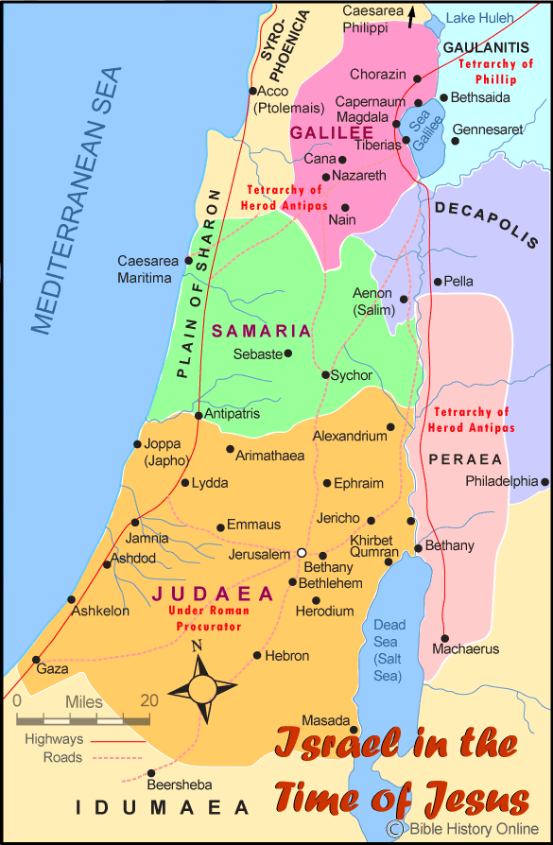
The journey was full of problems.

Slide 42
Mary probably walked 100 miles while heavily pregnant.

Slide 43
Mary gave birth to Jesus at the humblest place – a cave or a barn.

Slide 44
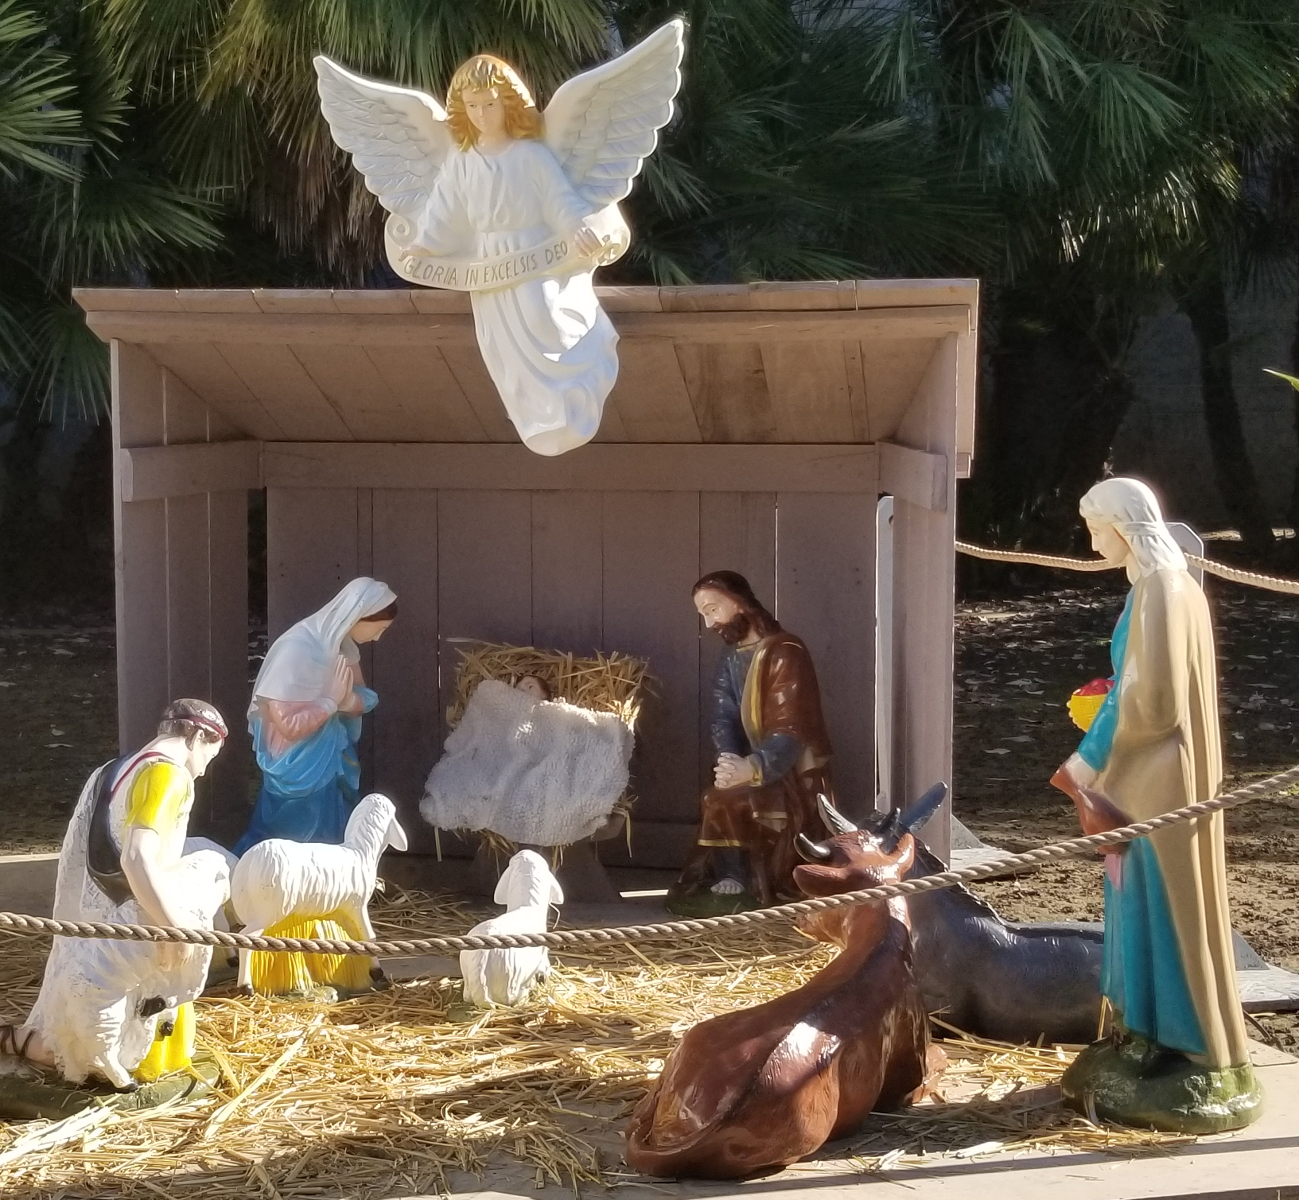

Slide 45
Does this look like a place suitable for the birth of the Son of God?

Slide 46
Sometimes when God works, it does not look like God at all.

Slide 47
There was an amazing visit by shepherds. That must have lifted their spirits.

Slide 48
But there was no record that angels appeared to Mary and Joseph when Jesus was born.

Slide 49
A few days later, Mary was warned by prophets at the temple that her heart would be torn because of Jesus.

Slide 50
I don’t think she could imagine what that statement really meant.

Slide 51
She might have thought: How can my life and the life of Son of God be so difficult?

Slide 52
They stayed in Bethlehem after the birth of Jesus, maybe to avoid the ridicule of their hometown neighbors.

Slide 53
About a year or two later, Magi’s visit helped prepare them for the trip to Egypt.

Slide 54
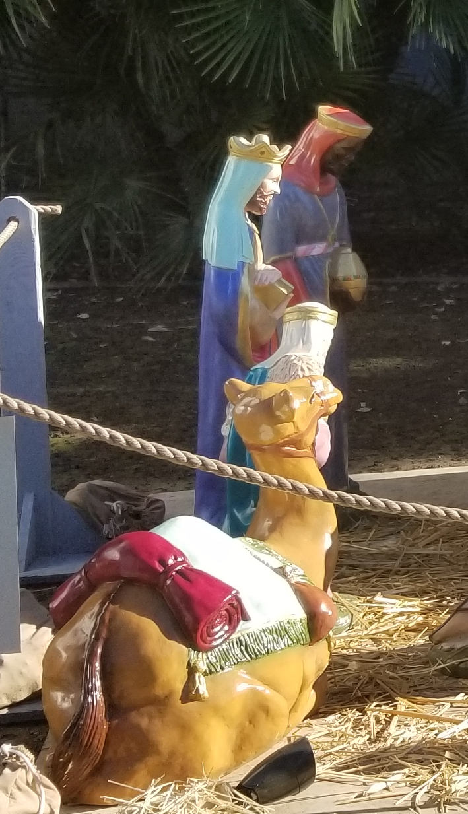
They fled to Egypt to save Jesus from death.

Slide 55
But if the magis did not visit, maybe they didn’t have to flee?

Slide 56
Why did this whole magi visit and escape to Egypt have to happen? No one knows for sure.

Slide 57
The precious spices given by the magi provided funds for this journey.

Slide 58
Even though God provided in the most amazing way, the journey was still challenging.

Slide 59
When they moved back to Nazareth, they must have faced ridicule once again.

Slide 60
Joseph died; she had to raise 7 or more children on her own.

Slide 61
Mark 6:3
Jesus
James
Joseph
Judas
Simon
His sisters
Judas
Simon
His sisters

Slide 62
Jesus helped take care of the family as the head of household.

Slide 63
Even though Jesus was never a father, he experienced earthly fatherhood through raising his siblings.

Slide 64
Mary visited Jesus at least a few times during His ministry.

Slide 65
She witnessed Jesus’s ministry and knew He is the Son of God as promised by Gabriel

Slide 66
Mary may have thought Jesus would be king, as did the other disciples.

Slide 67
But what she saw was her innocent son, Jesus, condemned as a criminal and crucified.

Slide 68
All her dreams were shattered at the foot of the cross.

Slide 69
Did she know Jesus would be resurrected? Did not seem like it…

Slide 70
Gabriel and the prophets never mentioned that, and she wasn’t there when Jesus mentioned it to his disciples.

Slide 71
But she saw the resurrected Jesus and realized Gabriel’s words were true.

Slide 72
She probably stayed with the disciples and Jesus during the forty days after resurrection.

Slide 73
She was probably there during the ascension of Jesus.

Slide 74
She served the Lord with early Christians for the rest of her life.

Slide 75
Her other son, James, became the leader of the early church.

Slide 76
She has many stories and likely helped Luke record the story of Jesus's birth.

Slide 77
Mary would forever be called an obedient servant and a greatly blessed woman.

Slide 78
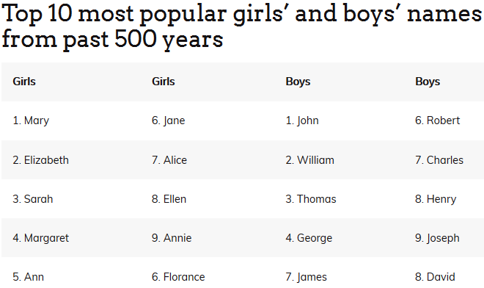

Slide 79
From her story we see some basic principles of Christian faith:

Slide 80
1. If we allow God to do so, He’ll be actively involved in our lives.

Slide 81
Ephesians 2:10 - For we are God’s handiwork, created in Christ Jesus to do good works, which God prepared in advance for us to do.

Slide 82
2. Everything is under God’s control and/or allowed by God.

Slide 83
Ephesians 1:11 - In him we were also chosen, having been predestined

Slide 84
according to the plan of him who works out everything in conformity with the purpose of his will.

Slide 85
3. God has long-term plans for humanity and for each one of us.

Slide 86
Jeremiah 29:11 –
For I know the plans I have for you,” declares the Lord,
“plans to prosper you and not to harm you, plans to give you hope and a future.

Slide 87
“plans to prosper you and not to harm you, plans to give you hope and a future.”

Slide 88
4. When we choose to obey God, we can fulfill our destiny.

Slide 89
Eph. 1:11 - We were also chosen to belong to him. God decided to choose us long ago in keeping with his plan.

Slide 90
He works out everything to fit his plan and purpose.

Slide 91
Exo. 19:5-6a - Now if you obey me fully and keep my covenant, then out of all nations you will be my treasured possession.

Slide 92
Although the whole earth is mine, you will be for me a kingdom of priests and a holy nation.

Slide 93
Are you ready to obey and follow God and do something great for Him with your life?

Slide 94
God’s evaluation of you is what really matters…
Notes:
English: “poor in spirit” These are people who know their spiritual needs and they cannot satisfy God on their own. These people cry out to God and will get what they ask for.
Most religion: motivate people to do what they want. Chr: tells your real need – that you cannot save yourself – and then get free grace. That’s not normal way of motivating people

Slide 95
Matthew 25:23 - His master replied, ‘Well done, good and faithful servant! You have been faithful with a few things;
Notes:
English: “poor in spirit” These are people who know their spiritual needs and they cannot satisfy God on their own. These people cry out to God and will get what they ask for.
Most religion: motivate people to do what they want. Chr: tells your real need – that you cannot save yourself – and then get free grace. That’s not normal way of motivating people

Slide 96
I will put you in charge of many things. Come and share your master’s happiness!’
Notes:
English: “poor in spirit” These are people who know their spiritual needs and they cannot satisfy God on their own. These people cry out to God and will get what they ask for.
Most religion: motivate people to do what they want. Chr: tells your real need – that you cannot save yourself – and then get free grace. That’s not normal way of motivating people

Slide 97
So serve God and people with a pure heart. God will do His part at the right time.
Notes:
English: “poor in spirit” These are people who know their spiritual needs and they cannot satisfy God on their own. These people cry out to God and will get what they ask for.
Most religion: motivate people to do what they want. Chr: tells your real need – that you cannot save yourself – and then get free grace. That’s not normal way of motivating people

Slide 98
No matter what happens, we can believe that it is for our own long-term benefit because God loves us.

Slide 99
Romans 8:28 - And we know that in all things God works for the good of those who love him, who have been called according to his purpose.

Slide 100
Our journey, no matter how difficult, is part of God’s plan and will be good for us in the long run.

Slide 101
So no matter how hard life seems right now, don’t give up! Trust God and journey on with faith.

Slide 102
May the Lord say to you one day: “You good and faithful servant.”

Slide 103
May the Lord bless you all.

