Slide 1
Parable of
the Talents

Slide 2
Scripture:
Matthew 25:14-30

Slide 3
Jesus said, “Again, it will be like a man going on a journey, who called his servants and entrusted his wealth to them.

Slide 4
To one he gave five bags of gold, to another two bags, and to another one bag, each according to his ability. Then he went on his journey.

Slide 5
The man who had received five bags of gold went at once and put his money to work and gained five bags more.

Slide 6
So also, the one with two bags of gold gained two more.

Slide 7
But the man who had received one bag went off, dug a hole in the ground and hid his master’s money.

Slide 8
After a long time the master of those servants returned and settled accounts with them.
The man who had received five bags of gold brought the other five. ‘Master,’ he said, ‘you entrusted me with five bags of gold. See, I have gained five more.’
」His master replied, ‘Well done, good and faithful servant! You have been faithful with a few things; I will put you in charge of many things. Come and share your master’s happiness!’
」The man with two bags of gold also came. ‘Master,’ he said, ‘you entrusted me with two bags of gold; see, I have gained two more.’
」His master replied, ‘Well done, good and faithful servant! You have been faithful with a few things; I will put you in charge of many things. Come and share your master’s happiness!’
」Then the man who had received one bag of gold came. ‘Master,’ he said, ‘I knew that you are a hard man, harvesting where you have not sown and gathering where you have not scattered seed. So I was afraid and went out and hid your gold in the ground. See, here is what belongs to you.’
」His master replied, ‘You wicked, lazy servant! So you knew that I harvest where I have not sown and gather where I have not scattered seed? Well then, you should have put my money on deposit with the bankers, so that when I returned I would have received it back with interest.
」‘So take the bag of gold from him and give it to the one who has ten bags. For whoever has will be given more, and they will have an abundance. Whoever does not have, even what they have will be taken from them. And throw that worthless servant outside, into the darkness, where there will be weeping and gnashing of teeth.’

Slide 9
The man who had received 5 bags of gold brought the other 5. ‘Master,’ he said, ‘you entrusted me with 5 bags of gold. See, I have gained 5 more.’

Slide 10
His master replied, ‘Well done, good and faithful servant! You have been faithful with a few things;
I will put you in charge of many things. Come and share your master’s happiness!’
」The man with two bags of gold also came. ‘Master,’ he said, ‘you entrusted me with two bags of gold; see, I have gained two more.’
」His master replied, ‘Well done, good and faithful servant! You have been faithful with a few things; I will put you in charge of many things. Come and share your master’s happiness!’
」Then the man who had received one bag of gold came. ‘Master,’ he said, ‘I knew that you are a hard man, harvesting where you have not sown and gathering where you have not scattered seed. So I was afraid and went out and hid your gold in the ground. See, here is what belongs to you.’
」His master replied, ‘You wicked, lazy servant! So you knew that I harvest where I have not sown and gather where I have not scattered seed? Well then, you should have put my money on deposit with the bankers, so that when I returned I would have received it back with interest.
」‘So take the bag of gold from him and give it to the one who has ten bags. For whoever has will be given more, and they will have an abundance. Whoever does not have, even what they have will be taken from them. And throw that worthless servant outside, into the darkness, where there will be weeping and gnashing of teeth.’

Slide 11
I will put you in charge of many things. Come and share your master’s happiness!’

Slide 12
The man with 2 bags of gold also came. ‘Master,’ he said, ‘you entrusted me with 2 bags of gold; see, I have gained 2 more.’

Slide 13
His master replied, ‘Well done, good and faithful servant! You have been faithful with a few things;

Slide 14
I will put you in charge of many things. Come and share your master’s happiness!’

Slide 15
Then the man who had received one bag of gold came. ‘Master,’ he said, ‘I knew that you are a hard man,

Slide 16
harvesting where you have not sown and gathering where you have not scattered seed.

Slide 17
So I was afraid and went out and hid your gold in the ground. See, here is what belongs to you.’

Slide 18
His master replied, ‘You wicked, lazy servant! So you knew that I harvest where I have not sown and gather where I have not scattered seed?

Slide 19
Well then, you should have put my money on deposit with the bankers, so that when I returned I would have received it back with interest.

Slide 20
‘So take the bag of gold from him and give it to the one who has 10 bags. For whoever has will be given more, and they will have an abundance.

Slide 21
Whoever does not have, even what they have will be taken from them.

Slide 22
And throw that worthless servant outside, into the darkness, where there will be weeping and gnashing of teeth.’

Slide 23
Parable of
the Talents

Slide 24
This is the second of three sermons in the “The Meaning of Christian Life” series.

Slide 25
This series is based on three parables found in Luke 19, Matthew 25, and Luke 16.

Slide 26
These three parables talk about three things we have on this Earth: our time, talents, and treasures.

Slide 27
Last time we talked about the “Parable of the Minas” in Luke 19. It focuses on our time on Earth.

Slide 28
In this parable called the “Parable of the Bags of Gold”, we have a master who gave money to his servants to make more money.

Slide 29
This time, he actually gave three servants different amounts of money: five bags, two bags, and one bag of gold.

Slide 30
When the master returned after finishing dealing with some business elsewhere, he called for the three of them.

Slide 31
The first servant who got five bags made another five bags, and he was praised by the master.

Slide 32
The second servant who got two bags made another two bags, and he was praised by the master with the exact same wording.

Slide 33
The last one hid his one bag of gold and didn’t make any money with it. The master was very upset and rebuked him harshly.

Slide 34
The master took his money away and gave it to the first servant who had ten bags. And the last servant was thrown into the darkness.

Slide 35
It is easy to figure out what the bags of gold represent.

Slide 36
In some translations, it gave the unit as a “talent” instead of a “bag”.

Slide 37
In English, the word “talent” means one’s abilities.

Slide 38
v15: To one he gave five bags of gold, to another two bags, and to another one bag, each according to his ability.

Slide 39
So there are two clues that these bags of gold represent a person’s abilities.

Slide 40
In English, the word “talent” means one’s abilities, but it is also an ancient Middle Eastern measurement of weight and currency.

Slide 41
As a measurement of weight, the value of a talent depends on what’s being weighed.

Slide 42
A talent is about 75 lbs. or 33 kg. A kilogram of gold today (10/2/2025) is about US$124,000.

Slide 43
So 33 kg of gold is about $4.1 million as of 10/2/2025.

Slide 44
1 talent = $4.1 million
2 talent = $8.2 million
5 talent = $20.5 million

Slide 45
That’s a lot of money, and one can really do some big business with it.

Slide 46
The master really wants them to make money. This is no longer a simple test.

Slide 47
The large amount of money also means God really values people’s abilities.

Slide 48
The first servant was given five bags, and at the end, he earned five more bags. He doubled the money that was originally given to him.

Slide 49
The wording is crucial here. He didn’t say, “I have ten bags now.” He said, “I’ve gained five more.”

Slide 50
This wording implies the gain was in addition to the original money, which was still there.

Slide 51
Since the monies in this parable represent one’s talents, this implies that our talents gained on Earth are still useful in eternity.

Slide 52
The talents here represent both our abilities and our wisdom gained through living on this Earth and dealing with people and things.

Slide 53
Our failures, losses, and painful experiences on Earth all add to our wisdom and talents.

Slide 54
The first two servants retained the talents they were initially given and gained more talents and wisdom through their learning and living on Earth.

Slide 55
In eternity, they get to keep both. Somehow, their talents are useful in eternity.

Slide 56
In Luke 19, the minas were used to earn money, but the original minas were used up.

Slide 57
Those original minas represent our earthly lives. Once they are used up, they are gone. The faithful servant did not come back with it.

Slide 58
But in this parable, the two faithful servants came back with the original monies and said they had doubled them.

Slide 59
Although the two servants made different amounts, they both doubled the master’s original monies.

Slide 60
祂用同樣的稱讚:「好, 你這又良善又忠心的僕人, 你在不多的事上有忠心, 我要把許多事派你管理。可以進來享受你主人的快樂！」

Slide 61
In v.21 & 23, the master praised both of them with the same words: “Well done, good and faithful servant!

Slide 62
You have been faithful with a few things; I will put you in charge of many things. Come and share your master’s happiness!”

Slide 63
Same identical words! That means in the eyes of the master, the two servants were the same. They both made 100% gains with their monies.

Slide 64
So the master didn’t evaluate them based on the amounts of money made, but by the rates of return, which were both 100%.

Slide 65
The master’s praise, “good and faithful servant”, tells us a lot about what God looks for in us.

Slide 66
God is looking for a person’s faithfulness and trustworthiness. The servants were faithful in using the master’s money.

Slide 67
The word “good” signals intent. They were good because they decided to use the master’s money to make more money as they were instructed.

Slide 68
The master didn’t call them “smart” or “competent”, which would signal the servants’ intelligence or ability. That is not God’s focus.

Slide 69
Today, most employers look at employees’ output and reward them accordingly.

Slide 70
God looks for intentions, and output is a sign of one’s intentions, but not why they get awarded.

Slide 71
God compares one’s output to one’s given abilities and resources, and He judges based on rates of return.

Slide 72
Also, in this parable, the master also said, “Come and share your master’s happiness!”

Slide 73
So, aside from getting significant and new responsibilities, the servants were also being rewarded for their faithful labor.

Slide 74
The third servant tried to keep the money from the master by not using it, but in the end, he lost it anyway and gained nothing from it.

Slide 75
His excuse was the same as that third servant in Luke 19 – it’s unfair that the master didn’t make money on his own but asks his servants to do it.

Slide 76
The master here said the same thing in return – that’s exactly what I had planned.

Slide 77
He said the servant should at least put the money in the bank and earn interest, even if he couldn’t figure out how to make more money with it.

Slide 78
A bank is a place where idle funds can be loaned out for someone to earn money, and the depositor can share in the borrower’s gains.

Slide 79
Some of us have talents that are good in things other than preaching the gospel or serving others. We can use our talents to support those who do.

Slide 80
The Christian Church is like the human body. There are mouths to preach and hands to do God’s work and help people.

Slide 81
But mouth and hands cannot survive on their own. We need all kinds of organs to keep a person alive and functional.

Slide 82
We need feet to walk to people who need help. You who drive people to church or drive ministers to senior apartments are our feet.

Slide 83
We need donors to give the money (food), and the church’s managers (the digestive system) can turn it into energy to do work.

Slide 84
We need prayer warriors (the skin and immune system) to fight off the devil’s attacks (germs and viruses).

Slide 85
In short, the Christian Church needs all kinds of talents to work. God is the ultimate provider, but He uses people to do His work on Earth.

Slide 86
Like the Parable of the Minas, the third servant’s unused money was given to the one with the most money, and he was thrown into darkness.

Slide 87
He has a bit of talent, and he hid it in the ground. The master was upset that he didn’t even try to use the money.

Slide 88
The Minas Parable tells us to use our earthly lives for God, and we will be given responsibilities in eternity based on what we did with our earthly lives.

Slide 89
This parable tells us to use our abilities for God, and we get to keep our talents and the additional ones we gain for use in eternity.

Slide 90
In God’s eyes, one’s faithfulness matters more than one’s abilities.

Slide 91
Because God can teach someone to do greater things, but He can’t change someone’s heart if he has wrong motives and doesn’t want to be changed.

Slide 92
God gave us free will. He respects our decisions even when it is not the best decision.

Slide 93
We were given some talents on Earth, and we work to earn more, but in eternity, we will learn even more and accomplish much greater things.

Slide 94
Now let’s think about something that’s not in the parable: what if the third servant did go try to make money but didn’t make any?

Slide 95
Worse yet, what if he lost part or all of the original bag of gold given to him?

Slide 96
I think the master’s reaction may depend on the third servant’s attitude.

Slide 97
Did he try his best to make money? If he tried his best, then he was faithful.

Slide 98
If he was not careful with the money, then he was not faithful.

Slide 99
If he didn’t think he could do it right, the master said there’s always the banking option.

Slide 100
In the real world, we can’t lose our initial abilities. Our only real option is use them for God and gain more talents or not.

Slide 101
Use the talent for Him is what He cared about the most. If we do that, we will inevitably earn more from our experiences even if we experienced failures.

Slide 102
God will guide us so when we are willing, we can always do things for Him and gain more valuable talents, experiences, and wisdom.

Slide 103
This parable made it clear that it is the rate of return that the master used to evaluate them. In this parable, both servants made 100% in return.

Slide 104
Although the first servant made 2.5 times more money in return, they were the same to God because the rates of return were both 100%.

Slide 105
The master gave the exact praise to both servants to show us that God saw them as equals.

Slide 106
But when it comes to the third servant, suddenly the master turned from a generous man to a very harsh man, so it seems.

Slide 107
The servant hid the money. He did not use it as the master requested. He wasted his earthly talents.

Slide 108
The master called him a “wicked, lazy servant”. That’s very harsh. God must be very upset at people who waste their talents.

Slide 109
That’s because when you don’t use God’s resources properly, you are doing the devil’s work…

Slide 110
Devil wants you to waste your and others’ lives away! A life not living for God is a life living for the devil.

Slide 111
Just like in the other parable, the servant complained that the master didn’t do anything and still wanted something in return.

Slide 112
We sometimes complain to God why He doesn’t seem to care about the world’s problems such as extreme poverty, hunger, and war.

Slide 113
God’s response: I already did – I created you to help tackle these problems. I gave you time, talent, and treasures so you can help solve it.

Slide 114
One day, God will ask how did you use your 3 Ts:
Time
Talent
Treasure

Slide 115
How many of us waste our talents on our own enjoyment and do not try to use it for God and His purposes?

Slide 116
Did God give you a gift of communicating with people? Use that to tell them about Jesus.

Slide 117
Did God give you a gift of understanding the Bible? Use that to teach people.

Slide 118
Did God give you a gift of managing an organization? Use that to help manage the church.

Slide 119
Did God give you a bigger car that can help take people to church or drive seniors around? Use it when you can.

Slide 120
Did God give you a good job or bless your business so you make money? Tithe as Bible teaches us so others can do God’s work.

Slide 121
In your jobs or spare time, are you going above your normal responsibilities to help others?

Slide 122
Dr. Ho Feng-Shan, the Chinese Consul-General in Vienna, saved several thousands of Jews in Austria before and during WWII.

Slide 123
He worked tirelessly approving visas for Jews to go to Shanghai. They used that visa to safely leave Austria.

Slide 124
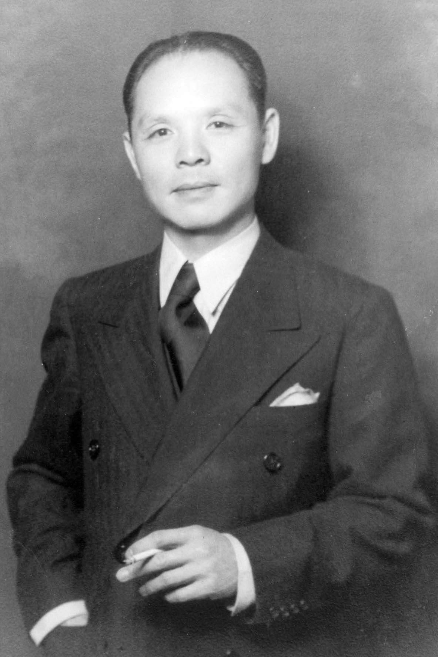
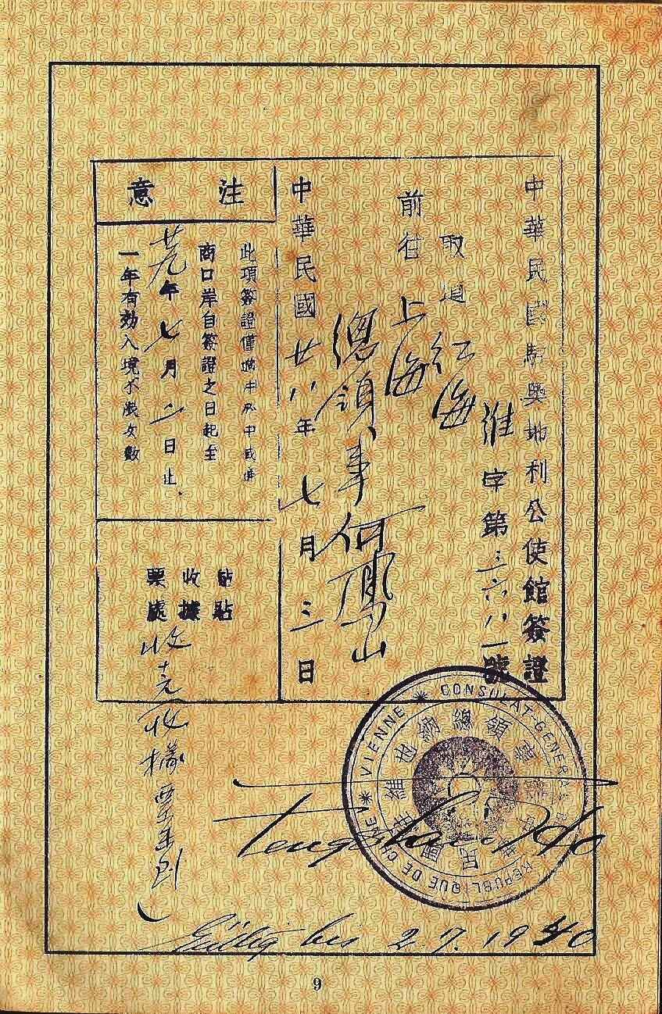

Slide 125
He saved at least 4,000 Jews from certain death by doing what he could do as consul-general – issuing visas.

Slide 126
There are doctors and nurses who donate a few weeks a year or weekends to help people in poor communities.

Slide 127
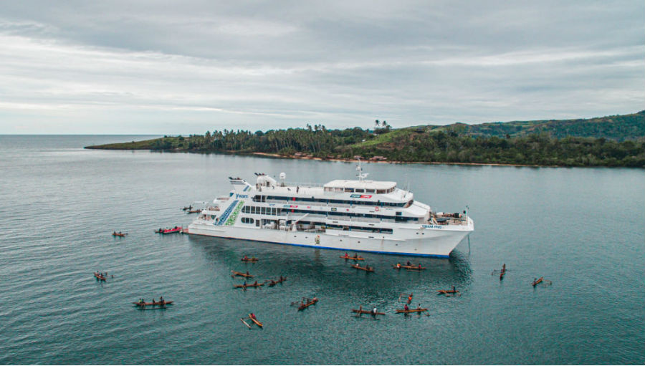
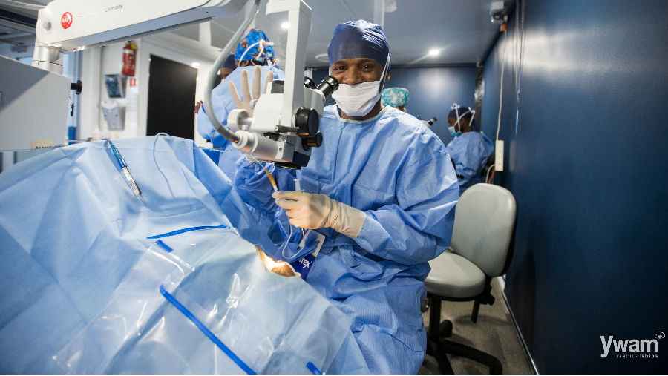
A medical ship
By YWAM

Slide 128

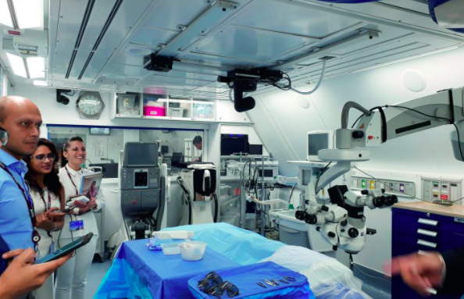

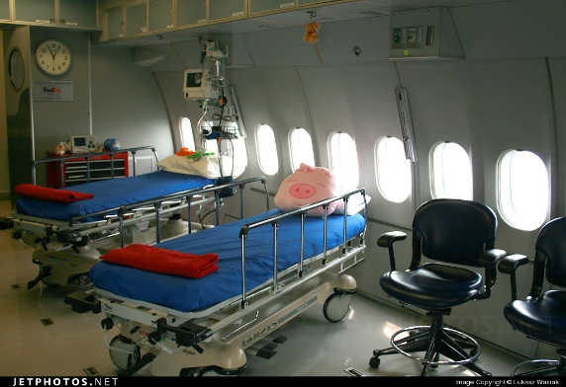
Orbis - The Flying Eye Hospital

Slide 129
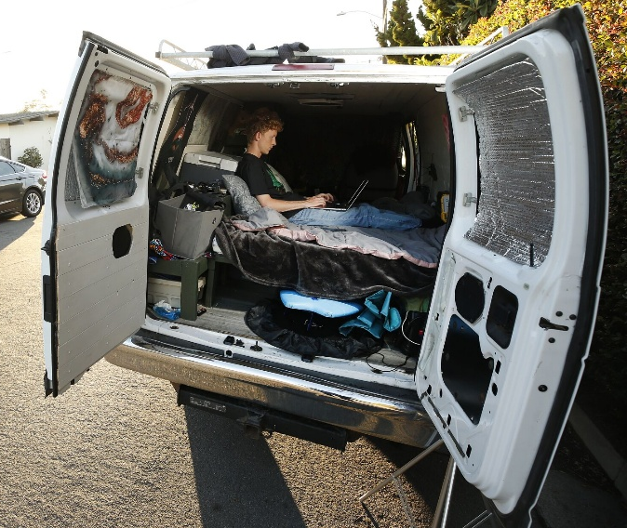
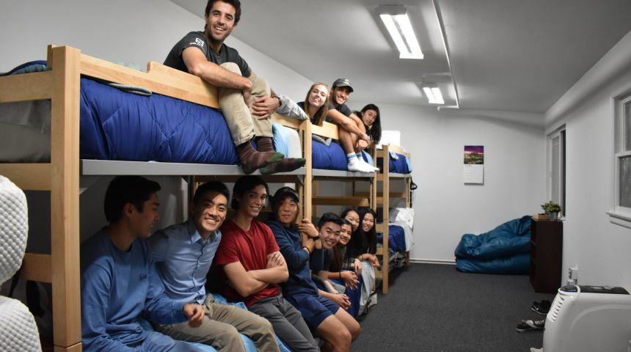
There are teachers and others who care for needy students outside their classrooms.

Slide 130
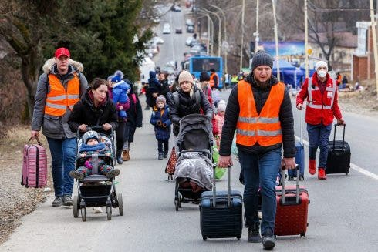
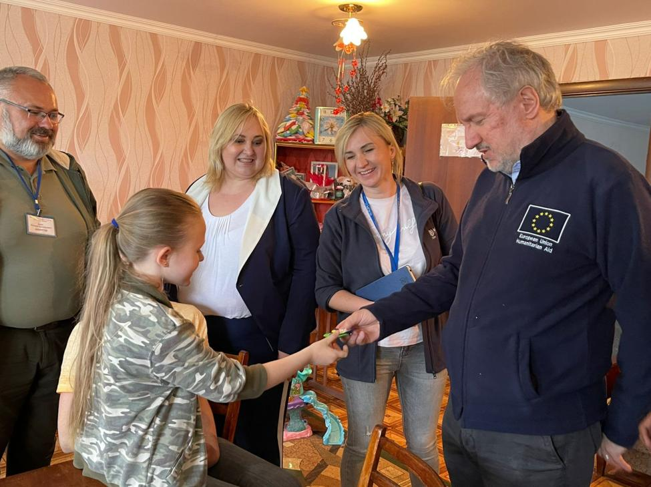
Many European families took in Ukrainian temporary migrants in times of war.

Slide 131

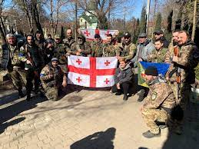
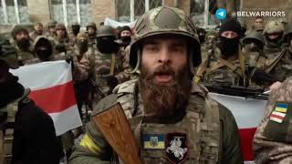
Many foreigners went to Ukraine to resist the Russian invasion.

Slide 132
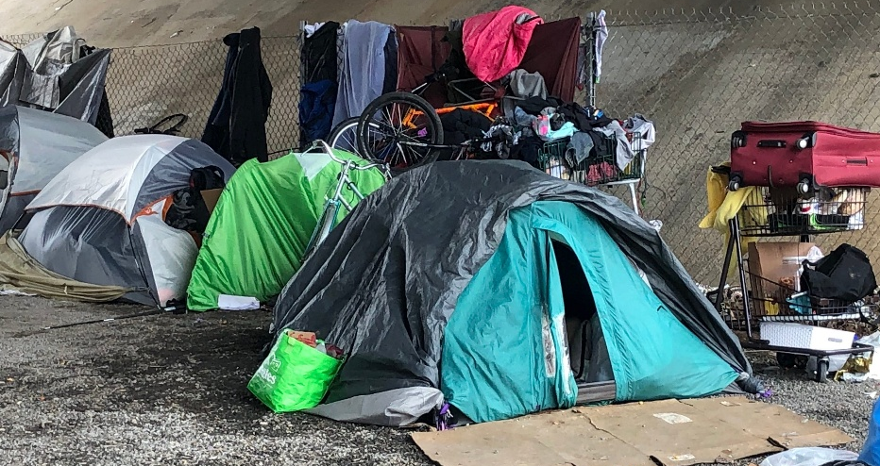
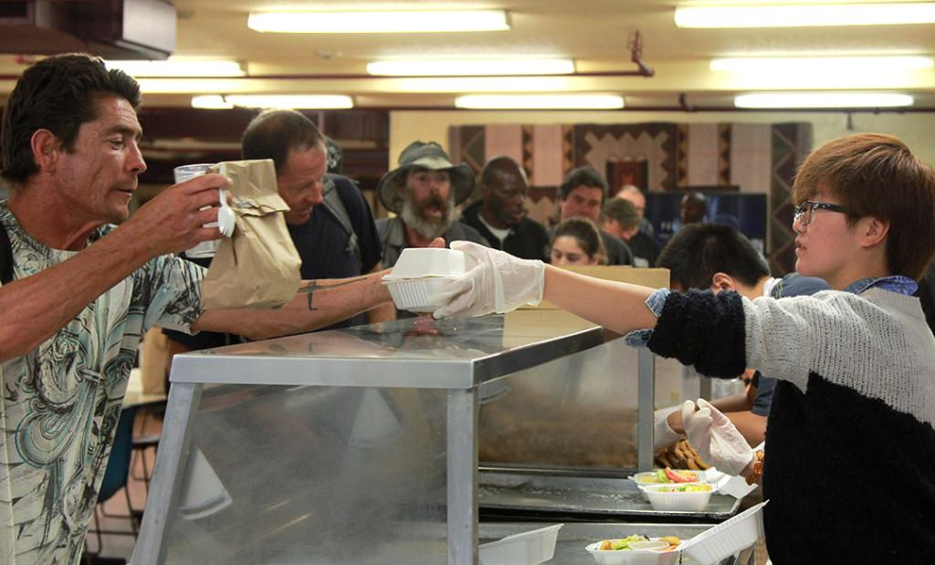
Locally, some people work in homeless shelters and food banks to help the poor.

Slide 133
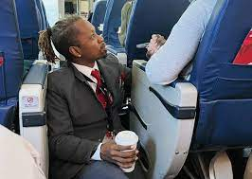
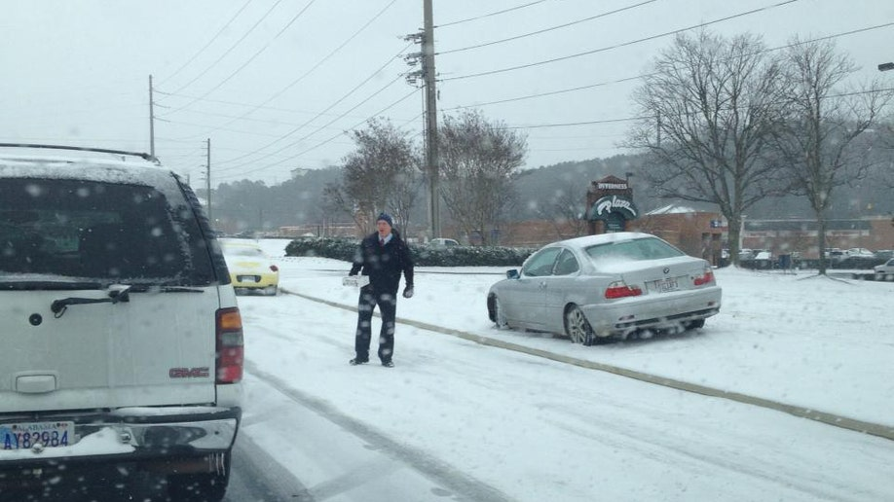
Or simply care for people while doing their everyday jobs.

Slide 134
When you are willing, God will show you ways to serve other people and give you the resources to do so.

Slide 135
Finally, keep each other accountable and tell other Christians when they waste their talents. You are helping them to prepare for eternity.

Slide 136
In conclusion, this parable teaches us many critical lessons:

Slide 137
First, our earthly lives are a testing and training ground for us. We are given talents to start and we work to earn more through our experiences.

Slide 138
What are things you can earn keep forever?
Character
Perspective
Talents/skills
Experience which becomes knowledge & wisdom

Slide 139
Talents/skills
Experience which becomes knowledge & wisdom

Slide 140
These are things we build up and learn on Earth and we can use in eternity.

Slide 141
Second, God judges us by our intent, not our abilities or achievements. We just need to do the best we can based on what we are given.

Slide 142
Third, when we are unable to do as much as what we want for God, we can support others who can do it better and we will share in their output.

Slide 143
Finally, what’s worse is wasting our earthly lives away, or thinking that we can keep it for ourselves. The truth is, you can’t keep it because it’s temporary.

Slide 144
So how do these lessons affect us today?

Slide 145
Ask yourself: Am I doing what I can for God? Or am I wasting my life away, thinking it’s really mine to use as I please?

Slide 146
Our earthly life is a chance to trade the temporary for what’s eternal.

Slide 147
Although not all of us are meant to be ministers, but are you doing what you can to help others and further God’s kingdom?

Slide 148
You also serve God when you serve other people, when you guide them, provide for them, protect them, or heal them.

Slide 149
If you can’t do work for God directly, then support those who can. For instance, make money and donate to support God’s work.

Slide 150
God will reward you for doing what you can. You can share in the fruits of the other laborers when you support them.

Slide 151
Our goal in life should be hearing God’s praise when we finally meet Him:

Slide 152
“Well done, good and faithful servant! You have been faithful with a few things; I will put you in charge of many things. Come and share your master’s happiness!”

Slide 153
Finally, remember our earthly life is tiny and trivial compared to eternity. This parable suggests it’s only a testing and training ground.

Slide 154
Let’s not live in regret and be unable to move forward, for that would be a true failure.

Slide 155
Let’s make sure we are all ready for the real life that matters – the eternal life.
May God bless us all.

