Slide 1
Smooth and
also Prosperous?

Slide 2
Scripture:
Exodus 19:5-6

Slide 3
Now if you obey me fully and keep my covenant, then out of all nations you will be my treasured possession.

Slide 4
Although the whole earth is mine, you will be for me a kingdom of priests and a holy nation.’ These are the words you are to speak to the Israelites.”

Slide 5
Smooth and
also Prosperous?

Slide 6
In 2014, we bought a new Honda CR-V. When we got the new license plate, we were amazed at the plate’s lettering.

Slide 7
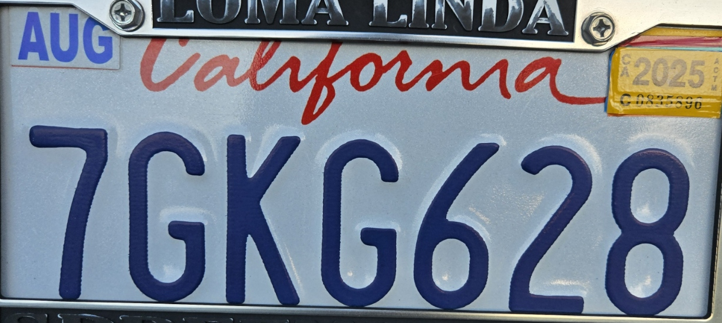

Slide 8
My wife said “628” is a very lucky phrase. It sounded like “Smooth sailing and get a lot of money.”

Slide 9
6 ≈ smooth
2 ≈ and
8 ≈ prosperous / get a big fortune

Slide 10
We all want our lives to be
“Smooth and prosperous.”
The word “smooth” is found in Chinese phrase for “have a good trip”.

Slide 11
Even more amazingly, the first four characters on the license plate perfectly represents our family.

Slide 12
}
7 = 妻 = Wife
G = George
K = Keona
G = Giovanni
6 = 順(利) Smooth
2 = 又 and also
8 = 發(財) Prosperous
我的家庭
My family

Slide 13
A few days later, I was thinking about this while driving. Then a thought came to me.

Slide 14
“You got it wrong. It’s not ‘Smooth and also prosperous (a.).’ It’s supposed to be ‘Obey and then prosper (v.).’

Slide 15
順利 → 順服
Smooth (a.) → Obey (v.)
又 → 而
and also → and then
發 → 發
Prosperous (a.) → Prosper (v.)

Slide 16
6 ≈ smooth obey
2 ≈ and also and then
8 ≈ prosperous (a.) prosper or make a big fortune (v.)

Slide 17
So if we obey God, then we can be prosperous?
Still a very good omen.

Slide 18
Also, because the first character is now a verb, the third character should also be a verb. So “prosperous” (a.) becomes “prosper” (v.).

Slide 19
Bible never said Christian life would be smooth. It does teach us to obey God and His teachings.

Slide 20
If your life is very smooth, then you will not learn the lessons God intends for you to learn.

Slide 21
If your life is very smooth, maybe it’s the devil wishing that you live comfortably and drift away from God.

Slide 22
"The road to hell is a gentle, downward slope so you feel comfortable and would keep going."

Slide 23
God will use people around you to help you learn. All your conflicts, suffering, difficulties are all lessons for you.

Slide 24
As Christians, we can have peace and joy even amid our difficulties because we know they will ultimately benefit us.

Slide 25
Because all these are lessons for us that make us better Christians and prepare us for eternity.

Slide 26
For instance, some people believe that one’s goal is to find the ideal spouse and live happily ever after.

Slide 27
In reality, the ideal spouse is one who can stay with you and support each other to get through life’s difficulties.

Slide 28
Remember the wedding vow? “I take you to be my wedded wife, to have and to hold, from this day forward,
for better or for worse, in sickness and in health, to love and to cherish, until we are parted by death."

Slide 29
for better or for worse, in sickness and in health, to love and to cherish, till death do us part."

Slide 30
It didn’t say I’ll love you only when you are pretty, rich, healthy, and fun to be with.

Slide 31
Why do we see so many divorces? In many cases, we made our love conditional.

Slide 32
You will find out that your spouse is not perfect. Your spouse and all the conflicts you two have are helping you grow as a Christian.

Slide 33
When I was young, I once asked a wise minister, “How do I know who is the spouse God has prepared for me?”

Slide 34
He asked, “Why do you think God would tell you?”

Slide 35
He was older and wiser to know that the process of finding a mate and sustaining the marriage are all part of God’s plan for us.

Slide 36
Once I heard that a marriage has three “rings”: engagement ring, wedding ring, and suffering.

Slide 37
The most important ring may be the suffering because that’s what shows your love for each other is genuine.

Slide 38
Anyone can buy expensive diamonds and rings, but not all can stay true and together during difficulties and conflicts.

Slide 39
I believe there’s another “ring” – “learning”. All the sufferings, conflicts, and problem-solving are there to help us grow.

Slide 40
“Learning” is why we are here on Earth. If you have more difficulties in life, you actually learn more and hopefully become wiser and maturer.

Slide 41
Everything in life is there to help you grow. So being “prosperous” does not seem like a major part of God’s plan for us.

Slide 42
When I was preparing this sermon for the first time, a thought came to me that I may have gotten the meaning of the last character “fa” wrong also.

Slide 43
The character “fa” does not mean “make big fortune.” It only means “to begin.”

Slide 44
So what does “fa” (發) really mean?
To start
To take action or make happen

Slide 45
發動: To start
發出: To issue
發表，發言: To express
發展，開發: To develop
發生: To happen
https://dictionary.writtenchinese.com/#sk=%E7%99%BC&svt=pinyin

Slide 46
Smooth → Obey
and → and then
Prosperous → start

Slide 47
If you obey God, then you can start to do what God wants you to do…

Slide 48
What should Christians obey?

Slide 49
1. God’s revealed word to all – Bible (logos)

Slide 50
2. God’s personal word, guidance, or revelation to you (rhema).

Slide 51
3. Your character (ethos), conscience, passion, responsibilities, etc.

Slide 52
What is the meaning “and then”? It implies causality, or at least some sort of sequence.

Slide 53
Smooth (a.) → Obey (a.)
and → therefore/thus/
and then (you can)…
prosperous (a.) → start (v.)

Slide 54
To start what? I believe it is to start living properly and doing God’s work using the resources He has given us.

Slide 55
Living properly – living the Christian lifestyle He has intended for us.

Slide 56
The most important Christian concept is “love.”

Slide 57
1 Corinthians 13:4-8a -
Love is patient, love is kind. It does not envy, it does not boast, it is not proud.
It does not dishonor others, it is not self-seeking, it is not easily angered, it keeps no record of wrongs. 6 Love does not delight in evil but rejoices with the truth. 7 It always protects, always trusts, always hopes, always perseveres. ove never fails.

Slide 58
It does not dishonor others, it is not self-seeking, it is not easily angered, it keeps no record of wrongs.

Slide 59
Love does not delight in evil but rejoices with the truth. It always protects, always trusts, always hopes,
always perseveres.

Slide 60
Galatians 5:22-23 -
But the fruit of the Spirit is love, joy, peace, forbearance, kindness, goodness, faithfulness,
gentleness and self-control. Against such things there is no law.

Slide 61
gentleness and self-control. Against such things there is no law.

Slide 62
Micah 6:8 -
He has shown you, O mortal, what is good.
And what does the Lord require of you?
To act justly and to love mercy
and to walk humbly[a] with your God.

Slide 63
To act justly and to love mercy and to walk humbly with your God.

Slide 64
What’s God’s work? Use the resources He has given us to love others and spread the Gospel.

Slide 65
What has God given us so that we can do His work?

Slide 66
Time: Luke 19
Talents: Matthew 25
Treasures: Luke 16

Slide 67
God wants us to use our time, talent, and treasure to do His work.

Slide 68
Our earthly life is a test and a training ground. God uses it to evaluate our hearts and train us for eternity.

Slide 69
Our earthly life is short and not ours to keep. Once it’s over, it’s gone. But you can earn eternal life with it.

Slide 70
We are born with some talents, and we can learn more. We get to keep both innate and learned talents for use in eternity.

Slide 71
Our earthly treasures are not really ours. We are just entrusted with them. God will give us real treasures based on how we use earthly treasures.

Slide 72
How we use our time, talents, and treasures will determine if we get great responsibilities and real treasures in eternity.

Slide 73
So don’t focus on amassing earthly wealth. Instead, focus on living for God and gaining eternal responsibilities and true wealth.

Slide 74
"He is no fool who gives what he cannot keep to gain that which he cannot lose.”
– Jim Elliot

Slide 75
We are not slaves to God. We always have the choice to follow Him or not.

Slide 76
Goal of Christians: Stay faithful, love God and love others. Then we can rule with the Lord.

Slide 77
Heard the
Gospel
Never
Victorious Christians, sit/rule with God
?
Continue to be true Christians
“To the one who is victorious, I will
give the right to sit with me on my throne…” --Rev 3:21
Yes
Believe Jesus died for sinners, repent, and accept as Savior
Accept Jesus
as Lord
and Savior
… but not continue to be faithful disciples -- “hard to be saved” (merely saved) – 1 Peter 4:18
Merely saved,
avoids hell
Hell/eternal separation from God
Decide not to accept Jesus
“whoever does not believe stands condemned already because they have
not believed in the name of God’s one and only Son.” -- John 3:18

Slide 78
This is the story of Abraham, the father of the Judeo-Christian faith:

Slide 79
God told him to leave the land of false gods and go to a promised land far away.

Slide 80
Because of his initial obedience, he embarked on a life of faith and altered the history of the world.

Slide 81
Once he tried to achieve God’s promise with his own method -- getting a son through a servant.

Slide 82
That son, Ishmael, supposedly became the forefather of Arabs, and the conflict with Abraham’s other descendants continues to this day.

Slide 83
Since there was no Bible at the time, God spoke to Abraham directly and he followed the rhema from God.

Slide 84
1. God’s revealed word to all – the Bible (logos)
2. God’s personal word, guidance, or revelation (rhema)
3. Your conscience (ethos), passion, responsibilities, etc.

Slide 85
The story of Joseph showed the importance of following your conscience and principles.

Slide 86
He refused to commit adultery with his boss’s wife and was put in jail because of it.

Slide 87
Due to his time in jail, he had the opportunity to interpret Pharaoh’s dreams and became the savior of Egypt.

Slide 88
Joseph must have wondered where’s God when he was sold and when he was in jail. But he did not lose his faith.

Slide 89
Later, when he had the chance to take revenge on his brothers, he treated them with mercy instead.

Slide 90
He not only saved the Israeli civilization, but the Egyptian civilization as well. He also changed world history.

Slide 91
1. God’s revealed word to all – the Bible (logos)
2. God’s personal word, guidance, or revelation (rhema)
3. Your conscience (ethos), passion, responsibilities, etc.

Slide 92
Without the faithfulness of Abraham and Joseph, there would be no Israeli civilization and Christianity today.

Slide 93
Hayao Miyazaki’s anime Naussica and the Valley of the Wind tells a very similar story.

Slide 94
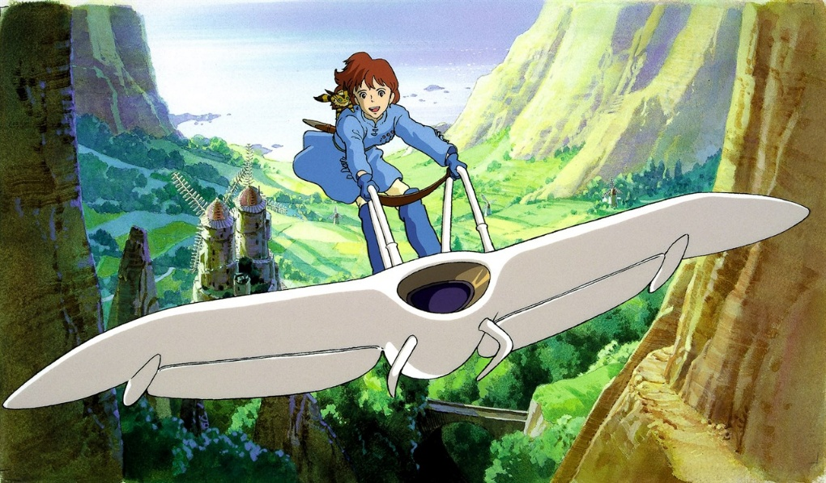
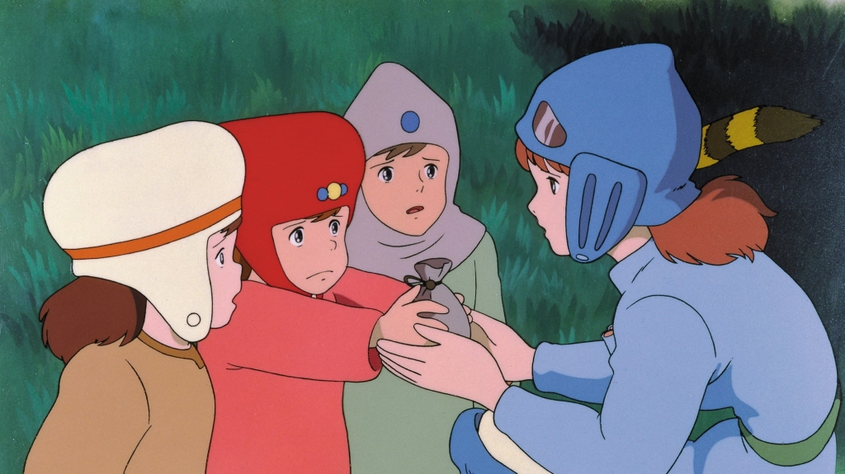
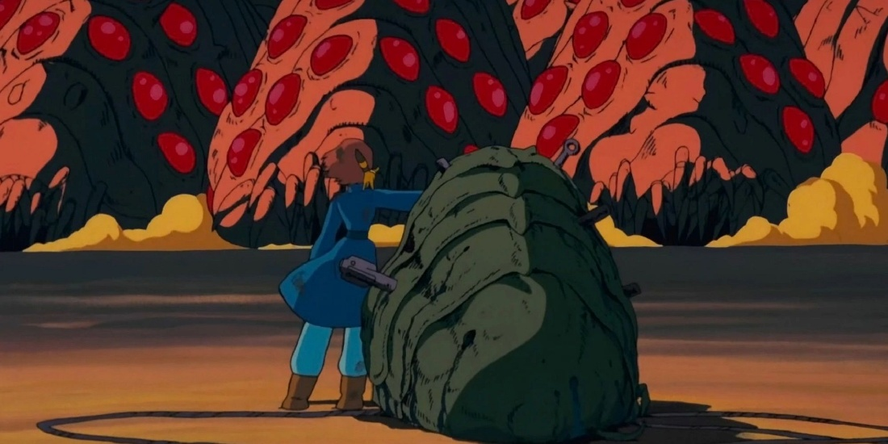
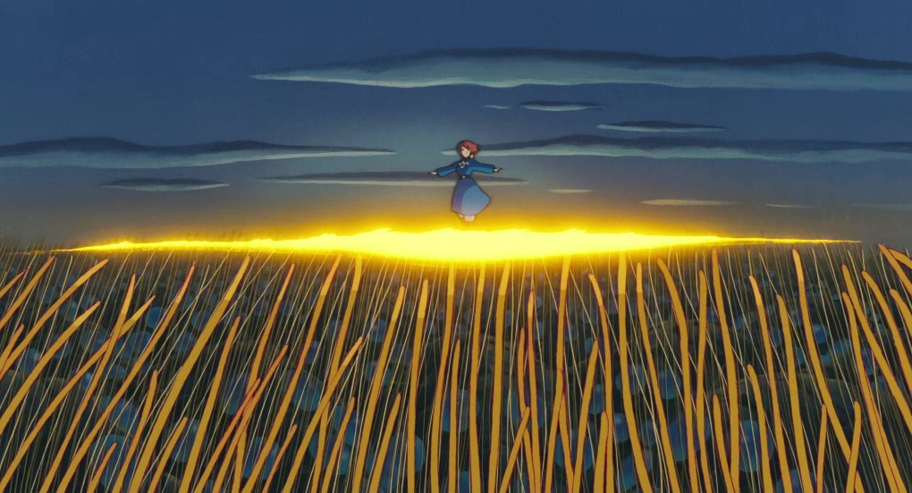

Slide 95
Naussica just did what she felt needed to be done, and ended up saving her village and the whole world.

Slide 96
Daniel was a royal boy in exile and made to serve a foreign king who conquered his homeland.

Slide 97
He faithfully fulfilled his duties and didn’t disobey God’s commandments even when it threatened his life.

Slide 98
Because of his faithfulness to his God and people, God gave him the greatest prophecies in the Bible.

Slide 99
The Book of Daniel detailed the history of the Mediterranean and the Middle East, the coming of the Messiah, and the end of the world.

Slide 100
It is perhaps the greatest proof that the Bible is divinely inspired. It also shows us that God is in control of history.

Slide 101
Daniel upheld his principles and continued to fulfill his duties. His faithfulness would later help Israelis return to their Promised Land.

Slide 102
1. God’s revealed word to all – the Bible (logos)
2. God’s personal word, guidance, or revelation (rhema)
3. Your conscience (ethos), passion, responsibilities, etc.

Slide 103
Are you ready to obey and follow God and do something great for Him with your life?

Slide 104
First things first: Study the Bible (logos) and get an idea of what that commitment may entail.

Slide 105
Once you have decided, tell the Lord that you want to make that commitment. It may be a very difficult road.

Slide 106
Then, ask the Lord to show you the way (rhema). It may not be obvious. It may even look ridiculous from the world’s perspective.

Slide 107
Sometimes a door opens but it’s not from God. Remember: opportunities do not imply God’s guidance or permission.

Slide 108
Stay faithful even when you fail or encounter difficulties. Follow God’s teachings (logos) and don’t give up.

Slide 109
If you don’t have guidance from God (rhema) yet, just continue to follow His word (logos) and fulfill your principles (ethos) and responsibilities.

Slide 110
Following God is a long journey. We can begin by obeying His teachings (logos), guidance (rhema), and our principles and beliefs (ethos).

Slide 111
So now, let’s begin
(“發” “fa”)!

