Slide 1
The Mystery of the Washing Machine

Slide 2
Scripture:
Isaiah 1:16-18

Slide 3
“Wash and make yourselves clean. Take your evil deeds out of my sight; stop doing wrong. Learn to do right; seek justice.

Slide 4
Defend the oppressed. Take up the cause of the fatherless; plead the case of the widow.” “Come now, let us settle the matter,” says the Lord.

Slide 5
“Though your sins are like scarlet, they shall be as white as snow; though they are red as crimson, they shall be like wool.”

Slide 6
The Mystery of the Washing Machine

Slide 7
Jesus frequently taught using parables. The parables could seem very simple, but there are timely deep meanings for those who seek.

Slide 8
Sometimes we hear very good modern analogies that can also teach us a lot about various Christian issues.

Slide 9
I once heard that the church is like a washing machine, and Christians are all dirty clothes trying to be clean.

Slide 10
Then one day God impressed me to study this allegory from a scientific perspective, and I learned a lot of truth from doing it.

Slide 11
The problem with washing: water and grease don’t mix.
Polar molecules tend to stick together and thus resist mixing with nonpolar molecules.

Slide 12
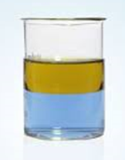
Water and oil don’t mix
Oil
Water

Slide 13
So how to make oil and water mix together so oil can be removed with water is the key to cloth washing.

Slide 14
We are like dirty clothing choosing to be clean and so we go into the washing machine = becoming Christians and going to church to learn and grow.

Slide 15
The process of washing dirty clothes represents the growth of Christians.

Slide 16
This modern allegory involves steps, things used, and chemical reactions involved in cloth washing:
1. Dirty clothes: people
2. Water: Holy Spirit

Slide 17
3. Cleaning chemicals – detergent, bleach, and softeners: God’s word and our prayers
4. Washer: the Church
5. Dryer: Our surroundings

Slide 18
1. Washing machine is filled with water, detergent and bleach: Church needs the Holy Spirit and God’s word.

Slide 19
Detergent: a surfactant that reduces surface tension so water can enter into the spaces in clothing and help grease stick to water molecules.

Slide 20
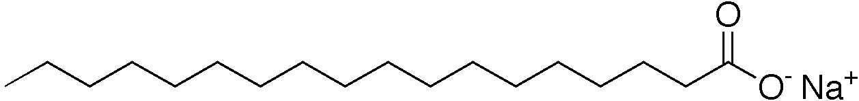
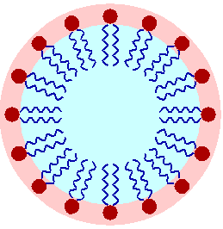
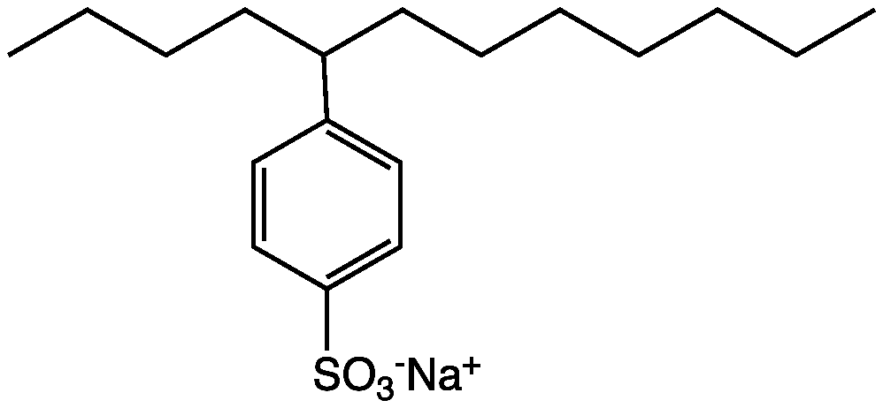
Surfactant

Slide 21
Think of water and oil as two different kinds of Velcro. Surfactant is like a thing with one type on each side so it can stick to both kinds.

Slide 22
Dirty stuff on clothes are visible because they have molecules that show us colors that are different from the ones on the clothes.

Slide 23
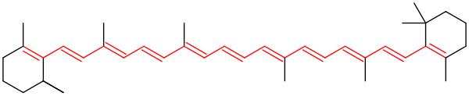
Chromophore - The part of a molecule that gives its colors

Slide 24
Bleach: breaks the double bonds in chromophores and kills germs.

Slide 25
2. When we put dirty clothes in washer, we should not pack them tightly so they can all come in contact with water and detergents.

Slide 26
3. As the washer turns, clothes rub against each other. This helps the chemicals to reach the grease and do their work of breaking and removing them.

Slide 27
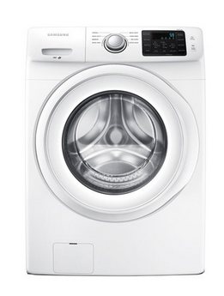
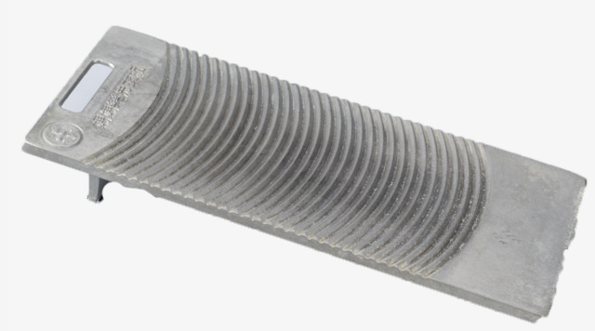
Washer Washing
board

Slide 28
4. When water is drained, it takes away grease. Please rinse a few times to get rid of all grease and dirt. We need the Holy Spirit to constantly cleanse us.

Slide 29
This is why you see the “Extra Rinse Cycle” option on at-home washing machines. Always use that option.

Slide 30
5. When the washing process is almost done, add in the softener.

Slide 31
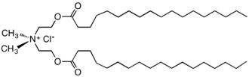
Softener is a cationic surfactant

Slide 32
Softeners: spread cations on the clothes. This reduces static electricity and make the clothes feel softer.

Slide 33
The softening must be done near the end of the washing process. That’s why there is a separate liquid holder for softeners.

Slide 34
God can change our hearts to be more merciful, humble, pure, etc. It’s hard for us to do ourselves.

Slide 35
Eze. 11:19 - I will give them an undivided heart and put a new spirit in them; I will remove from them their heart of stone and give them a heart of flesh.

Slide 36
Softener and detergent do not work together well, and so softener is put in at the end.

Slide 37
Removing sin is painful, and softener is like healing after the pain.

Slide 38
In the first seven beatitudes, we first get rid of sin (1-2), then soften our hearts (3-6), which prepares us to love others & spread the Gospel (7).

Slide 39
The Beatitudes | Christians’ Behaviors
1. Be spiritually needy | Don’t be arrogant
2. Mourning over sin | Don’t hurt others
3. Meek / gentle | Don’t oppress others
4. Hunger for God | Don’t sought worldly things excessively
5. Be merciful | Be kind to others
6. Have a pure heart | With right motives
7. Be a peacemaker: restore relationships | Then you can reduce conflict among people

Slide 40
Use detergent and bleach to clean the clothes = get rid of sin (1-2)
Use softener to make clothes softer = soften our hearts (3-6)

Slide 41
6. Using a dryer to get rid of moisture. Our trials and difficulties help us grow and learn to deal with things of the world. This is the 8th beatitude.

Slide 42
Dryer sheets release more softeners in the dryer. They help soften clothes and reduce the drying time. Our learning time can be shorter if we have the right hearts.

Slide 43
Sometimes Christians and non-Christians are hurt by others at church…
The rubbing of clothes helps detergent reach dirt and get rid of them.

Slide 44
Proverbs 27:17 -
As iron sharpens iron, so one person sharpens another.

Slide 45
God’s purpose is to help us get rid of our sinful nature and get a new heart.

Slide 46
To do this, He uses imperfect people in church and adds in His Holy Spirit, word, and timely healing.

Slide 47
This is the mystery of the washing machine.
The process is painful but necessary.

Slide 48
What happens if you are not “clean enough” at the time of judgment?

Slide 49
Revelation 19:8 – Fine linen, bright and clean, was given to the saints to wear. (Fine linen stands for the righteous acts of God’s holy people.)

Slide 50
Grace and righteousness come from the substitutionary atonement of Jesus. Substitutionary atonement is someone sacrificed on your behalf.

Slide 51
John 3:16 – For God so loved the world that He gave His one and only Son, that whoever believes in Him shall not perish but have eternal life.

Slide 52
Even if you are still not perfect when you finally face God, thanks to Jesus’s substitutionary atonement on your behalf, you will be “perfect” in God’s eyes.

Slide 53
But your heart and your work for God and others on Earth will determine your role in Heaven.

Slide 54
Non-Christians:
Do you think you are clean?

Slide 55
Do you think you are better than most Christians you see?

Slide 56
The truth is, none of us are good enough. It is through the grace and sacrifice of Jesus that we can be righteous before God.

Slide 57
Christians:
Are you willing to be washed?

Slide 58
Have you been hurt by other Christians at church? The washing process is painful but necessary.

Slide 59
If you have been hurt by other Christians at church…
Need to learn to forgive

Slide 60
Talk to them, and try to restore the relationship with them.

Slide 61
Remember: God will use those who hurt you to help you grow, to become the vessel He wants you to be.

Slide 62
Remember that they are learning and will be cleaner.

Slide 63
Ezekiel 36:26 - I will give you a new heart and put a new spirit in you; I will remove from you your heart of stone and give you a heart of flesh.

Slide 64
May we all be washed and softened so we are clean by the time we see our Lord in heaven.

Slide 65
May God bless you all.

