Slide 1
洗衣機的奧秘

Slide 2
讀經:
以賽亞書 1:16-18

Slide 3
「你們要洗濯, 自潔, 從我眼前除掉你們的惡行。要止住作惡,學習行善, 尋求公平, 解救受欺壓的, 給孤兒申冤, 為寡婦辨屈。」

Slide 4
耶和華說 :「你們來, 我們彼此辯論。你們的罪雖像朱紅, 必變成雪白; 雖紅如丹顏, 必白如羊毛。」

Slide 5
洗衣機的奧秘

Slide 6
耶穌常用比喻 (parables) 來教導大眾及門徒。這些比喻可以用很簡單的解釋，但在適合時也可有更深入的理解。
Notes:
Jesus gave parables that are simple and have meaning to most people, but for those who pursue God, he will reveal deeper meanings. Sometimes, true meanings really come out when you study several parables and combine the meanings.
In our lives, God will also use things around you to teach you necessary lessons. The key is to have a receptive heart so the lessons can be seen.

Slide 7
有時我們也會聽到一些非常好的現代比喻。它們也可以教我們很多關於各種基督教的知識。
Notes:
Jesus gave parables that are simple and have meaning to most people, but for those who pursue God, he will reveal deeper meanings. Sometimes, true meanings really come out when you study several parables and combine the meanings.
In our lives, God will also use things around you to teach you necessary lessons. The key is to have a receptive heart so the lessons can be seen.

Slide 8
我曾經聽過基督的教會就像一台洗衣機。基督徒都是想要被洗乾淨的髒衣服。
Notes:
Jesus gave parables that are simple and have meaning to most people, but for those who pursue God, he will reveal deeper meanings. Sometimes, true meanings really come out when you study several parables and combine the meanings.
In our lives, God will also use things around you to teach you necessary lessons. The key is to have a receptive heart so the lessons can be seen.

Slide 9
後來有一天，神感動我用科學的角度來研究這個比喻。我從中學到了很多的真理。
Notes:
Jesus gave parables that are simple and have meaning to most people, but for those who pursue God, he will reveal deeper meanings. Sometimes, true meanings really come out when you study several parables and combine the meanings.
In our lives, God will also use things around you to teach you necessary lessons. The key is to have a receptive heart so the lessons can be seen.

Slide 10
洗衣服的問題: 水和油性污垢不能混合或黏在一起。極性分子會互相吸引因而抵制與其他非極性分子混合。

Slide 11

水和油性污垢不混合或黏在一起
油
水

Slide 12
那麼如何讓油和水充分混合，從而用水去除油污，是洗衣服的關鍵。

Slide 13
我們就像骯髒的衣服選擇想成為乾淨，所以我們進入洗衣機 = 成為基督徒，去教會學習及成長。

Slide 14
洗衣服的步驟意表了基督徒成長的過程。

Slide 15
這個現代的比喻涉及洗衣服時用的步驟、物品、及有關的化學反應:
1. 髒衣服: 人 / 基督徒
2. 水: 聖靈 - 賽 44:3

Slide 16
3. 化學品 - 洗衣精，漂白劑，柔軟劑等:
神的話語，禱告
4. 洗衣機: 基督的教會
5. 烘乾機: 我們的環境

Slide 17
1. 洗衣機裡裝滿了水、洗衣精和漂白劑 – 教會需要有聖靈及神的話。

Slide 18
洗衣精: 一種表面活性劑, 可降低表面張力, 因此水可穿過衣服上的孔洞並幫助污垢分子粘附在水分子上。

Slide 19

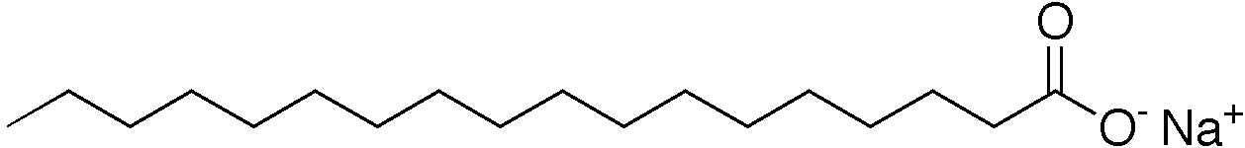
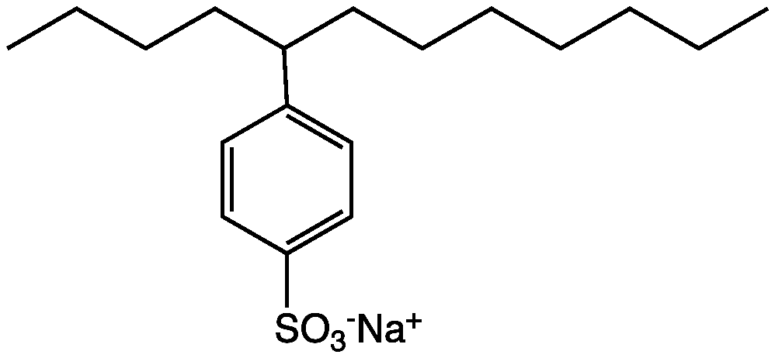
表面活性劑 (surfactant)

Slide 20
水和油就像兩種不同類型的維克羅 (Velcro)。 表面活性劑就像一個兩種都有的一個東西, 因此可以同時使用兩種類型的維克羅 .
Notes:
Jesus gave parables that are simple and have meaning to most people, but for those who pursue God, he will reveal deeper meanings. Sometimes, true meanings really come out when you study several parables and combine the meanings.
In our lives, God will also use things around you to teach you necessary lessons. The key is to have a receptive heart so the lessons can be seen.

Slide 21
衣服上的髒東西是可見的，因為它們的分子給我們看到的顏色與衣服上的顏色不同。
Notes:
Jesus gave parables that are simple and have meaning to most people, but for those who pursue God, he will reveal deeper meanings. Sometimes, true meanings really come out when you study several parables and combine the meanings.
In our lives, God will also use things around you to teach you necessary lessons. The key is to have a receptive heart so the lessons can be seen.

Slide 22
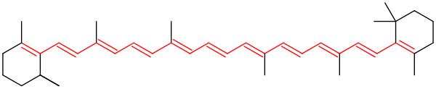
發色團 - 分子的一部分，給出了它的顏色。

Slide 23
漂白劑: 破壞發色團或減少發色團的雙鍵(double bonds)，殺死細菌。
Notes:
Jesus gave parables that are simple and have meaning to most people, but for those who pursue God, he will reveal deeper meanings. Sometimes, true meanings really come out when you study several parables and combine the meanings.
In our lives, God will also use things around you to teach you necessary lessons. The key is to have a receptive heart so the lessons can be seen.

Slide 24
2. 放入骯髒的衣服 –
應該鬆開放置，不要擠在一起。需要能盡量與水接觸。
Notes:
Jesus gave parables that are simple and have meaning to most people, but for those who pursue God, he will reveal deeper meanings. Sometimes, true meanings really come out when you study several parables and combine the meanings.
In our lives, God will also use things around you to teach you necessary lessons. The key is to have a receptive heart so the lessons can be seen.

Slide 25
3. 開動洗衣機 – 水的流動和衣物之間的摩擦有助於漂白劑及洗衣精接觸污垢並進行破壞及黏走污垢的工作。
Notes:
Conflicts, difficulties, and suffering are part of the growing and learning process. It’d help us become better Christians.

Slide 26
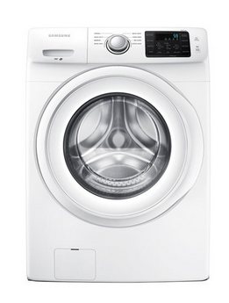
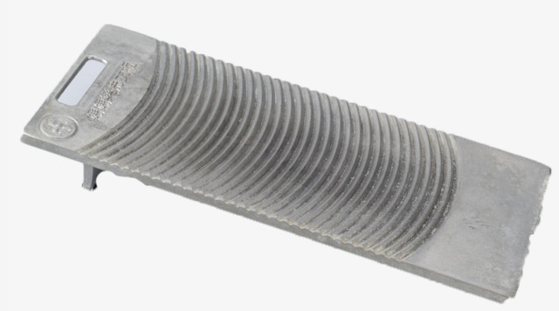
洗衣機 洗衣板

Slide 27
4. 當水被排出時，它會帶走污垢。 請多做幾次: 我們需要聖靈不斷的流入來潔淨我們。

Slide 28
這就是為什麼會在洗衣機上有「額外沖洗」的選項。 我建議你都要使用該選項。
Notes:
Jesus gave parables that are simple and have meaning to most people, but for those who pursue God, he will reveal deeper meanings. Sometimes, true meanings really come out when you study several parables and combine the meanings.
In our lives, God will also use things around you to teach you necessary lessons. The key is to have a receptive heart so the lessons can be seen.

Slide 29
5. 在快結束時添加軟化劑。

Slide 30
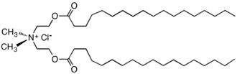
軟化劑是一種陽性表面活性劑

Slide 31
軟化劑讓陽離子(cation) 散佈在衣服上來減少靜電，讓衣服感覺軟一點
Notes:
Jesus gave parables that are simple and have meaning to most people, but for those who pursue God, he will reveal deeper meanings. Sometimes, true meanings really come out when you study several parables and combine the meanings.
In our lives, God will also use things around you to teach you necessary lessons. The key is to have a receptive heart so the lessons can be seen.

Slide 32
軟化必須在接近結束時完成。這就是為什麼有一個單獨放軟化劑的地方。
Notes:
Jesus gave parables that are simple and have meaning to most people, but for those who pursue God, he will reveal deeper meanings. Sometimes, true meanings really come out when you study several parables and combine the meanings.
In our lives, God will also use things around you to teach you necessary lessons. The key is to have a receptive heart so the lessons can be seen.

Slide 33
神可以改變人的心靈: 亙慈悲，謙卑，純潔…
人們自己卻很難做到。

Slide 34
以西結11:19 - 我要使他們有合一的心，也要將新靈放在他們裡面，又從他們肉體中除掉石心，賜給他們肉心。

Slide 35
軟化劑和洗衣精不能很好地共處，所以要在最後才加入。

Slide 36
消除罪惡的過程是痛苦的; 柔軟劑有點像治療。

Slide 37
在八福中的前七福, 要先先去除罪 (1,2), 然後軟化心 (3-6),才能準備基督徒去愛其他人並傳播福音 (7) 。

Slide 38
前七福 | 基督徒的行動
1.心靈貧窮 | 不驕傲、自垮
2.為罪而哀慟 | 不犯罪害人
3.溫柔(謙和) | 不去打壓別人
4.飢渴慕義 | 不追求世上之物
5.憐憫他人 | 體諒別人
6.純潔的心 | 沒有不對的動機
7.締造和平 | 恢復與神與人的關係

Slide 39
除罪 (1,2) = 用洗衣精和漂白劑來洗衣服
軟化心 (3-6) = 用柔軟劑讓衣服變比較軟

Slide 40
6. 用烘乾機去除水分 -- 試驗和困難 -- 幫助我們進一步成長。(第八福)
Notes:
Difficulties in life and our growth in God should further soften our hearts and make us more Christ-like.

Slide 41
乾燥片釋放更多的柔軟劑,使衣服更柔軟並減少干燥所需的時間。如果我們有正確的心, 我們學習的時間可以縮短一點。
Notes:
Difficulties in life and our growth in God should further soften our hearts and make us more Christ-like.

Slide 42
基督徒和非基督徒在教會裡有時會受到傷害…
衣物的摩擦有助於清潔劑接觸污垢並進行黏走污垢的工作。
Notes:
You may fee you are being hurt, but you’ll be cleaner as a result.

Slide 43
箴言 27:17 -
鐵磨鐵，磨出刃來，
朋友相感也是如此。

Slide 44
神的目的是幫助我們擺脫罪惡的本性並獲得新的心。

Slide 45
為了做到這一點，祂會用教會中不完美的人，並加入他的聖靈，言語和及時的醫治。

Slide 46
這就是洗衣機的奧秘。雖然這個過程有時會很痛苦，但這是必要的。
Notes:
Jesus gave parables that are simple and have meaning to most people, but for those who pursue God, he will reveal deeper meanings. Sometimes, true meanings really come out when you study several parables and combine the meanings.
In our lives, God will also use things around you to teach you necessary lessons. The key is to have a receptive heart so the lessons can be seen.

Slide 47
最終審判時，你還不夠潔白怎麼辦?

Slide 48
啟示錄 19:8 -
聖徒就蒙恩得穿光明潔白的細麻衣。這細麻衣就是聖徒所行的義。
Notes:
Righteousness comes from God. Our willingness to come to God and be washed determine what we’ll get and do in the eternity.

Slide 49
恩典和義是來自於耶穌基督的替代贖罪:
替代贖罪就是有人為你犧牲。

Slide 50
約翰 3:16 – 神愛世人，甚至將他的獨生子賜給他們，叫一切信他的不致滅亡，反得永生。

Slide 51
即使你最終面對神的時候仍然不是完美的，但因耶穌為了你的替代贖罪的犧牲，神會看你是完美的。

Slide 52
但是你的心和你在地球上對神和他人的服事將決定你在天堂中的角色
。

Slide 53
提醒非基督徒們:
你認為你潔白嗎?

Slide 54
你認為你比大部分的基督徒好嗎?

Slide 55
老實說, 我們都不夠好。我們要藉著耶穌的恩典和犧牲，我們才能在神面前稱義。
Notes:
Jesus gave parables that are simple and have meaning to most people, but for those who pursue God, he will reveal deeper meanings. Sometimes, true meanings really come out when you study several parables and combine the meanings.
In our lives, God will also use things around you to teach you necessary lessons. The key is to have a receptive heart so the lessons can be seen.

Slide 56
基督徒們:
你有願意被洗嗎?

Slide 57
你在教會因其他基督徒受傷了嗎？ 洗衣的過程是痛苦的但是是必須的。

Slide 58
如果你因其他基督徒而在教會受了傷…
要學會原諒

Slide 59
與他們溝通，試著恢復與他們的關係。

Slide 60
請記住: 神會用那些傷害你的人幫助你成長，讓你成為祂希望你所變成的器皿。

Slide 61
要記得他們也正在學習並且會變的更清潔。

Slide 62
以西結 36:26 –
我也要賜給你們一個新心,將新靈放在你們裡面, 又從你們的肉體中除掉石心,賜給你們肉心。

Slide 63
願我們都被洗滌和軟化,這樣當我們在天堂見到我們的主時我們就已是乾淨的了。
Notes:
Jesus gave parables that are simple and have meaning to most people, but for those who pursue God, he will reveal deeper meanings. Sometimes, true meanings really come out when you study several parables and combine the meanings.
In our lives, God will also use things around you to teach you necessary lessons. The key is to have a receptive heart so the lessons can be seen.

Slide 64
願神祝福各位。
Notes:
Jesus gave parables that are simple and have meaning to most people, but for those who pursue God, he will reveal deeper meanings. Sometimes, true meanings really come out when you study several parables and combine the meanings.
In our lives, God will also use things around you to teach you necessary lessons. The key is to have a receptive heart so the lessons can be seen.

