Slide 1
5th Beatitude: Mercy

Slide 2
Scripture
Matthew 18:23-35
The Unmerciful Servant

Slide 3
Jesus said, “Therefore, the kingdom of heaven is like a king who wanted to settle accounts with his servants. As he began the settlement, a man who owed him ten thousand bags of gold was brought to him.
Since he was not able to pay, the master ordered that he and his wife and his children and all that he had be sold to repay the debt.
“At this the servant fell on his knees before him. ‘Be patient with me,’ he begged, ‘and I will pay back everything.’ The servant’s master took pity on him, canceled the debt and let him go.
“But when that servant went out, he found one of his fellow servants who owed him a hundred silver coins. He grabbed him and began to choke him. ‘Pay back what you owe me!’ he demanded.
“His fellow servant fell to his knees and begged him, ‘Be patient with me, and I will pay it back.’
“But he refused. Instead, he went off and had the man thrown into prison until he could pay the debt. When the other servants saw what had happened, they were outraged and went and told their master everything that had happened.
“Then the master called the servant in. ‘You wicked servant,’ he said, ‘I canceled all that debt of yours because you begged me to. Shouldn’t you have had mercy on your fellow servant just as I had on you?’ In anger his master handed him over to the jailers to be tortured, until he should pay back all he owed.
“This is how my heavenly Father will treat each of you unless you forgive your brother or sister from your heart.”
Matthew 18:23-35

Slide 4
Since he was not able to pay, the master ordered that he and his wife and his children and all that he had be sold to repay the debt.

Slide 5
“At this the servant fell on his knees before him. ‘Be patient with me,’ he begged, ‘and I will pay back everything.’ The servant’s master took pity on him, canceled the debt and let him go.

Slide 6
“But when that servant went out, he found one of his fellow servants who owed him a hundred silver coins. He grabbed him and began to choke him. ‘Pay back what you owe me!’ he demanded.

Slide 7
“His fellow servant fell to his knees and begged him, ‘Be patient with me, and I will pay it back.’
“But he refused. Instead, he went off and had the man thrown into prison until

Slide 8
he could pay the debt. When the other servants saw what had happened, they were outraged and went and told their master everything that had happened.

Slide 9
“Then the master called the servant in. ‘You wicked servant,’ he said, ‘I canceled all that debt of yours because you begged me to. Shouldn’t you have had mercy on your fellow servant just as I had on you?’

Slide 10
In anger his master handed him over to the jailers to be tortured, until he should pay back all he owed.

Slide 11
“This is how my heavenly Father will treat each of you unless you forgive your brother or sister from your heart.”

Slide 12
5th Beatitude: Mercy

Slide 13
One of the most important teachings of Jesus is the “Beatitudes” found in Matthew 5:2-12, also known as the
“Sermon on the Mount”.
Notes:
English: “poor in spirit” These are people who know their spiritual needs and they cannot satisfy God on their own. These people cry out to God and will get what they ask for.
Most religion: motivate people to do what they want. Chr: tells your real need – that you cannot save yourself – and then get free grace. That’s not normal way of motivating people

Slide 14
It is important because it shows the basic principles of the proper Christian attitude and is the roadmap of Christian growth.
Notes:
English: “poor in spirit” These are people who know their spiritual needs and they cannot satisfy God on their own. These people cry out to God and will get what they ask for.
Most religion: motivate people to do what they want. Chr: tells your real need – that you cannot save yourself – and then get free grace. That’s not normal way of motivating people

Slide 15
In the 8 beatitudes, we first get rid of sin (1-2), then soften our hearts (3-6), which prepare us to love others and spread the Gospel (7-8).

Slide 16
Beatitudes | Christian’s actions
1. Be poor in spirit | Know their spiritual needs and return to God
2. Mourn over sin | Depart from sin
3. Meek / humble | Do not dominate others
4. Want righteousness | Don’t seek worldliness
5. Be merciful | Be forgiving to others
6. Have a pure heart | Don’t have evil motives
7. Be peacemakers | Restore people’s relationship each other and with God
8. Be persecuted for sake of righteousness | Overcome difficulties when working for God
Notes:
Sometimes, when someone is going through the sin-removal process, we need to be thoughtful in our application of love and mercy

Slide 17
1st beatitude:
Blessed are the poor in spirit, for theirs is the kingdom of heaven.
Notes:
English: “poor in spirit” These are people who know their spiritual needs and they cannot satisfy God on their own. These people cry out to God and will get what they ask for.
Most religion: motivate people to do what they want. Chr: tells your real need – that you cannot save yourself – and then get free grace. That’s not normal way of motivating people

Slide 18
Knowing you are spiritually needy.
If you know you need God, you will find Him and His free salvation for you.
Notes:
English: “poor in spirit” These are people who know their spiritual needs and they cannot satisfy God on their own. These people cry out to God and will get what they ask for.
Most religion: motivate people to do what they want. Chr: tells your real need – that you cannot save yourself – and then get free grace. That’s not normal way of motivating people

Slide 19
2nd beatitude:
Blessed are those who mourn, for they will be comforted.
Notes:
Mourning about sin – true repentance. True repentance would lead to a willingness to change. True change comes from God because most people are too weak.
Meek = have power/authority but not use it wrongly or put people down. That’s what JC had. Real authority comes from God.

Slide 20
Be sad about sin:
Then repent and turn away
You will find true freedom through God
Notes:
English: “poor in spirit” These are people who know their spiritual needs and they cannot satisfy God on their own. These people cry out to God and will get what they ask for.
Most religion: motivate people to do what they want. Chr: tells your real need – that you cannot save yourself – and then get free grace. That’s not normal way of motivating people

Slide 21
3rd beatitude:
Blessed are the meek, for they will inherit the earth.

Slide 22
Be humble -- You need to know that the real power and authority aren’t in this world.
When you don’t fight for power and try to control others, you will be happy.
Notes:
English: “poor in spirit” These are people who know their spiritual needs and they cannot satisfy God on their own. These people cry out to God and will get what they ask for.
Most religion: motivate people to do what they want. Chr: tells your real need – that you cannot save yourself – and then get free grace. That’s not normal way of motivating people

Slide 23
4th beatitude: Blessed are those who hunger and thirst for righteousness, for they will be filled.
Those who seek and hunger for God will get what they sought after.
Notes:
Hunger for righteousness – God, His purposes, what He cares about. If he seeks after God, you will find Him and receive His gifts.
Be merciful so you can receive mercy: God’s mercy is not free – JC paid the price. He wants us to give a little since we were given much.

Slide 24
First four beatitudes seem to be negative matters being turned into positive. The fifth beatitude is positive on both sides.

Slide 25
We can also see that the first four beatitudes involve the gradual changing of one’s heart by God.
Once a person is willing to change, God will take over and change that person’s heart gradually.

Slide 26
Starting with the fifth beatitude, however, we can see that the person needs to start living out the changed heart. The inward change now needs to be shown on the outside.

Slide 27
Now that action is needed, it’s a lot more difficult. It’s also time to see if the inward change is genuine or not.

Slide 28
5th beatitude:
Blessed are the merciful, for they will be shown mercy.

Slide 29
Even though it makes more logical sense, that does not mean it is easier to do.

Slide 30
Mercy = not getting the punishment one deserves
Related concepts: “grace” and “justice”

Slide 31
Mercy: not getting the punishment one deserves
Grace: getting the blessings one doesn’t deserve to get

Slide 32
Justice: getting the deserved rewards and punishments = fairness

Slide 33
Conflict between Justice, Mercy, & Grace
\ Should Actually \ | Should get | Should not get
Actually get | Justice | Grace
Do not get | Mercy | Justice
Notes:
For bad things -> Mercy
For good things -> Grace

Slide 34
People sinned → separated from God, deserve to go to hell
Justice: You go to the hell you deserve

Slide 35
Mercy: You don’t need to go to the hell which you deserve
Grace: You go to the heaven you don’t deserve to go

Slide 36
God gave us mercy so we don’t go to the hell we deserve.

Slide 37
He gave us grace so we can go to the heaven we don’t deserve to go.

Slide 38
What does God expect of us? He had mercy on us, and so we should have mercy on others.
Notes:
一個真正誠心接受神憐憫和恩典的人，也會去憐憫他人
Sounds nice but what’s the consequence if we don’t forgive others after receiving forgiveness? Mercy and forgiveness are very important to God. He decided to connect the two. He greatly rewards mercy and withdraws mercy from those who are not merciful.

Slide 39
God gave us so much that we giving a little for others should not be difficult…
Notes:
一個真正誠心接受神憐憫和恩典的人，也會去憐憫他人
Sounds nice but what’s the consequence if we don’t forgive others after receiving forgiveness? Mercy and forgiveness are very important to God. He decided to connect the two. He greatly rewards mercy and withdraws mercy from those who are not merciful.

Slide 40
Proverbs 19:17 --
Anyone who is kind to poor people lends to the Lord. God will reward* them for what they have done.
Notes:
Being merciful and helping others is so important to God that He promises to repay our efforts. He owes you! That’s a much stronger obligation than a promise. Although this is what we should do anyway, God puts special focus here to help us build up our wealth in heaven. He knows our selfish human nature needs extra boost. It’s like giving extra credit to students who choose to learn more.

Slide 41
Rewards – at-will, voluntary
Repaying debt – a must
Notes:
Being merciful and helping others is so important to God that He promises to repay our efforts. He owes you! That’s a much stronger obligation than a promise. Although this is what we should do anyway, God puts special focus here to help us build up our wealth in heaven. He knows our selfish human nature needs extra boost. It’s like giving extra credit to students who choose to learn more.

Slide 42
What is real mercy?
Feeling genuine sympathy for others
Not for selfish reasons
Notes:
Sometimes our unwise mercy actually hurts a person
The story of judge who went to jail with the veteran
This is perhaps the best help you can give someone – bring them to the source of all help
Paying forward – this is how we can change the world

Slide 43
How to be merciful properly?
Help those who really need help
Help people stand up, and get re-established
Help people return to God
Notes:
Sometimes our unwise mercy actually hurts a person
The story of judge who went to jail with the veteran
This is perhaps the best help you can give someone – bring them to the source of all help
Paying forward – this is how we can change the world

Slide 44
This is a virtuous cycle
Movie: Pay it Forward (2000)
Notes:
Sometimes our unwise mercy actually hurts a person
The story of judge who went to jail with the veteran
This is perhaps the best help you can give someone – bring them to the source of all help
Paying forward – this is how we can change the world

Slide 45
Pay it Forward – Amazing impacts
Notes:
Sometimes our unwise mercy actually hurts a person
The story of judge who went to jail with the veteran
This is perhaps the best help you can give someone – bring them to the source of all help
Paying forward – this is how we can change the world

Slide 46
Remember: no matter how they are right now, they are all God’s children.
When you are kind to someone's child, that person is usually very grateful.
Notes:
Sometimes our unwise mercy actually hurts a person
The story of judge who went to jail with the veteran
This is perhaps the best help you can give someone – bring them to the source of all help
Paying forward – this is how we can change the world

Slide 47
The beneficiary and your children will also remember your merciful acts for others long afterwards.
Notes:
Sometimes our unwise mercy actually hurts a person
The story of judge who went to jail with the veteran
This is perhaps the best help you can give someone – bring them to the source of all help
Paying forward – this is how we can change the world

Slide 48
That is because merciful acts really resonate with our original hearts which God created in His image.
Notes:
Sometimes our unwise mercy actually hurts a person
The story of judge who went to jail with the veteran
This is perhaps the best help you can give someone – bring them to the source of all help
Paying forward – this is how we can change the world

Slide 49
What happens if you are not merciful and don’t forgive others?

Slide 50
Matthew 6:15 –
But if you do not forgive the sins of other people, your Father will not forgive your sins.

Slide 51
James 2:13 –
Judgment without mercy will be shown to anyone who has not been merciful. Mercy triumphs over judgment.

Slide 52
Confucian teaching: Reciprocity (恕) = “similar or same heart” That character is found in the word “forgiveness” (饒恕)
Notes:
恕 = similar heart
a. You let others do well as you do well yourself. OR You stand firm and do well first then you can help others. OR If you want to do well, help others to do well first.
b. Don’t do onto others what you don’t want others to do unto you
→ Rather self-centered/selfish, but illustrates the point

Slide 53
Zi Gong asked, saying, "Is there one word which may serve as a rule of practice for all one's life?“ The Master said, "Is not reciprocity (恕) such a word? What you do not want done to yourself, do not do to others."
Notes:
恕 = similar heart
a. You let others do well as you do well yourself. OR You stand firm and do well first then you can help others. OR If you want to do well, help others to do well first.
b. Don’t do onto others what you don’t want others to do unto you
→ Rather self-centered/selfish, but illustrates the point

Slide 54
Forgiveness: You want someone to have mercy and forgive you, then you need to be merciful and forgive others also
Notes:
恕 = similar heart
a. You let others do well as you do well yourself. OR You stand firm and do well first then you can help others. OR If you want to do well, help others to do well first.
b. Don’t do onto others what you don’t want others to do unto you
→ Rather self-centered/selfish, but illustrates the point

Slide 55
What about our salvation? Is it conditional?
Notes:
神的憐憫是有條件的 - 你需要接受和給予他人
如果你不憐憫他人，你顯然不相信神的憐憫，那麼你對耶穌的仁慈/寬恕的信心不是真誠的，也代表你並不誠心相信耶穌的救恩
關鍵是你的意圖 - 你願意原諒他人嗎？ 我們有時暫時沒辦法原諒他人，但如果你的意圖是要原諒，你會被原諒的。 但有些人不肯去原諒他人，那他也不會被神赦免。

Slide 56
Do you really believe in and appreciate God’s mercy and salvation if you are not merciful towards others?
Notes:
神的憐憫是有條件的 - 你需要接受和給予他人
如果你不憐憫他人，你顯然不相信神的憐憫，那麼你對耶穌的仁慈/寬恕的信心不是真誠的，也代表你並不誠心相信耶穌的救恩
關鍵是你的意圖 - 你願意原諒他人嗎？ 我們有時暫時沒辦法原諒他人，但如果你的意圖是要原諒，你會被原諒的。 但有些人不肯去原諒他人，那他也不會被神赦免。

Slide 57
We are “justified by faith”, but our actions show our true faith or beliefs.
Notes:
神的憐憫是有條件的 - 你需要接受和給予他人
如果你不憐憫他人，你顯然不相信神的憐憫，那麼你對耶穌的仁慈/寬恕的信心不是真誠的，也代表你並不誠心相信耶穌的救恩
關鍵是你的意圖 - 你願意原諒他人嗎？ 我們有時暫時沒辦法原諒他人，但如果你的意圖是要原諒，你會被原諒的。 但有些人不肯去原諒他人，那他也不會被神赦免。

Slide 58
James 2:18 --
But someone will say, “You have faith; I have deeds.”
Show me your faith without deeds, and I will show you my faith by my deeds.
Notes:
神的憐憫是有條件的 - 你需要接受和給予他人
如果你不憐憫他人，你顯然不相信神的憐憫，那麼你對耶穌的仁慈/寬恕的信心不是真誠的，也代表你並不誠心相信耶穌的救恩
關鍵是你的意圖 - 你願意原諒他人嗎？ 我們有時暫時沒辦法原諒他人，但如果你的意圖是要原諒，你會被原諒的。 但有些人不肯去原諒他人，那他也不會被神赦免。

Slide 59
True belief and acceptance of mercy and forgiveness from God will change a person.
Notes:
神的憐憫是有條件的 - 你需要接受和給予他人
如果你不憐憫他人，你顯然不相信神的憐憫，那麼你對耶穌的仁慈/寬恕的信心不是真誠的，也代表你並不誠心相信耶穌的救恩
關鍵是你的意圖 - 你願意原諒他人嗎？ 我們有時暫時沒辦法原諒他人，但如果你的意圖是要原諒，你會被原諒的。 但有些人不肯去原諒他人，那他也不會被神赦免。

Slide 60
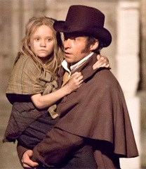
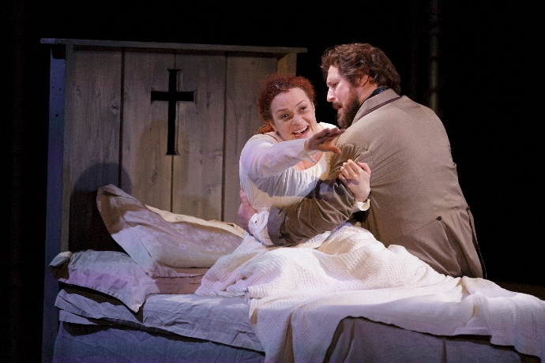
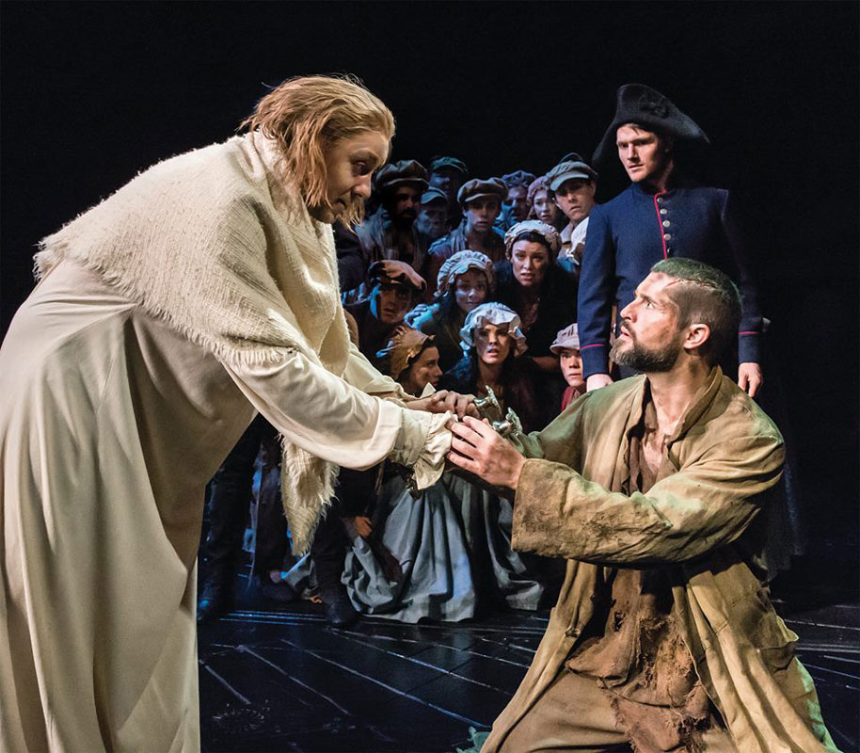
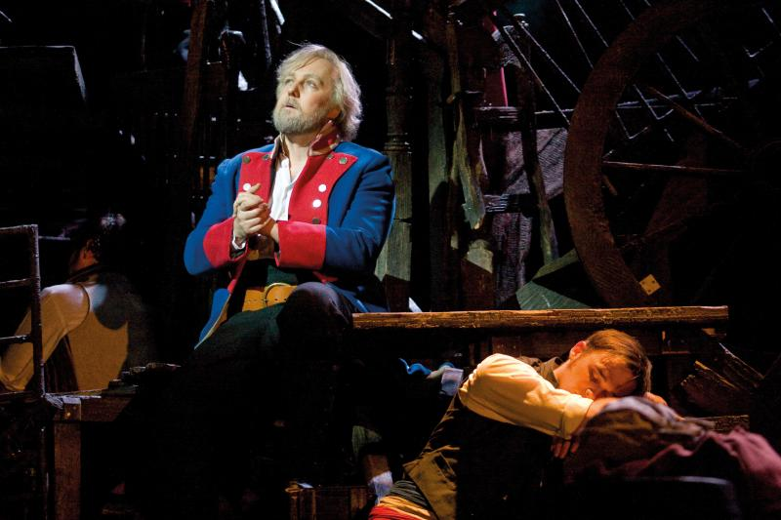
Valjean in Les Miserables
He received
mercy and changed to become merciful to others

Slide 61
Conversely, an unmerciful or unforgiving person does not truly believe in God’s forgiveness of him.
Notes:
神的憐憫是有條件的 - 你需要接受和給予他人
如果你不憐憫他人，你顯然不相信神的憐憫，那麼你對耶穌的仁慈/寬恕的信心不是真誠的，也代表你並不誠心相信耶穌的救恩
關鍵是你的意圖 - 你願意原諒他人嗎？ 我們有時暫時沒辦法原諒他人，但如果你的意圖是要原諒，你會被原諒的。 但有些人不肯去原諒他人，那他也不會被神赦免。

Slide 62
Can one be saved if his actions show that he does not believe he is forgiven by God?
Notes:
神的憐憫是有條件的 - 你需要接受和給予他人
如果你不憐憫他人，你顯然不相信神的憐憫，那麼你對耶穌的仁慈/寬恕的信心不是真誠的，也代表你並不誠心相信耶穌的救恩
關鍵是你的意圖 - 你願意原諒他人嗎？ 我們有時暫時沒辦法原諒他人，但如果你的意圖是要原諒，你會被原諒的。 但有些人不肯去原諒他人，那他也不會被神赦免。

Slide 63
Nobody can answer that. We only see the outside. Only God can see one’s heart.
Notes:
神的憐憫是有條件的 - 你需要接受和給予他人
如果你不憐憫他人，你顯然不相信神的憐憫，那麼你對耶穌的仁慈/寬恕的信心不是真誠的，也代表你並不誠心相信耶穌的救恩
關鍵是你的意圖 - 你願意原諒他人嗎？ 我們有時暫時沒辦法原諒他人，但如果你的意圖是要原諒，你會被原諒的。 但有些人不肯去原諒他人，那他也不會被神赦免。

Slide 64
Then what about justice?
Notes:
May not be done on Earth, but at judgement time. His rewards and punishments are eternal – far more than what people can get on Earth

Slide 65
Romans 12:19
Do not take revenge, my dear friends, but leave room for God’s wrath, for it is written: “It is mine to avenge; I will repay,” says the Lord.
Notes:
English: “poor in spirit” These are people who know their spiritual needs and they cannot satisfy God on their own. These people cry out to God and will get what they ask for.
Most religion: motivate people to do what they want. Chr: tells your real need – that you cannot save yourself – and then get free grace. That’s not normal way of motivating people

Slide 66
It’s your job to be merciful and forgiving. It’s God’s job to enforce justice, either on Earth or in Afterlife or both.
Notes:
English: “poor in spirit” These are people who know their spiritual needs and they cannot satisfy God on their own. These people cry out to God and will get what they ask for.
Most religion: motivate people to do what they want. Chr: tells your real need – that you cannot save yourself – and then get free grace. That’s not normal way of motivating people

Slide 67
Some pain may be too much for someone to forgive. We need to at least be willing and try to forgive.
Notes:
神的憐憫是有條件的 - 你需要接受和給予他人
如果你不憐憫他人，你顯然不相信神的憐憫，那麼你對耶穌的仁慈/寬恕的信心不是真誠的，也代表你並不誠心相信耶穌的救恩
關鍵是你的意圖 - 你願意原諒他人嗎？ 我們有時暫時沒辦法原諒他人，但如果你的意圖是要原諒，你會被原諒的。 但有些人不肯去原諒他人，那他也不會被神赦免。

Slide 68
Perhaps the key is your intention. Have you tried to be merciful and forgiving?
Notes:
神的憐憫是有條件的 - 你需要接受和給予他人
如果你不憐憫他人，你顯然不相信神的憐憫，那麼你對耶穌的仁慈/寬恕的信心不是真誠的，也代表你並不誠心相信耶穌的救恩
關鍵是你的意圖 - 你願意原諒他人嗎？ 我們有時暫時沒辦法原諒他人，但如果你的意圖是要原諒，你會被原諒的。 但有些人不肯去原諒他人，那他也不會被神赦免。

Slide 69
1 Cor. 4:5 -- Therefore judge nothing before the appointed time; wait until the Lord comes. He will bring to light what is hidden in darkness and will expose the motives of the heart. At that time each will receive their praise from God.
Notes:
English: “poor in spirit” These are people who know their spiritual needs and they cannot satisfy God on their own. These people cry out to God and will get what they ask for.
Most religion: motivate people to do what they want. Chr: tells your real need – that you cannot save yourself – and then get free grace. That’s not normal way of motivating people

Slide 70
The heart – that’ll be the 6th beatitude…

Slide 71
5th beatitude:
Be merciful towards others, and you will be shown mercy.
May God bless you all.

