Slide 1
第五福: 憐憫

Slide 2
讀經: 馬太福音 18:23-35
不憐憫的僕人

Slide 3
天國好像一個王要和他僕人算帳。 才算的時候，有人帶了一個欠一千萬銀子的來。 因為他沒有什麼償還之物，主人吩咐把他和他妻子兒女並一切所有的都賣了償還。

Slide 4
那僕人就俯伏拜他，說：『主啊，寬容我！將來我都要還清。』 那僕人的主人就動了慈心，把他釋放了，並且免了他的債。

Slide 5
那僕人出來，遇見他的一個同伴欠他十兩銀子，便揪著他，掐住他的喉嚨，說:『你把所欠的還我!』 他的同伴就俯伏央求他，說:『寬容我吧！將來我必還清。

Slide 6
他不肯，竟去把他下在監裡，等他還了所欠的債。 眾同伴看見他所做的事，就甚憂愁，去把這事都告訴了主人。 於是主人叫了他來，對他說：

Slide 7
『你這惡奴才! 你央求我，我就把你所欠的都免了。 你不應當憐恤你的同伴，像我憐恤你嗎?』 主人就大怒，把他交給掌刑的，等他還清了所欠的債。

Slide 8
你們各人若不從心裡饒恕你的弟兄，我天父也要這樣待你們了。」

Slide 9
第五福: 憐憫

Slide 10
耶穌最重要的教導之一是馬太福音 5:2-12 中的「八福」，也稱為
「登山寶訓」。
Notes:
English: “poor in spirit” These are people who know their spiritual needs and they cannot satisfy God on their own. These people cry out to God and will get what they ask for.
Most religion: motivate people to do what they want. Chr: tells your real need – that you cannot save yourself – and then get free grace. That’s not normal way of motivating people

Slide 11
它很重要，因為它顯示了基督徒應有的態度的基本原則，也顯示了基督徒成長的路線圖。
Notes:
English: “poor in spirit” These are people who know their spiritual needs and they cannot satisfy God on their own. These people cry out to God and will get what they ask for.
Most religion: motivate people to do what they want. Chr: tells your real need – that you cannot save yourself – and then get free grace. That’s not normal way of motivating people

Slide 12
在八福中，要先去除罪 (1-2)，然後軟化心 (3-6)，才能準備基督徒去愛其他人並傳播福音 (7-8) 。

Slide 13
八福 | 基督徒的行動
1.知道心靈貧窮 | 要回到神的面前
2.哀慟:為罪而難過 | 脫離罪惡
3.溫柔(謙和) | 不靠自己去打壓別人
4.飢渴慕義,親近神 | 不過度的追求世上之物
5.憐憫他人 | 要體諒別人
6.清心(純潔的心) | 要沒有不對的動機
7.締造和平或平安 | 恢復神與人,人與人的關係
8.為義受逼迫 | 為主工作要克服各樣困難
Notes:
Sometimes, when someone is going through the sin-removal process, we need to be thoughtful in our application of love and mercy

Slide 14
第一福:
虛心 (心靈貧窮) 的人有福了， 因為天國是他們的。
Notes:
English: “poor in spirit” These are people who know their spiritual needs and they cannot satisfy God on their own. These people cry out to God and will get what they ask for.
Most religion: motivate people to do what they want. Chr: tells your real need – that you cannot save yourself – and then get free grace. That’s not normal way of motivating people

Slide 15
要知道你在心靈上有需要。
如果你知道你需要神,
你就會找到祂和祂的救贖。
Notes:
English: “poor in spirit” These are people who know their spiritual needs and they cannot satisfy God on their own. These people cry out to God and will get what they ask for.
Most religion: motivate people to do what they want. Chr: tells your real need – that you cannot save yourself – and then get free grace. That’s not normal way of motivating people

Slide 16
第二福:
哀慟的人有福了,
因為他們必得安慰。
Notes:
Mourning about sin – true repentance. True repentance would lead to a willingness to change. True change comes from God because most people are too weak.
Meek = have power/authority but not use it wrongly or put people down. That’s what JC had. Real authority comes from God.

Slide 17
對罪惡感到難過:
然後悔改並離開罪惡
你就會找到真正的自由
Notes:
English: “poor in spirit” These are people who know their spiritual needs and they cannot satisfy God on their own. These people cry out to God and will get what they ask for.
Most religion: motivate people to do what they want. Chr: tells your real need – that you cannot save yourself – and then get free grace. That’s not normal way of motivating people

Slide 18
第三福:
溫柔(謙和)的人有福了，
因為他們必承受土地。

Slide 19
要謙和，謙虛 --
你必須知道那真正的權柄不在這世上。
當你不爭權奪力並試圖支配別人時，你會快樂。
Notes:
English: “poor in spirit” These are people who know their spiritual needs and they cannot satisfy God on their own. These people cry out to God and will get what they ask for.
Most religion: motivate people to do what they want. Chr: tells your real need – that you cannot save yourself – and then get free grace. That’s not normal way of motivating people

Slide 20
第四福:
飢渴慕義的人有福了, 因為他們必得飽足。
那些尋求並渴望神的人會尋得祂。
Notes:
Hunger for righteousness – God, His purposes, what He cares about. If he seeks after God, you will find Him and receive His gifts.
Be merciful so you can receive mercy: God’s mercy is not free – JC paid the price. He wants us to give a little since we were given much.

Slide 21
前四福似乎是消極的問題變成了積極的。第五福則是因果都是積極的。

Slide 22
我們還可以看到，前四福涉及神逐漸改變人的心。
人一旦願意改變，神就會逐漸接管、改變人的心。

Slide 23
然而，從第五福開始，我們可以看到這個人需要開始活出改變的心。
內在的改變現在需要表現在外表上。

Slide 24
現在需要採取行動，但難度要大得多。 也是時候看看內心的改變是否是真實了。

Slide 25
第五福:
憐憫人的人有福了,
因為他們必蒙憐憫。

Slide 26
雖然它更符和邏輯, 那並不代表它比較容易做到。

Slide 27
「憐憫」=沒得到該得的處罰
相關詞:「恩典」與「正義」

Slide 28
憐憫: 沒得到該得的處罰
恩典: 得到不配得到的好處

Slide 29
正義: 得到該得的獎勵及處罰; = 公平

Slide 30
正義與憐憫及恩典的衝突
\ 應該 實際 \ | 應該得到 | 不應該得到
實際得到 | 正義 | 恩典
沒有得到 | 憐憫 | 正義
Notes:
For bad things -> Mercy
For good things -> Grace

Slide 31
人因有罪 → 離開了神, 該下地獄
正義: 去你應得的地獄

Slide 32
憐憫: 不去你應得的地獄
恩典: 可去你不配去的天堂

Slide 33
神憐憫我們，所以我們可以不去我們該去的地獄。

Slide 34
神賜給了我們恩典，所以我們可以去我們不配去的天堂並與祂同在。

Slide 35
神對我們的期望是什麼?
神憐憫了我們，所以我們也要憐憫他人。
Notes:
一個真正誠心接受神憐憫和恩典的人，也會去憐憫他人
Sounds nice but what’s the consequence if we don’t forgive others after receiving forgiveness? Mercy and forgiveness are very important to God. He decided to connect the two. He greatly rewards mercy and withdraws mercy from those who are not merciful.

Slide 36
神給了我們如此的多，我們給別人一點點不應該是困難的…
Notes:
一個真正誠心接受神憐憫和恩典的人，也會去憐憫他人
Sounds nice but what’s the consequence if we don’t forgive others after receiving forgiveness? Mercy and forgiveness are very important to God. He decided to connect the two. He greatly rewards mercy and withdraws mercy from those who are not merciful.

Slide 37
箴言 19:17 –
憐憫貧窮的就是借給耶和華，他的善行耶和華必償還*。
Notes:
Being merciful and helping others is so important to God that He promises to repay our efforts. He owes you! That’s a much stronger obligation than a promise. Although this is what we should do anyway, God puts special focus here to help us build up our wealth in heaven. He knows our selfish human nature needs extra boost. It’s like giving extra credit to students who choose to learn more.

Slide 38
賞賜獎勵 – 是自願的
還所欠的債 – 是必須的
Notes:
Being merciful and helping others is so important to God that He promises to repay our efforts. He owes you! That’s a much stronger obligation than a promise. Although this is what we should do anyway, God puts special focus here to help us build up our wealth in heaven. He knows our selfish human nature needs extra boost. It’s like giving extra credit to students who choose to learn more.

Slide 39
什麼是真正的憐憫？
真正的同情他人
不是出於自私的原因
Notes:
Sometimes our unwise mercy actually hurts a person
The story of judge who went to jail with the veteran
This is perhaps the best help you can give someone – bring them to the source of all help
Paying forward – this is how we can change the world

Slide 40
如何正確的憐憫他人？
幫助真正需要幫助的人
幫助他人重新站起來
幫助他人回到神面前
Notes:
Sometimes our unwise mercy actually hurts a person
The story of judge who went to jail with the veteran
This is perhaps the best help you can give someone – bring them to the source of all help
Paying forward – this is how we can change the world

Slide 41
這是一個益性的迴轉
電影: “往前回報”
(2000)
Notes:
Sometimes our unwise mercy actually hurts a person
The story of judge who went to jail with the veteran
This is perhaps the best help you can give someone – bring them to the source of all help
Paying forward – this is how we can change the world

Slide 42
往前回報 –
有驚人的影響力
Notes:
Sometimes our unwise mercy actually hurts a person
The story of judge who went to jail with the veteran
This is perhaps the best help you can give someone – bring them to the source of all help
Paying forward – this is how we can change the world

Slide 43
記住:不論他們現今如何，他們都是神的孩子。
當你善待某人的孩子時，那個人通常都會非常感激你。
Notes:
Sometimes our unwise mercy actually hurts a person
The story of judge who went to jail with the veteran
This is perhaps the best help you can give someone – bring them to the source of all help
Paying forward – this is how we can change the world

Slide 44
受益者及你的孩子也會深深地記住你仁慈的行為。
Notes:
Sometimes our unwise mercy actually hurts a person
The story of judge who went to jail with the veteran
This is perhaps the best help you can give someone – bring them to the source of all help
Paying forward – this is how we can change the world

Slide 45
因為仁慈的行為會激發起我們最原本的心靈。那是以神的形像所創造的。
Notes:
Sometimes our unwise mercy actually hurts a person
The story of judge who went to jail with the veteran
This is perhaps the best help you can give someone – bring them to the source of all help
Paying forward – this is how we can change the world

Slide 46
如果你不憐憫及饒恕別人會怎麼樣呢？

Slide 47
馬太6:15 - 你們不饒恕人的過犯，你們的天父也必不饒恕你們的過犯。

Slide 48
雅各 2:13 –
因為那不憐憫人的,也要受無憐憫的審判; 憐憫原是向審判誇勝。

Slide 49
儒家思想: 「恕」 = 相似的心… 這個字也在「饒恕」中
Notes:
恕 = similar heart
a. You let others do well as you do well yourself. OR You stand firm and do well first then you can help others. OR If you want to do well, help others to do well first.
b. Don’t do onto others what you don’t want others to do unto you
→ Rather self-centered/selfish, but illustrates the point

Slide 50
子貢問曰：「有一言而可以終身行之者乎？」子曰：「其恕乎！己所不欲，勿施於人。」
Notes:
恕 = similar heart
a. You let others do well as you do well yourself. OR You stand firm and do well first then you can help others. OR If you want to do well, help others to do well first.
b. Don’t do onto others what you don’t want others to do unto you
→ Rather self-centered/selfish, but illustrates the point

Slide 51
饒恕: 你要他人憐憫赦免你，你也要憐憫赦免他人
Notes:
恕 = similar heart
a. You let others do well as you do well yourself. OR You stand firm and do well first then you can help others. OR If you want to do well, help others to do well first.
b. Don’t do onto others what you don’t want others to do unto you
→ Rather self-centered/selfish, but illustrates the point

Slide 52
那麼我們的救恩呢…
是有條件的嗎?…
Notes:
神的憐憫是有條件的 - 你需要接受和給予他人
如果你不憐憫他人，你顯然不相信神的憐憫，那麼你對耶穌的仁慈/寬恕的信心不是真誠的，也代表你並不誠心相信耶穌的救恩
關鍵是你的意圖 - 你願意原諒他人嗎？ 我們有時暫時沒辦法原諒他人，但如果你的意圖是要原諒，你會被原諒的。 但有些人不肯去原諒他人，那他也不會被神赦免。

Slide 53
如果你不憐憫他人，你有真正的相信及感激神的憐憫及救恩嗎?
Notes:
神的憐憫是有條件的 - 你需要接受和給予他人
如果你不憐憫他人，你顯然不相信神的憐憫，那麼你對耶穌的仁慈/寬恕的信心不是真誠的，也代表你並不誠心相信耶穌的救恩
關鍵是你的意圖 - 你願意原諒他人嗎？ 我們有時暫時沒辦法原諒他人，但如果你的意圖是要原諒，你會被原諒的。 但有些人不肯去原諒他人，那他也不會被神赦免。

Slide 54
我們是「因信稱義」，但我們的行為表明了我們真正的信仰。
Notes:
神的憐憫是有條件的 - 你需要接受和給予他人
如果你不憐憫他人，你顯然不相信神的憐憫，那麼你對耶穌的仁慈/寬恕的信心不是真誠的，也代表你並不誠心相信耶穌的救恩
關鍵是你的意圖 - 你願意原諒他人嗎？ 我們有時暫時沒辦法原諒他人，但如果你的意圖是要原諒，你會被原諒的。 但有些人不肯去原諒他人，那他也不會被神赦免。

Slide 55
雅各書 2:18 --
必有人說：「你有信心，我有行為。」你將你沒有行為的信心指給我看，我便藉著我的行為，將我的信心指給你看。
Notes:
神的憐憫是有條件的 - 你需要接受和給予他人
如果你不憐憫他人，你顯然不相信神的憐憫，那麼你對耶穌的仁慈/寬恕的信心不是真誠的，也代表你並不誠心相信耶穌的救恩
關鍵是你的意圖 - 你願意原諒他人嗎？ 我們有時暫時沒辦法原諒他人，但如果你的意圖是要原諒，你會被原諒的。 但有些人不肯去原諒他人，那他也不會被神赦免。

Slide 56
一個人若是真正相信及接受神的憐憫和赦免, 他的心的會有所改變。
Notes:
神的憐憫是有條件的 - 你需要接受和給予他人
如果你不憐憫他人，你顯然不相信神的憐憫，那麼你對耶穌的仁慈/寬恕的信心不是真誠的，也代表你並不誠心相信耶穌的救恩
關鍵是你的意圖 - 你願意原諒他人嗎？ 我們有時暫時沒辦法原諒他人，但如果你的意圖是要原諒，你會被原諒的。 但有些人不肯去原諒他人，那他也不會被神赦免。

Slide 57
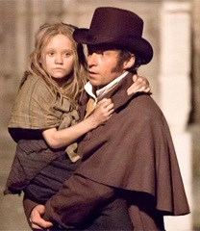
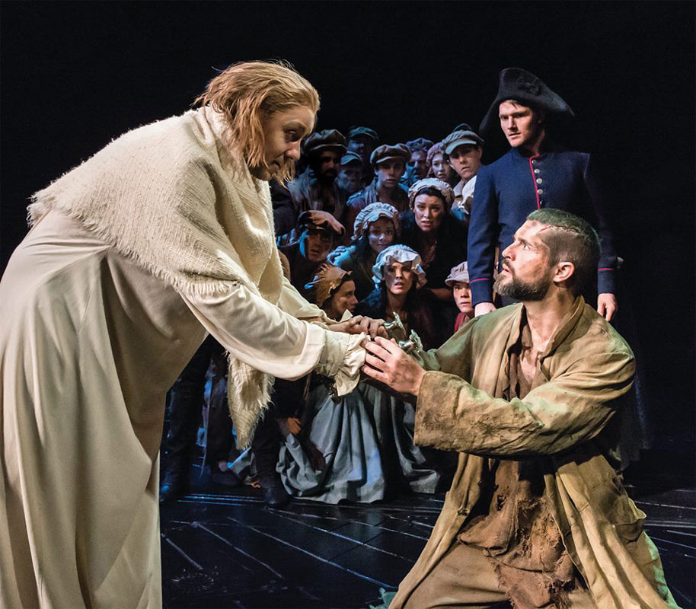
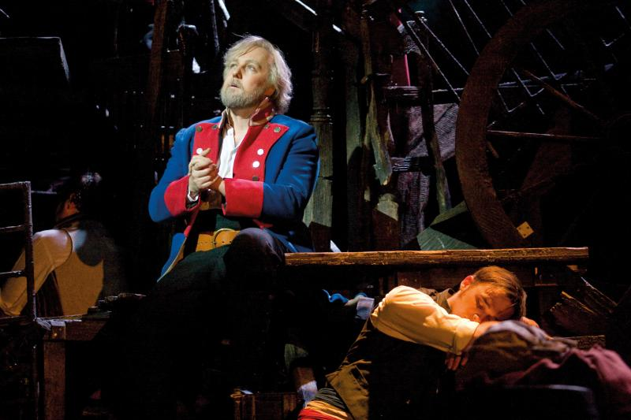
悲慘世界 中的尚萬強
他得到憐憫而因此改變
成為一個憐憫他人的人

Slide 58
反過來說，一個不仁慈或不寬恕他人的人並不真正的相信神對他的寬恕。
Notes:
神的憐憫是有條件的 - 你需要接受和給予他人
如果你不憐憫他人，你顯然不相信神的憐憫，那麼你對耶穌的仁慈/寬恕的信心不是真誠的，也代表你並不誠心相信耶穌的救恩
關鍵是你的意圖 - 你願意原諒他人嗎？ 我們有時暫時沒辦法原諒他人，但如果你的意圖是要原諒，你會被原諒的。 但有些人不肯去原諒他人，那他也不會被神赦免。

Slide 59
如果他的行為表明他不相信神的赦免, 他有得救嗎？
Notes:
神的憐憫是有條件的 - 你需要接受和給予他人
如果你不憐憫他人，你顯然不相信神的憐憫，那麼你對耶穌的仁慈/寬恕的信心不是真誠的，也代表你並不誠心相信耶穌的救恩
關鍵是你的意圖 - 你願意原諒他人嗎？ 我們有時暫時沒辦法原諒他人，但如果你的意圖是要原諒，你會被原諒的。 但有些人不肯去原諒他人，那他也不會被神赦免。

Slide 60
沒人能回答這個問題。我們只看到人的表面。只有神才能看到一個人的心。
Notes:
神的憐憫是有條件的 - 你需要接受和給予他人
如果你不憐憫他人，你顯然不相信神的憐憫，那麼你對耶穌的仁慈/寬恕的信心不是真誠的，也代表你並不誠心相信耶穌的救恩
關鍵是你的意圖 - 你願意原諒他人嗎？ 我們有時暫時沒辦法原諒他人，但如果你的意圖是要原諒，你會被原諒的。 但有些人不肯去原諒他人，那他也不會被神赦免。

Slide 61
那正義呢？
Notes:
May not be done on Earth, but at judgement time. His rewards and punishments are eternal – far more than what people can get on Earth

Slide 62
羅馬書12:19
親愛的弟兄，不要自己申冤，寧可讓步，聽憑主怒；因為經上記著：「主說：申冤在我，我必報應。」
Notes:
May not be done on Earth, but at judgement time. His rewards and punishments are eternal – far more than what people can get on Earth

Slide 63
仁慈和寬容是你的職責。在今生或是在來世伸張正義是神的職責。
Notes:
English: “poor in spirit” These are people who know their spiritual needs and they cannot satisfy God on their own. These people cry out to God and will get what they ask for.
Most religion: motivate people to do what they want. Chr: tells your real need – that you cannot save yourself – and then get free grace. That’s not normal way of motivating people

Slide 64
有時某些痛苦可能太深了。我們至少需要願意及嘗試去原諒。
Notes:
神的憐憫是有條件的 - 你需要接受和給予他人
如果你不憐憫他人，你顯然不相信神的憐憫，那麼你對耶穌的仁慈/寬恕的信心不是真誠的，也代表你並不誠心相信耶穌的救恩
關鍵是你的意圖 - 你願意原諒他人嗎？ 我們有時暫時沒辦法原諒他人，但如果你的意圖是要原諒，你會被原諒的。 但有些人不肯去原諒他人，那他也不會被神赦免。

Slide 65
也許關鍵是你的意圖。你有試著去憐憫及赦免嗎?
Notes:
神的憐憫是有條件的 - 你需要接受和給予他人
如果你不憐憫他人，你顯然不相信神的憐憫，那麼你對耶穌的仁慈/寬恕的信心不是真誠的，也代表你並不誠心相信耶穌的救恩
關鍵是你的意圖 - 你願意原諒他人嗎？ 我們有時暫時沒辦法原諒他人，但如果你的意圖是要原諒，你會被原諒的。 但有些人不肯去原諒他人，那他也不會被神赦免。

Slide 66
哥林多前書 4:5 - 所以，時候未到，什麼都不要論斷，只等主來，他要照出暗中的隱情，顯明人心的意念。那時，各人要從神那裡得著稱讚。
Notes:
English: “poor in spirit” These are people who know their spiritual needs and they cannot satisfy God on their own. These people cry out to God and will get what they ask for.
Most religion: motivate people to do what they want. Chr: tells your real need – that you cannot save yourself – and then get free grace. That’s not normal way of motivating people

Slide 67
我們的心及動機 – 那就是第六福…

Slide 68
第五福: 要憐憫他人， 你們就必蒙憐憫。
願神祝福各位。

