Slide 1
Mystery of the Washing Machine
Scripture:
Isaiah 1:16-18

Slide 2
“Wash and make yourselves clean. Take your evil deeds out of my sight; stop doing wrong. Learn to do right; seek justice.

Slide 3
Defend the oppressed. Take up the cause of the fatherless; plead the case of the widow.” “Come now, let us settle the matter,” says the Lord.

Slide 4
“Though your sins are like scarlet, they shall be as white as snow; though they are red as crimson, they shall be like wool.”

Slide 5
Mystery of the Washing Machine

Slide 6
Jesus frequently taught using parables. The parables could seem very simple, but there are timely deep meanings for those who seek.

Slide 7
Sometimes we hear very good modern analogies that can also teach us a lot about various Christian issues.

Slide 8
I once heard that the church is like a washing machine, and we are all dirty clothes trying to be clean.

Slide 9
Then one day God impressed me to study this allegory with a scientific perspective, and I learned a lot of truth from studying it.

Slide 10
This modern allegory involves things used in cloth washing:
1. Dirty clothes: people
2. Water: Holy Spirit (Isa. 44:3)

Slide 11
3. Cleaning chemicals – detergent, bleach, and softeners: God’s word and our prayers
4. Washer: the Church
5. Dryer: Our surroundings

Slide 12
The problem with washing: water and grease don’t mix.
Polar and nonpolar molecules tend to stick together and resist mixing with each other.

Slide 13
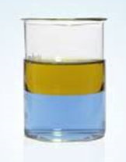
Water and oil don’t mix
oil
water

Slide 14
We tend to like to be with people similar to us, and so it takes a deliberate choice to change that.

Slide 15
Becoming a Christian is that choice that we make.

Slide 16
We are like dirty clothing choosing to be clean and so we go into the washing machine = becoming Christians and going to church to learn and grow.

Slide 17
The process of washing the dirty clothes represents the growth of Christians.

Slide 18
1. Washing machine is filled with water, detergent and bleach: Church needs the Holy Spirit and God’s word.

Slide 19
Detergent: a surfactant that reduces surface tension so water can enter into the spaces in clothing and help grease stick to water molecules.

Slide 20
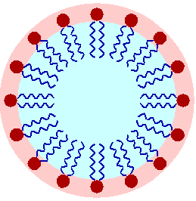
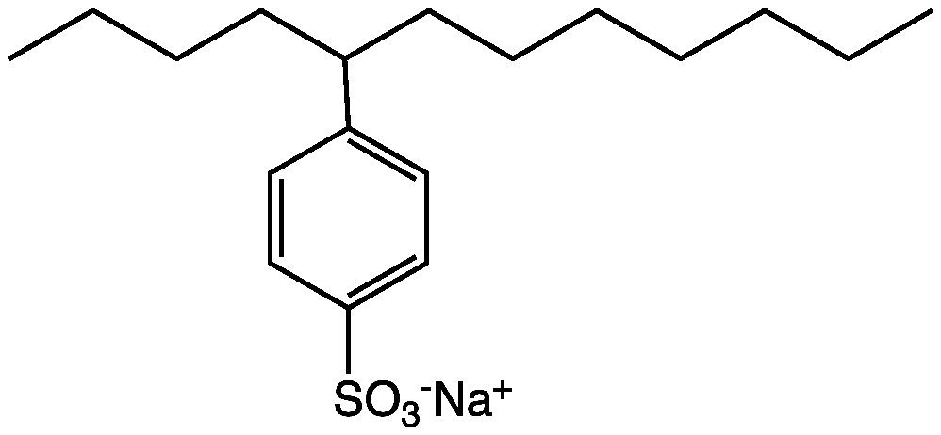
Surfactant

Slide 21
Think of water and oil as two different kinds of Velcro. Surfactant is like a thing with one type on each side so it can stick to both kinds.

Slide 22
Dirty stuff on clothes are visible because they have molecules that show us colors that are different from the ones on the clothes.

Slide 23
Chromophore - The part of a molecule that gives its colors

Slide 24
Bleach: breaks the double bonds in chromophores and kills germs.

Slide 25
2. When we put dirty clothes in washer, we should not pack them tightly so they can all come in contact with water and detergents.

Slide 26
3. As the washer turns, clothes rub against each other. This helps the chemicals to reach the grease and do their work of breaking and removing them.

Slide 27
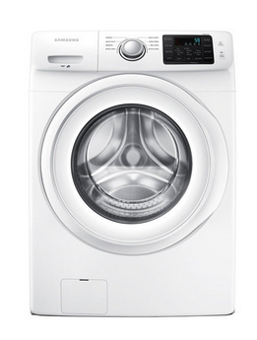
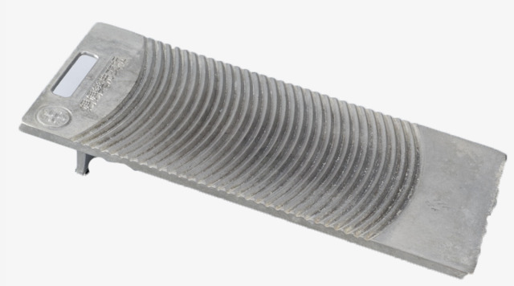
Clothes Washing
Washer board

Slide 28
4. When water is drained, it takes away grease. Please rinse a few times to get rid of all grease and dirt. We need the Holy Spirit to constantly cleanse us.

Slide 29
This is why you see the “extra rinse cycle” option on at-home washing machines. Always use that option.

Slide 30
5. When the washing process is almost done, add in the softener.

Slide 31
Softeners is a cationic surfactant

Slide 32
Softeners spread cations on the clothes. This reduces static electricity and make the clothes feel softer.

Slide 33
The softening must be done near the end of the washing process, and that’s why there is a separate liquid holder for softeners.

Slide 34
God can change our hearts to be more merciful, humble, pure..

Slide 35
Eze. 11:19 - I will give them an undivided heart and put a new spirit in them; I will remove from them their heart of stone and give them a heart of flesh.

Slide 36
Softener and detergent do not work together well, and so softener is put in at the end.

Slide 37
Removing sin is painful, and softener is like healing after the pain.

Slide 38
In the 8 beatitudes, we first get rid of sin (1-2), then soften our hearts (3-6), which prepare us to love others & spread the Gospel (7-8).

Slide 39
Beatitudes | Christian’s actions
1. Be poor in spirit | Know their spiritual needs and return to God
2. Mourn over sin | Depart from sin
3. Meek / humble | Do not dominate others
4. Want righteousness | Don’t seek worldliness
5. Be merciful | Be forgiving to others
6. Have a pure heart | Don’t have evil motives
7. Be peacemakers | Restore people’s relationship each other and with God
8. Be persecuted for sake of righteousness | Overcome difficulties when working for God
Notes:
Sometimes, when someone is going through the sin-removal process, we need to be thoughtful in our application of love and mercy

Slide 40
6. Using a dryer to get rid of moisture. Our trials and difficulties help us grow and learn to deal with things of the world. This is the 8th beatitude.

Slide 41
Dryer sheets release more softeners in the dryer. They help soften clothes and reduce the drying time. Our learning time can be shorter if we have the right hearts.

Slide 42
Sometimes Christians and non-Christians are hurt by others at church…
The rubbing of clothing helps detergent reach dirt and get rid of them.

Slide 43
Proverbs 27:17
As iron sharpens iron, so one person sharpens another.

Slide 44
God’s purpose is to help us get rid of our sinful nature and get a new heart.

Slide 45
To do this, He uses imperfect people in church and adds in His Holy Spirit, word, and timely healing.

Slide 46
This is the mystery of the washing machine.
The process is painful but necessary.

Slide 47
What happens if you are not “clean enough” at the time of judgment?

Slide 48
Rev. 19:8 - Fine linen, bright and clean, was given to the saints to wear.” (Fine linen stands for the righteous acts of God’s holy people.)

Slide 49
Grace and righteousness comes from the substitutionary atonement of Jesus.
Substitutionary atonement is someone sacrificed on your behalf.

Slide 50
John 3:16 –
For God so loved the world that He gave His one and only Son, that whoever believes in Him shall not perish but have eternal life.

Slide 51
Even if you are still not perfect when you finally face God, thanks to Jesus’s substitutionary atonement on your behalf, you will be “perfect” in God’s eyes.

Slide 52
But your heart and your work for God and others on Earth will determine your role in Heaven.

Slide 53
Non-Christians:
Do you think you are clean?

Slide 54
Do you think you are better than most Christians you see?

Slide 55
The truth is, none of us are good enough. It is through the grace and sacrifice of Jesus that we can be righteous before God.

Slide 56
Christians:
Are you willing to be washed?

Slide 57
Have you been hurt by other Christians at church? The washing process is painful but necessary.

Slide 58
If you have been hurt by other Christians at church…
Learn to forgive

Slide 59
Talk to them, and try to restore the relationship with them.

Slide 60
God uses those who hurt you to help you grow, to become the vessel He wants you to be.

Slide 61
Remember that they are learning and will be cleaner.

Slide 62
Ezekiel 36:26 - I will give you a new heart and put a new spirit in you; I will remove from you your heart of stone and give you a heart of flesh.

Slide 63
May we all be washed and softened so we are clean by the time we see our Lord in heaven. May God bless you all.

