Slide 1
The Donuts Allegory
Scripture:
Jeremiah 18:1-4

Slide 2
Jeremiah 18:1-4
This is the word that came to Jeremiah from the Lord:
“Go down to the potter’s house, and there I will give you my message.” 3 So I went down to the potter’s house, and I saw him working at the wheel. 4 But the pot he was shaping from the clay was marred in his hands; so the potter formed it into another pot, shaping it as seemed best to him.

Slide 3
“Go down to the potter’s house, and there I will give you my message.”
So I went down to the potter’s house, and I saw him working at the wheel. 4 But the pot he was shaping from the clay was marred in his hands; so the potter formed it into another pot, shaping it as seemed best to him.

Slide 4
So I went down to the potter’s house, and I saw him working at the wheel.

Slide 5
But the pot he was shaping from the clay was marred in his hands;
so the potter formed it into another pot, shaping it as seemed best to him.

Slide 6
so the potter formed it into another pot, shaping it as seemed best to him.

Slide 7
The Donuts Allegory

Slide 8
How to make donuts?
1. Flour mixed with water, yeast, salt, sugar, egg and oil

Slide 9
When flour is mixed with water, it turns into the elastic gluten when kneaded.

Slide 10
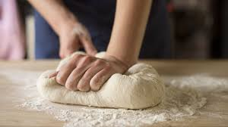

Slide 11
The yeast turns sugar into CO₂ and breaks down starch, protein, and fat into more basic molecules.

Slide 13
The CO₂ is trapped by the elastic gluten and the dough rises.

Slide 14
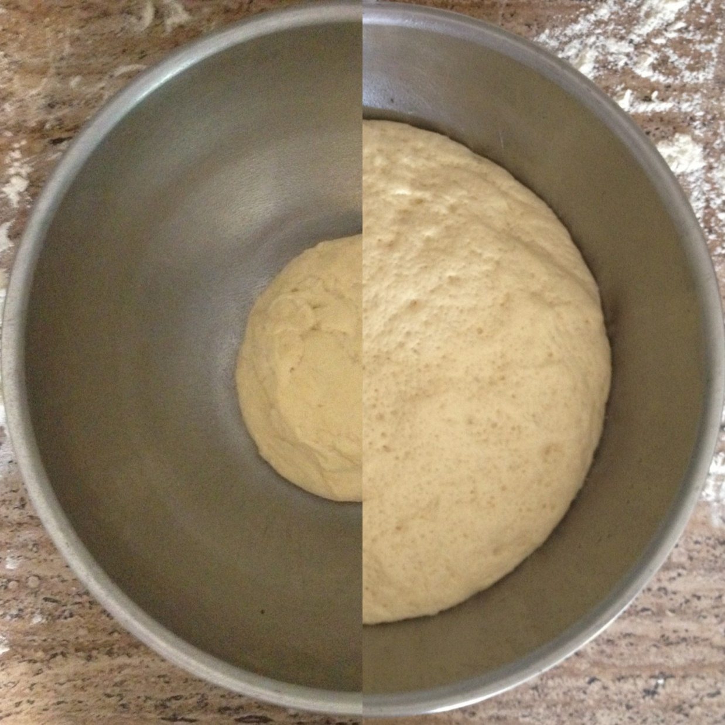

Slide 15
Cut the dough into the shapes of donuts.

Slide 16
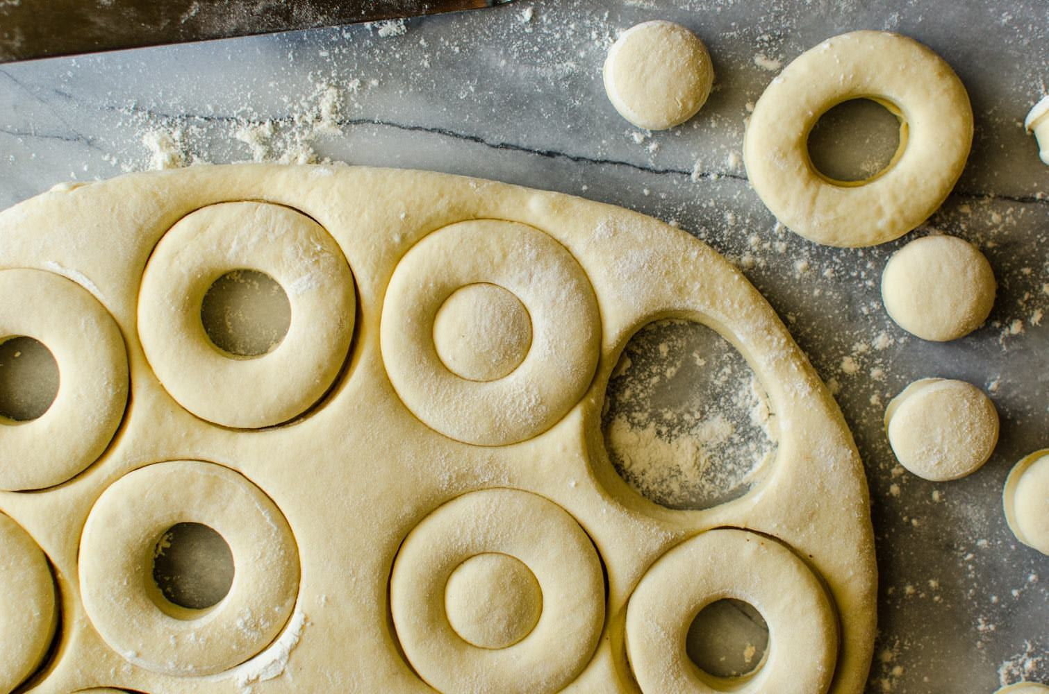

Slide 17
When the dough with the hole is fried, it turns into fluffy donuts.

Slide 18
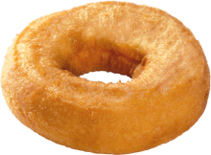

Slide 19
The donut can be soft because the hole allowed heat to get to all parts quickly and evenly.

Slide 20
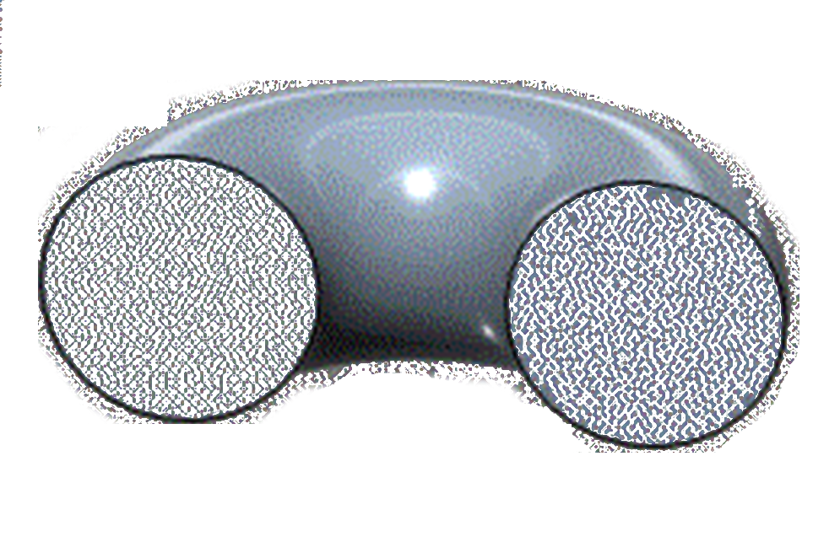

Slide 21
Without the hole, a donut won’t be as fluffy and soft. It won’t taste like a donut that we like.

Slide 22
Our lives are like donuts. There are holes that some of us would like filled:

Slide 23
Poverty
Illness
Losses
Abuse Failures
Turmoil

Slide 24
Like the holes in donuts, these deficiencies can make us better.

Slide 25
What can these holes bring us?

Slide 26
Perseverance – Do not give up on yourself, others, and various things so easily.

Slide 27
James 1:2-4
Consider it pure joy, my brothers and sisters, whenever you face trials of
many kinds, because you know that the testing of your faith produces perseverance. Let perseverance finish its work so that you may be mature and complete, not lacking anything.

Slide 28
many kinds, because you know that the testing of your faith produces perseverance.

Slide 29
Let perseverance finish its work so that you may be mature and complete, not lacking anything.

Slide 30
Endurance – Can endure the pain and still not lose faith and hope.

Slide 31
Romans 5:3-4 - Not only so, but we also glory in our sufferings, because we know that
suffering produces perseverance; perseverance, character; and character, hope.

Slide 32
suffering produces perseverance; perseverance, character; and character, hope.

Slide 33
Faith & reliance on God – Believe that God loves you and you can count on Him.

Slide 34
Philippians 4:13
I can do all this through Him who gives me strength.

Slide 35
2 Corinthians 12:7-9
In order to keep me from becoming conceited, I was given a thorn in my flesh,
a messenger of Satan, to torment me. Three times I pleaded with the Lord to take it away from me. But he said to me, “My grace is sufficient for you, for my power is made perfect in weakness.” Therefore I will boast all the more gladly about my weaknesses, so that Christ’s power may rest on me.

Slide 36
a messenger of Satan, to torment me. Three times I pleaded with the Lord to take it away from me.

Slide 37
But he said to me, “My grace is sufficient for you, for my power is made perfect in weakness.”

Slide 38
Therefore I will boast all the more gladly about my weaknesses, so that Christ’s power may rest on me.

Slide 39
Compassion & encouragement to others – Healed people can best heal people.

Slide 40
The story of the homeless and the dog…

Slide 41
Humility – We see ourselves as who we really are – imperfect beings who need God

Slide 42
1 Corinthians 1:28-29
God chose the lowly things of this world and the despised things --
and the things that are not -to nullify the things that are, so that no one may boast before him.

Slide 43
and the things that are not -- to nullify the things that are, so that no one may boast before him.

Slide 44
What can help us get those benefits?

Slide 45
Right Perspective: See things as they really are – from God’s perspective

Slide 46
Our earthly life is only a test and a training ground

Slide 47
Jeremiah 18:1-4
This is the word that came to Jeremiah from the Lord: “Go down to the potter’s house, and there
I will give you my message.” So I went down to the potter’s house, and I saw him working at the wheel. But the pot he was shaping from the clay was marred in his hands; so the potter formed it into another pot, shaping it as seemed best to him.

Slide 48
I will give you my message.” So I went down to the potter’s house, and I saw him working at the wheel. But the pot he was

Slide 49
shaping from the clay was marred in his hands; so the potter formed it into another pot, shaping it as seemed best to him.

Slide 50
Earthly life is illusionary and temporary. Afterlife is real and eternal.

Slide 51
2 Corinthians 4:16-17
Therefore we do not lose heart. Though outwardly we are wasting away, yet
inwardly we are being renewed day by day. For our light and momentary troubles are achieving for us an eternal glory that far outweighs them all.

Slide 52
inwardly we are being renewed day by day. For our light and momentary troubles are

Slide 53
achieving for us an eternal glory that far outweighs them all.

Slide 54
Right Attitude – Face these with joy and hope, not anger or sadness

Slide 55
Contentment – Be happy with what you have and not be envious of others

Slide 56
Philippians 4:10-13
I rejoiced greatly in the Lord that at last you renewed your concern for me.
Indeed, you were concerned, but you had no opportunity to show it. 11 I am not saying this because I am in need, for I have learned to be content whatever the circumstances. 12 I know what it is to be in need, and I know what it is to have plenty. I have learned the secret of being content in any and every situation, whether well fed or hungry, whether living in plenty or in want. I can do all this through him who gives me strength.

Slide 57
Indeed, you were concerned, but you had no opportunity to show it. I am not saying this because

Slide 58
I am in need, for I have learned to be content whatever the circumstances. I know what it is to

Slide 59
be in need, and I know what it is to have plenty. I have learned the secret of being content in

Slide 60
any and every situation, whether well fed or hungry, whether living in plenty or in want.

Slide 61
I can do all this through him who gives me strength.

Slide 62
Hope – helps us endure and keep our faith

Slide 63
Faith – Believe that God has the best intention for you

Slide 64
Romans 8:28
And we know that in all things God works for the good of those who love him,
who have been called according to his purpose.

Slide 65
who have been called according to his purpose.

Slide 66
Jeremiah 29:11
“For I know the plans I have for you,” declares the Lord,
“plans to prosper you and not to harm you, plans to give you hope and a future.

Slide 67
“plans to prosper you and not to harm you, plans to give you hope and a future.”

Slide 68
Believe that God’s timing and methods are better than yours.

Slide 69
Next four sermons – how to overcome adversity.

