Slide 1
Building on
a Solid Foundation
Scripture:
Luke 6:47-49

Slide 2
As for everyone who comes to me and hears my words and puts them into practice, I will show you what they are like.
They are like a man building a house, who dug down deep and laid the foundation on rock. When a flood came, the torrent struck that house but could not shake it, because it was well built. But the one who hears my words and does not put them into practice is like a man who built a house on the ground without a foundation. The moment the torrent struck that house, it collapsed and its destruction was complete.”

Slide 3
They are like a man building a house, who dug down deep and laid the foundation on rock.

Slide 4
When a flood came, the torrent struck that house but could not shake it, because it was well built.

Slide 5
But the one who hears my words and does not put them into practice is like a man who built a house on the ground without a foundation.

Slide 6
The moment the torrent struck that house, it collapsed and its destruction was complete.”

Slide 7
Building on
a Solid Foundation

Slide 8
This is an easy-to-understand parable by Jesus. Doing it, however, is very difficult.

Slide 9
This parable shows the three steps of spiritual achievements:

Slide 10
1. Come to God - come to the right location for the building

Slide 11
2. Hear His words - understand the need for foundation

Slide 12
3. Put into practice – actually building out a solid foundation for the building

Slide 13
What is building a house? A house is a shelter -- the place for protection and rest. It is also a means of wealth accumulation.

Slide 14
Shelter is an important human physical need, only second after food.

Slide 15
Is it a heavenly dwelling?
No, the parable says it encounters storms. So this is likely on Earth.

Slide 16
The parable shows our work is on earth but for a godly purpose. What we build here does matter for eternity.

Slide 17
Our earthly lives are only a test and training ground. But they determine our initial eternal position and possessions.

Slide 18
So what is a foundation? In short, it helps anchor the building in place and helps protect it against certain disasters.

Slide 19
To do this, we want the ground to be as solid as possible.

Slide 20
If the ground is not solid enough, we will need to go deeper and maybe even transform the base through different means.

Slide 21
But a strong ground (e.g., bedrock) is harder to dig into. This requires a lot of work.

Slide 22
So either way, building a foundation is not easy. For today’s taller buildings, it is very expensive.

Slide 23
To do it right, we need to study the soil very carefully. In the construction field, we call it “geotechnical studies”.

Slide 24
We have to drill holes into the ground at multiple places to see what’s underneath.

Slide 25
We have to study things like soil density, water retention and drainage rates, compressibility, shear strength, etc.

Slide 26
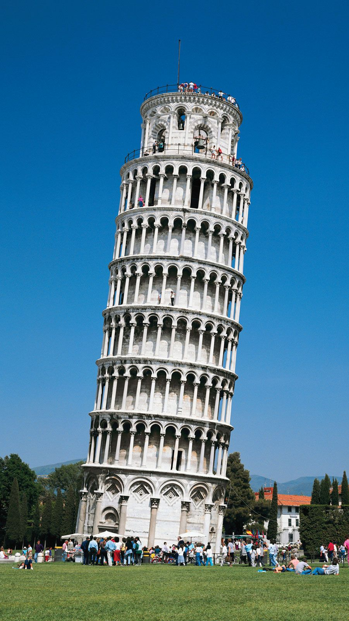
Leaning Tower of Pisa is the result of bad geotechnical studies and insufficient foundation.

Slide 27
Geologists say the ground is like a thick liquid. It can "flow" when shaken.

Slide 28
When the ground moves, the building on top can move, tilt over, collapse, or torn apart.

Slide 29
So after we have a site, we need to study it to see what kind of foundation we need to build.

Slide 30
We need the right foundation to protect the building we want to build on top of it. We don’t want to build another Tower of Pisa.

Slide 31
What are the Christian Foundations?
1. Jesus Christ is our Lord and Savior - all other gods are fake.

Slide 32
Salvation by grace – understand that we are saved because of what Jesus has done for us, not what we have achieved ourselves.

Slide 33
Understanding salvation by grace should have implications for our earthly living.

Slide 34
If you truly believe God’s sacrificial love for us, you would live a different lifestyle – one that’s loving and sacrificial.

Slide 35
2. After we are saved by grace, we need to live by faith.

Slide 36
We need to believe that God will love and lead you. Although sometimes we don’t see that immediately.

Slide 37
We need to believe that His teachings and promises are true. Otherwise, life can be hard to endure sometimes.

Slide 38
We need to rely on Him when we encounter difficulties, but you have to do your part first.

Slide 39
For example, you can’t pray for a good grade on a test if you don’t study yourself.

Slide 40
3. Understanding our purpose in this world

Slide 41
This earthly life is only a test and a training ground. We are here to learn and put what we learned into action.

Slide 42
First, we need to learn about God. We need to follow His teachings and put into practice.

Slide 43
For instance, we need to forgive others as we are forgiven.

Slide 44
You don’t have to be a Bible scholar in order to put the teachings into practice.

Slide 45
Whatever you have learned, start putting it into practice. When you are ready, God will teach you more.

Slide 46
Some people go to church or Bible school all day to get more knowledge. God, on the other hand, wants you to use what you have learned already.

Slide 47
James 2:26 –
As the body without the spirit is dead, so faith without deeds is dead.

Slide 48
Whatever you don’t get to learn on Earth, you can learn in heaven. You have plenty of time there.

Slide 49
Second, we need to yield to God. That means surrendering our own will to Him.

Slide 50
We need to follow God instead of our own desires. This could mean giving up your own original plans for your life.

Slide 51
Third, we need to focus on eternity instead of this world.

Slide 52
We need to focus on eternity but with the proper balance so you fulfill your earthly responsibilities also.

Slide 53
Otherwise, you become a bad testimony for Christ. That's not pleasing to God.

Slide 54
There’s a saying: "Someone is so heavenly-minded that he is no earthly good."

Slide 55
Make sure you are a good parent, friend, and employee besides being a good Christian.

Slide 56
Fourth, we need to live for Him and others. For God is love and He loved us. He wants us to do the same.

Slide 57
People returning from near death experiences: a being asked how you have loved others.

Slide 58
Fifth, you need to have pure intentions.
God cares more about our intentions than our results.

Slide 59
Wrong intentions are like bad foundations -- you can't build properly if foundation is bad.

Slide 60
Finally, you need to have proper relationships with others.

Slide 61
Learn what love is and how to love.
Learn how to serve people properly.
Learn how to handle relationships and conflicts.

Slide 62
With these foundations, you can proceed with doing God's work.

Slide 63
But Christians tend to make many errors about these issues.

Slide 64
First, they come to build at the wrong location. Their focus is not even on God.

Slide 65
Sometimes we build on earthly concerns, such as wealth accumulation, power, and bodily satisfaction.

Slide 66
Most of us focus on wealth excessively. We have many industries built upon that desire.

Slide 67
We need money to live, but many of us end up living for money instead. We can’t stop trying to get more wealth.

Slide 68
When we focus on power, it is often based on a desire to be great. That desire is the cause of devil's downfall.

Slide 69
When we focus on bodily satisfaction, we put our desires above our spiritual principles.

Slide 70
“You only live once” (“YOLO”) – a very harmful philosophy.

Slide 71
Basically, it’s telling people to just enjoy this life as much as possible, and all other matters and people are not important since nothing is eternal.

Slide 72
Second, they can come to the right place – Jesus Christ – and still build the wrong foundation.

Slide 73
Yes, it is possible to build something wrong at the right place.

Slide 74
A foundation needs to match the building’s needs. It needs to secure the building and help keep it standing.

Slide 75
A solid ground is great, but the foundation needs to take advantage of it.

Slide 76
What are the wrong foundations on the right grounds?

Slide 77
Some Christians seek out earthly money and power in the name of God.

Slide 78
Prosperity gospel: wealth is evidence of God’s approval and Christians need to claim it and will get it.

Slide 79
If that’s true, then why did Jesus and the apostles live in poverty?

Slide 80
People give money to God not because they love God and want to use the money to do God’s work.

Slide 81
They want God to give them more. They see God as the money tree or the printing machine.

Slide 82
God becomes those people’s ATMs – put money in and get a lot more out.

Slide 83
God will bless people financially, but seeing God that way is clearly not biblical. It also shifts our focus to wealth instead of God.

Slide 84
When we focus on wealth, we focus on the gift, not the giver which is God.

Slide 85
Some Christians use their influence to seize and exert political power on the society or other Christians.

Slide 86
Generally, that power is used to mainly to benefit themselves and not the society.

Slide 87
Many Christians follow “leaders” that use them to gain political power.

Slide 88
Just because one claims to be Christian, it does not mean they have the right intentions and will serve God’s purposes.

Slide 89
You can better judge them by what they do, not by what they say.

Slide 90
I found that people who advertise their Christian faith constantly are often the ones you have to watch out for.

Slide 91
If God gives us power, it is to serve others, not to benefit ourselves.

Slide 92
Then there are people who build for looks only – it has fake or no foundation at all.

Slide 93
Someone who prays all day vs. someone who helps people -- which one is more pleasing to God?

Slide 94
Some look pious but are not sincere about their faith. These people will be revealed.

Slide 95
Some people seem very pious yet their actions outside of church are no different than non-Christians.

Slide 96
Gandhi led the Indian independence against a supposedly “Christian” colonizer – Great Britain.

Slide 97
He was asked about his views on the Christianity. Two quotes really bother me.

Slide 98
“I like your Christ, I do not like your Christians. Your Christians are so unlike your Christ.”

Slide 99
“If it weren’t for Christians, I’d be a Christian.”

Slide 100
Matthew 5:13-16 -- “You are the salt of the earth; but if the salt loses its flavor, how shall it be seasoned?
It is then good for nothing but to be thrown out and trampled underfoot by men. “You are the light of the world. A city that is set on a hill cannot be hidden. Nor do they light a lamp and put it under a basket, but on a lampstand, and it gives light to all who are in the house. Let your light so shine before men, that they may see your good works and glorify your Father in heaven.”

Slide 101
It is then good for nothing but to be thrown out and trampled underfoot by men.
“You are the light of the world. A city that is set on a hill cannot be hidden. Nor do they light a lamp and put it under a basket, but on a lampstand, and it gives light to all who are in the house. Let your light so shine before men, that they may see your good works and glorify your Father in heaven.”

Slide 102
“You are the light of the world. A city that is set on a hill cannot be hidden. Nor do they light a lamp and put it under a basket, but on a lampstand,

Slide 103
and it gives light to all who are in the house. Let your light so shine before men, that they may see your good works and glorify your Father in heaven.”

Slide 104
"Sunday-only Christians" - just show up at church but don't try to practice the Word.

Slide 105
God will cast them out into darkness because their faith is not real.

Slide 106
This is like the servants who hid master's monies in the ground and not use it.

Slide 107
They wasted God's resources given to them to do great things for God.

Slide 108
Don't waste your time, talent, and treasure -- they are all given by God to test and train you.

Slide 109
Eternity is what really matters. What you do on Earth determines at least your starting point in eternity.

Slide 110
One day you will have to answer to God on how you used the resources He gave you.

Slide 111
Without the right foundation, no matter how beautiful the building on top is, it will not last.

Slide 112
Let's build up our proper foundation in Christ and achieve great things for God.

Slide 113
Because in the end, it's ourselves who will benefit from properly using the God-given resources.
God bless you all.

