Slide 1
Parable of the Bags of Gold

Slide 2
Scripture:
Matthew 25:14-30

Slide 3
“Again, it will be like a man going on a journey, who called his servants and entrusted his wealth to them.
To one he gave five bags of gold, to another two bags, and to another one bag, each according to his ability. Then he went on his journey. The man who had received five bags of gold went at once and put his money to work and gained five bags more. So also, the one with two bags of gold gained two more. But the man who had received one bag went off, dug a hole in the ground and hid his master’s money.
」After a long time the master of those servants returned and settled accounts with them. The man who had received five bags of gold brought the other five. ‘Master,’ he said, ‘you entrusted me with five bags of gold. See, I have gained five more.’
」His master replied, ‘Well done, good and faithful servant! You have been faithful with a few things; I will put you in charge of many things. Come and share your master’s happiness!’
」The man with two bags of gold also came. ‘Master,’ he said, ‘you entrusted me with two bags of gold; see, I have gained two more.’
」His master replied, ‘Well done, good and faithful servant! You have been faithful with a few things; I will put you in charge of many things. Come and share your master’s happiness!’
」Then the man who had received one bag of gold came. ‘Master,’ he said, ‘I knew that you are a hard man, harvesting where you have not sown and gathering where you have not scattered seed. So I was afraid and went out and hid your gold in the ground. See, here is what belongs to you.’
」His master replied, ‘You wicked, lazy servant! So you knew that I harvest where I have not sown and gather where I have not scattered seed? Well then, you should have put my money on deposit with the bankers, so that when I returned I would have received it back with interest.
」‘So take the bag of gold from him and give it to the one who has ten bags. For whoever has will be given more, and they will have an abundance. Whoever does not have, even what they have will be taken from them. And throw that worthless servant outside, into the darkness, where there will be weeping and gnashing of teeth.’

Slide 4
To one he gave five bags of gold, to another two bags, and to another one bag, each according to his ability. Then he went on his journey.

Slide 5
The man who had received five bags of gold went at once and put his money to work and gained five bags more.

Slide 6
So also, the one with two bags of gold gained two more.

Slide 7
But the man who had received one bag went off, dug a hole in the ground and hid his master’s money.

Slide 8
“After a long time the master of those servants returned and settled accounts with them.

Slide 9
The man who had received 5 bags of gold brought the other five. ‘Master,’ he said, ‘you entrusted me with five bags of gold. See, I have gained five more.’

Slide 10
“His master replied, ‘Well done, good and faithful servant! You have been faithful with a few things;

Slide 11
I will put you in charge of many things. Come and share your master’s happiness!’

Slide 12
“The man with two bags of gold also came. ‘Master,’ he said, ‘you entrusted me with two bags of gold; see, I have gained two more.’

Slide 13
“His master replied, ‘Well done, good and faithful servant! You have been faithful with a few things;

Slide 14
I will put you in charge of many things. Come and share your master’s happiness!’

Slide 15
“Then the man who had received one bag of gold came. ‘Master,’ he said, ‘I knew that you are a hard man,

Slide 16
harvesting where you have not sown and gathering where you have not scattered seed.

Slide 17
So I was afraid and went out and hid your gold in the ground. See, here is what belongs to you.’

Slide 18
“His master replied, ‘You wicked, lazy servant! So you knew that I harvest where I have not sown and gather where I have not scattered seed?

Slide 19
Well then, you should have put my money on deposit with the bankers, so that when I returned I would have received it back with interest.

Slide 20
“‘So take the bag of gold from him and give it to the one who has ten bags. For whoever has will be given more, and they will have an abundance.

Slide 21
Whoever does not have, even what they have will be taken from them.

Slide 22
And throw that worthless servant outside, into the darkness, where there will be weeping and gnashing of teeth.’

Slide 23
Parable of the Bags of Gold

Slide 24
This is the second of three sermons of “The Meaning of Christian Life” series.

Slide 25
This series is based on three parables found in Luke 19, Matthew 25, and Luke 16.

Slide 26
These three parables talk about three things we have on this Earth: our time, talents, and treasures.

Slide 27
Last time we talked about the “Parable of the Minas” in Luke 19. It focuses on our time on Earth.

Slide 28
In this parable called the “Parable of the Bags of Gold”, we have a master who gave money for his servants to make more money.

Slide 29
This time, he actually gave three servants different amounts of money: five bags, two bags, and one bag of gold.

Slide 30
When the master returned after finish dealing with some business elsewhere, he called for the three of them.

Slide 31
The first servant who got five bags made another five bags, and he was praised by the master.

Slide 32
The second servant who got two bags made another two bags, and he was praised by the master with the exact same wording.

Slide 33
The last one hid his one bag of gold and didn’t make any money with it. The master was very upset and rebuked him harshly.

Slide 34
The master took his money away and gave it to the first servant who has ten bags. And the last servant was thrown into the darkness.

Slide 35
It is easy to figure out what the bags of gold represent.

Slide 36
In some translations, it gave the unit as a “talent” instead of a “bag”.

Slide 37
In English, the word “talent” means one’s abilities but it is also an ancient Middle Eastern measurement of weight and currency.

Slide 38
As a measurement of weight and currency, a talent is 60 minas. As a measurement of weight, the value depends on what’s being weighted.

Slide 39
Therefore, a talent of gold is worth far more than one of silver. Let’s just assume that the two parables were talking about the same metal.

Slide 40
Then in this parable, the servants were given 300, 120, and 60 minas, respectively.

Slide 41
Since a silver mina is about three months of wages, this means they got 75, 30, and 15 years worth of wages!

Slide 42
Using the $8,000 = 1 mina from last time, they are $2.4 million; $960,000; and $480,000; respectively.

Slide 43
That’s a lot of money and one can really do some big business with it.

Slide 44
The master really wants them to make money. This is no longer a simple test.

Slide 45
What does the money represent in this parable? The Chinese Bible gave away the answer by naming this the “Parable of Talents (Abilities)”.

Slide 46
It just so happens that the word “talent” means both one’s abilities and the weight of currency used in the original scripture.

Slide 47
The first servant was given five bags, and at the end he earned five more bags. He doubled the money that was originally given to him.

Slide 48
The wording is crucial here. He didn’t say, “I have ten bags now.” He said, “I’ve gained five more.”

Slide 49
This wording implies the gain was in addition to the original money which was still there.

Slide 50
Since the monies in this parable represents one’s talents, this implies that our talents gained on Earth are still useful in eternity.

Slide 51
The talents here represent both our abilities and our wisdom gained through living on this Earth and dealing with people and things.

Slide 52
Our failures, losses, and painful experiences on Earth all add to our wisdom and talents.

Slide 53
The first two servants retained the talents they were initially given, and gained more talents and wisdom through their learning and living on Earth.

Slide 54
In the eternity, they get to keep both. Somehow, their talents are useful in eternity.

Slide 55
In Luke 19, the minas were used to earn money, but the original minas were used up.

Slide 56
Those original minas represent our earthly lives. Once they are used up, they are gone. The faithful servant did not come back with it.

Slide 57
But in this parable, the two faithful servants came back with the original monies and said they doubled them.

Slide 58
Although the two servants made different amounts, they both doubled the master’s original monies.

Slide 59
The master praised both of them with the same words: “Well done, good and faithful servant!

Slide 60
You have been faithful with a few things; I will put you in charge of many things. Come and share your master’s happiness!” (v.21 & 23)

Slide 61
Same identical words! That means in the eyes of the master, the two servants were the same. They both made 100% gains with their monies.

Slide 62
So the master didn’t evaluate them based on the amounts of money made, but by the rates of return which were both 100%.

Slide 63
The master’s praise, “good and faithful servant”, tell us a lot about what God looks for in us.

Slide 64
God is looking for a person’s faithfulness/ trustworthiness. The servants were faithful in using the master’s money.

Slide 65
The word “good” signals intent. They were good because they decided to use the master’s money to make more money as they were instructed.

Slide 66
The master didn’t call them “smart” or “competent”, which would signal the servants’ intelligence or ability. That is not God’s focus.

Slide 67
Today, most employers look at employees’ output and reward accordingly.

Slide 68
God looks for intentions, and output is a sign of one’s intentions but not why he gets awarded.

Slide 69
God compares one’s output to one’s given abilities and resources, and He judges based on rates of return.

Slide 70
Also, in this parable, the master also said, “Come and share your master’s happiness!”

Slide 71
So aside from getting great new responsibilities, the servants were also being rewarded for their faithful labor.

Slide 72
The third servant tried to keep the money from the master by not using it, but at the end he lost it anyway and didn’t get anything out of it.

Slide 73
His excuse was the same as that third servant in Luke 19 – it’s unfair that the master didn’t make money on his own but asks his servants to do it.

Slide 74
The master here said the same thing in return – that’s exactly what I had planned.

Slide 75
He said the servant should at least put the money in the bank and earn interest even if he couldn’t figure out how to make more money with it.

Slide 76
A bank is a place where unused money can be loaned out for someone to make money, and the depositor can share in the borrowers’ gains.

Slide 77
Some of us have talents that are good in some things other than preaching the gospel or serving others. We can use our talents to support those who do.

Slide 78
The Christian Church is like the human body. There are the mouth to preach and hands to do God’s work and help people.

Slide 79
But mouth and hands cannot survive on their own. We need all kinds of organs to make a person stay alive and be functional.

Slide 80
We need feet to walk to people who need help. You who drive people to church or drive ministers to senior apartments are our feet.

Slide 81
We need donors to give the money (food) and church’s managers (the digestive system) can turn it into energy to do work.

Slide 82
We need prayer warriors (the skin and immune system) to fight off devil’s attacks (germs and viruses).

Slide 83
In short, the Christian Church needs all kinds of talents to work. God is the ultimate provider but He uses people to do His work on Earth.

Slide 84
Like the Parable of the Minas, the third servant’s unused money was given to the one with the most money, and he was thrown into darkness.

Slide 85
He has a bit of talent, and he hid it in the ground. The master was upset that he didn’t even try to use the money.

Slide 86
The minas parable tells us to use our earthly lives for God, and we will be given responsibilities in the eternity based on what we did with our earthly lives.

Slide 87
This parable tells us to use our abilities for God, and we get to keep our talents and the additional ones we gained for use in eternity.

Slide 88
In God’s eyes, one’s faithfulness matters more than one’s abilities.

Slide 89
Because God can teach someone to do greater things, but He can’t change someone’s heart if he has wrong motives and doesn’t want to be changed.

Slide 90
We were given some talents on Earth, and we work to earn more talents, but in eternity we will learn even more and do much, much greater things.

Slide 91
Now let’s think about something that’s not in the parable: what if the third servant did go try to make money but didn’t make any?

Slide 92
Worse yet, what if he lost part or all of the original bag of gold given to him?

Slide 93
I think the master’s reaction may depend on the third servant’s attitude.

Slide 94
Did he try his best to make money? If he tried his best, then he was faithful.

Slide 95
If he was not careful with the money, then he was not faithful.

Slide 96
If he didn’t think he could do it right, the master said there’s always the banking option.

Slide 97
In the real world, we can’t possibly lose our initial abilities. Our only real option is use them for God and gain more talents or not.

Slide 98
Use the talent for Him is what He cared about the most. If we do that, we will inevitably earn more from our experiences even if we experienced failures.

Slide 99
God will guide us so when we are willing, we can always do things for Him and gain more valuable talents, experiences, and wisdom.

Slide 100
This parable made it clear that it is the rate of return that the master used to evaluate them. In this parable, both servants made 100% in return.

Slide 101
Although the first servant made 2.5 times more money in return, they were the same to God because the rates of return were both 100%.

Slide 102
The master gave the exact praise to both servants to show us that God saw them as equals.

Slide 103
But when it comes to the third servant, suddenly the master turned from a generous man to a very harsh man, so it seems.

Slide 104
The servant hid the money. He did not use it as the master requested. He wasted his earthly talents.

Slide 105
The master called him a “wicked, lazy servant”. That’s very harsh. God must be very upset at people who waste their talents.

Slide 106
That’s because when you don’t use God’s resources properly, you are doing the devil’s work…

Slide 107
Devil wants you to waste your and others’ lives away!
A life not living for God is a life living for the devil.

Slide 108
Just like in the other parable, the servant complained that the master didn’t do anything and still wanted something in return.

Slide 109
We sometimes complain to God why He doesn’t take care of the world’s problems such as extreme poverty, hunger, and war.

Slide 110
God’s response: I already did – I created you to help tackle these problems. I gave you time, talent, and treasures so you can help solve it.

Slide 111
One day, God will ask how did you use your 3 Ts:
Time
Talent
Treasure

Slide 112
How many of us waste our talents on our own enjoyment and do not try to use it for God and His purposes?

Slide 113
Did God give you a gift of communicating with people? Use that to tell them about Jesus.

Slide 114
Did God give you a gift of understanding the Bible? Use that to teach people.

Slide 115
Did God give you a gift of managing an organization? Use that to help manage the church.

Slide 116
Did God give you a bigger car that can help take people to church or drive seniors around? Use it when you can.

Slide 117
Did God give you a good job or bless your business so you make money? Tithe as Bible teaches us so others can do God’s work.

Slide 118
In your jobs or spare time, are you going above your normal responsibilities to help others?

Slide 119
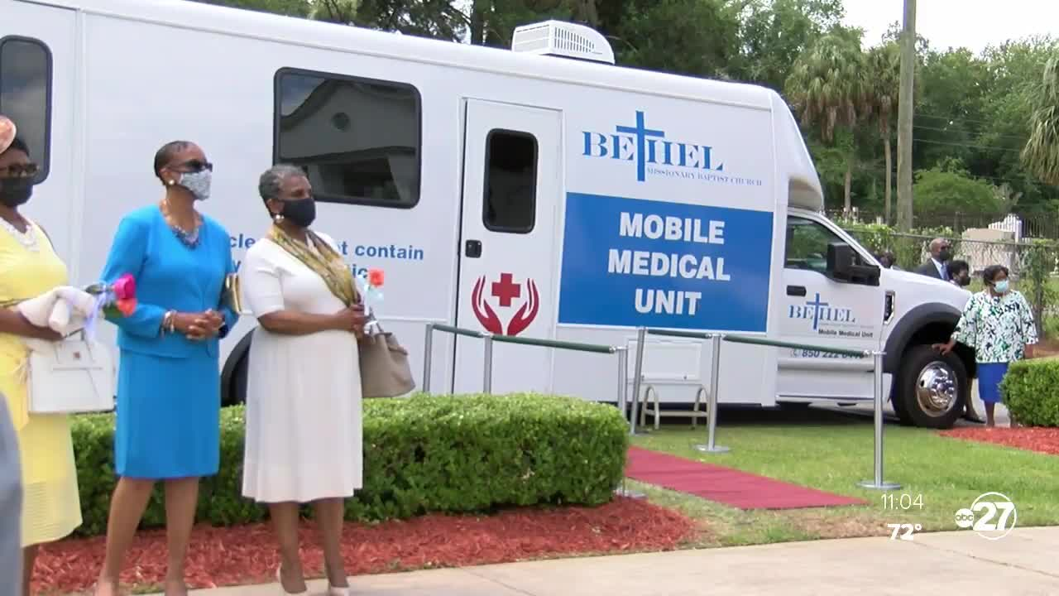

Slide 120
There are doctors and nurses who donate a few weeks a year or weekends to help people in poor communities.

Slide 121
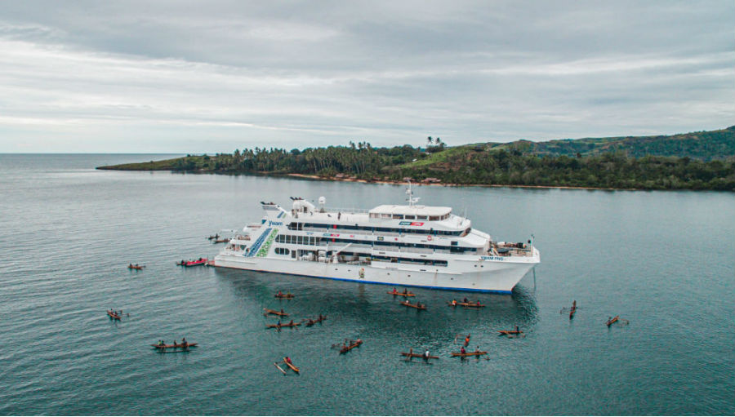
A medical ship
By YWAM

Slide 122
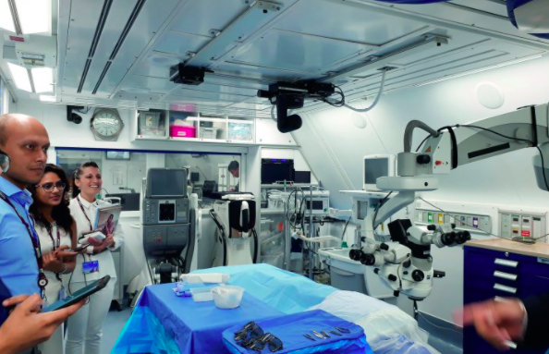
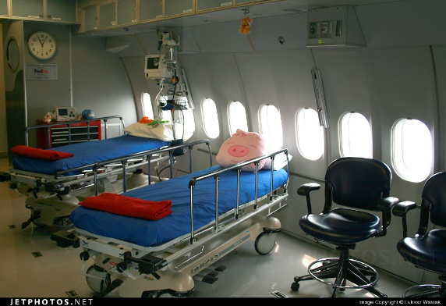
Orbis - The Flying Eye Hospital

Slide 123
There are teachers and others who care for needy students outside their classrooms.

Slide 124
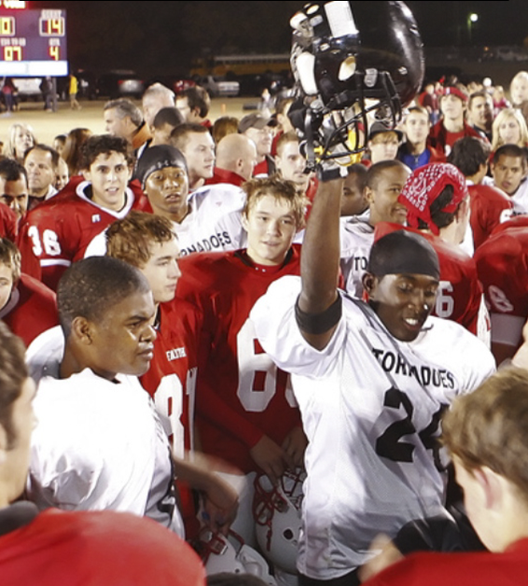
Gainesville State vs. Grapevine Faith
"You are just as valuable as any other person on planet Earth."

Slide 125
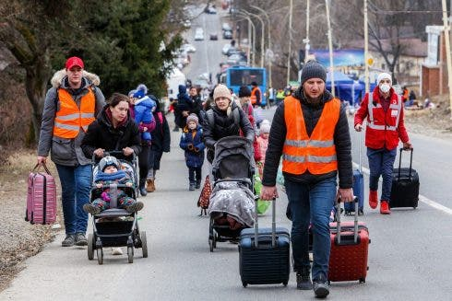
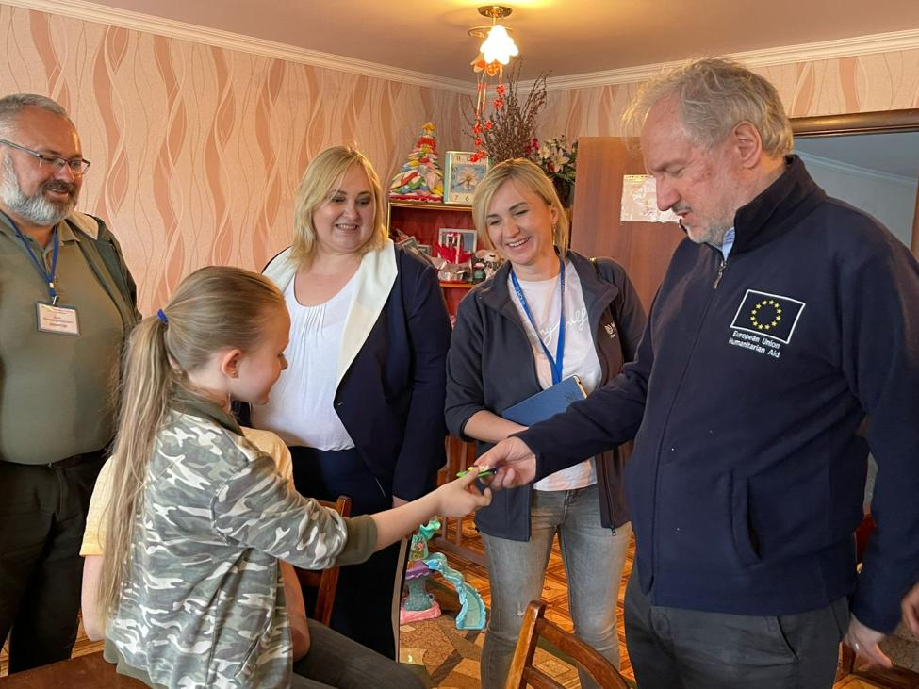
Many European families took in Ukrainian temporary migrants in times of war.

Slide 126
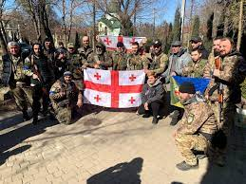
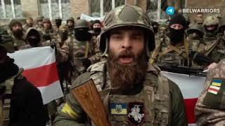
Many foreigners went to Ukraine to resist Russian invasion.

Slide 127
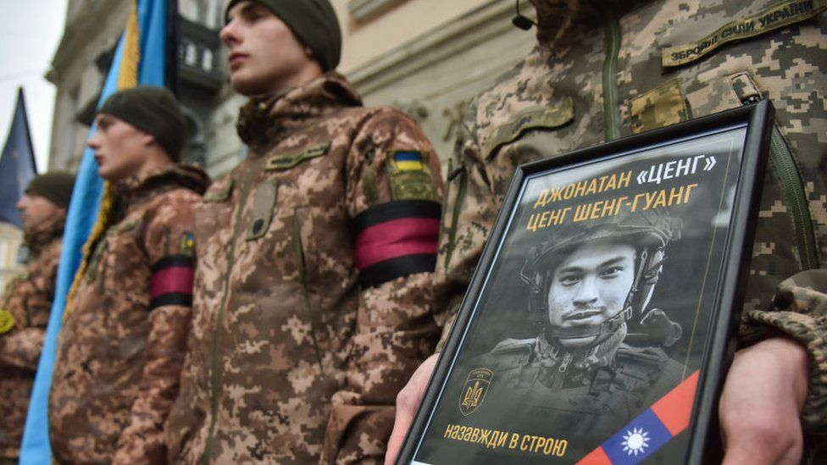
Ukraine honors a Taiwanese volunteer

Slide 128
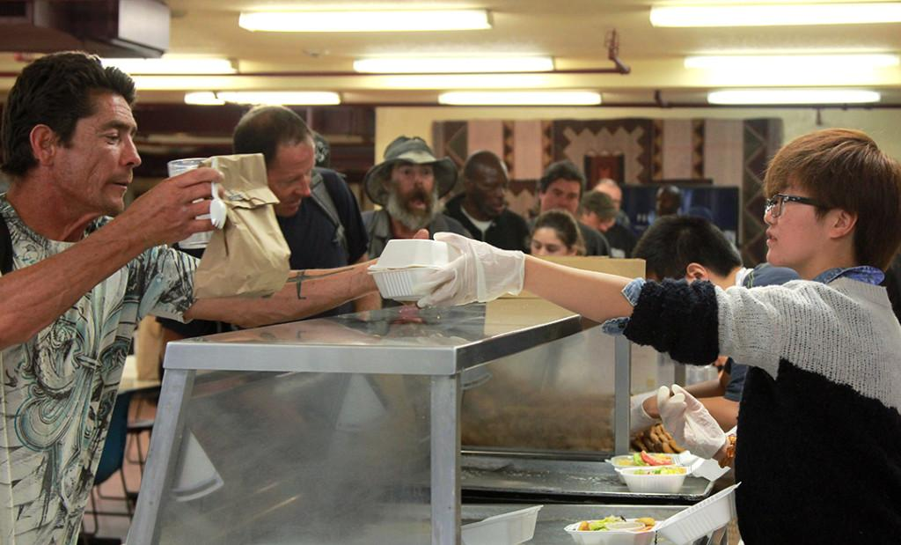
Locally, some people work in homeless shelters and food banks to help the poor.

Slide 129
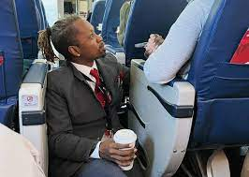
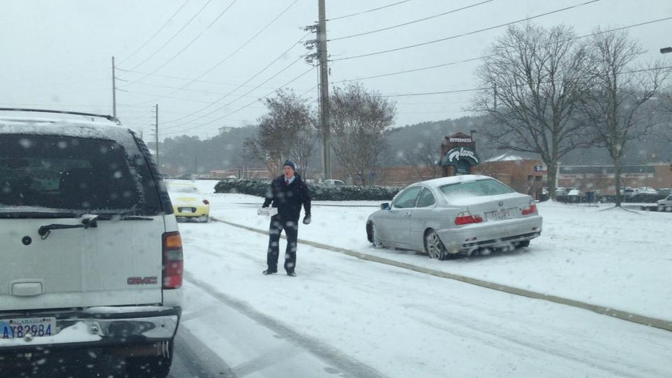
Or simply care for people while doing their everyday jobs.

Slide 130
When you are willing, God will show you ways to serve other people and give you the resources to do so.

Slide 131
Finally, keep each other accountable and tell other Christians when they waste their talents. You are helping them to prepare for eternity.

Slide 132
In conclusion, this parable teaches us many critical lessons:

Slide 133
First, our earthly lives are a testing and training ground for us. We are given talents to start and we work to earn more through our experiences.

Slide 134
What are things you can earn keep forever?
Character
Perspective
Talents/skills
Experience which becomes knowledge & wisdom

Slide 135
Talents/skills
Experience which becomes knowledge & wisdom

Slide 136
These are things we build up and learn on Earth and we can use in eternity.

Slide 137
Second, God judges us by our intent, not our abilities or achievements. We just need to do the best we can based on what we are given.

Slide 138
Third, when we are unable to do as much as what we want for God, we can support others who can do it better and we will share in their output.

Slide 139
Finally, what’s worst is wasting our earthly lives away, or think that we can keep it for ourselves. The truth is, you can’t keep it because it’s temporary.

Slide 140
So how do these lessons affect us today?

Slide 141
Ask yourself: am I doing what I can for God? Or am I wasting my life away, thinking it’s really mine to use as I please?

Slide 142
Our earthly life is a chance to trade the temporary for what’s eternal.

Slide 143
Although not all of us are meant to be ministers, but are you doing what you can to help others and further God’s kingdom?

Slide 144
You also serve God when you serve other people, when you guide them, provide for them, protect them, or heal them.

Slide 145
If you can’t do work for God directly, then support those who can. For instance, make money and donate to support God’s work.

Slide 146
God will reward you for doing what you can. You can share in the fruits of the other laborers when you support them.

Slide 147
Our goal in life should be hearing God’s praise when we finally meet Him:

Slide 148
“Well done, good and faithful servant! You have been faithful with a few things; I will put you in charge of many things. Come and share your master’s happiness!”

Slide 149
Finally, remember our earthly life is tiny and trivial compared to eternity. This parable suggests it’s only a testing and training ground.

Slide 150
Let’s not live in regret and be unable to move forward, for that would be a true failure.

Slide 151
Let’s make sure we are all ready for the real life that matters – the eternal life.
God bless us all.

