Slide 1
Parables of the Mustard Seed & Yeast in the Dough
Scripture:
Matt. 13:31-33

Slide 2
Jesus told them another parable: “The kingdom of heaven is like a mustard seed, which a man took and planted in his field.
Though it is the smallest of all seeds, yet when it grows, it is the largest of garden plants and becomes a tree, so that the birds come and perch in its branches.”
He told them still another parable: “The kingdom of heaven is like yeast that a woman took and mixed into about sixty pounds of flour until it worked all through the dough.”

Slide 3
Though it is the smallest of all seeds, yet when it grows, it is the largest of garden plants and becomes a tree,

Slide 4
so that the birds come and perch in its branches.”
He told them still another parable:
“The kingdom of heaven is like yeast that a woman took and mixed into about sixty pounds of flour until it worked all through the dough.”

Slide 5
“The kingdom of heaven is like yeast that a woman took and mixed into about sixty pounds of flour until it worked all through the dough.”

Slide 6
Parables of the Mustard Seed & Yeast in the Dough

Slide 7
In Matthew ch. 13, Jesus used seven parables to tell us about the Kingdom of Heaven.

Slide 8
“Kingdom of Heaven” means where God rules – generally while on Earth it is referring to His Church.

Slide 9
“Kingdom” = “King’s dominion” – where the King rules.

Slide 10
The Seven Parables:
1. Sower / Four Soils
2. Wheat & Tares
3. Mustard Seed
4. Yeast in the Dough
Hidden Treasure
Precious Pearl
The Net

Slide 11
5. Hidden Treasure
in the Field
6. Precious Pearl
7. Fishing with the
Net

Slide 12
The mustard seed and the yeast in the dough parables seem very similar on the surface.

Slide 13
But like the parables of the minas and talents, we will see deeper meanings when we compare them carefully.

Slide 14
And with our modern knowledge in chemistry, we can see even more meanings from these parables.

Slide 15
The most basic explanation: Kingdom of Heaven grows from the smallest faith and Gospel.

Slide 16
Both the mustard seed and the yeast in the dough show tremendous growth from the small things.

Slide 17
Let’s first analyze the parable of the mustard seed.

Slide 18
Mustard seed is used again later by Jesus to represent the growth of faith from the smallest bit:

Slide 19
Luke 17:6
Jesus replied, “If you have faith as small as a mustard seed,
you can say to this mulberry tree, ‘Be uprooted and planted in the sea,’ and it will obey you.

Slide 20
you can say to this mulberry tree, ‘Be uprooted and planted in the sea,’ and it will obey you.

Slide 21
The man who sowed the mustard seeds should represent God, the sower in the Four Soils parable too.

Slide 22
He is the true source of Gospel and faith. He is the one who really plants faith in people.

Slide 23
The field represents His domain – His Church on this Earth. The plants grow inside the Church.

Slide 24
Mustard seed is the Gospel and starting faith – small but has all the genes needed to form the plant.

Slide 25
The mustard trees are the mature Christians. They serve the community in general.

Slide 26
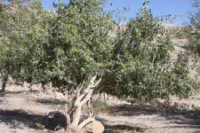
在中東的芥菜樹
Mustard Tree in the Middle East

Slide 27
Mature mustard trees provide food and shelter to birds and animals.

Slide 28
Jesus called us “the light and the salt of the world” (Matthew 5:13-16).

Slide 29
Today, many Christians and Christian groups are on the forefront of service to humanity.

Slide 30
They sacrifice their time, treasure, and talents to serve humanity – no matter who they are.

Slide 31
Serving others is the most important means of spreading the Christian faith.

Slide 32
“Preach the Gospel at all times. When necessary, use words.”
-- Unknown

Slide 33
So the mustard seed parable is not hard to understand. Living it out may be hard, though.

Slide 34
John 12:24
Very truly I tell you, unless a kernel of wheat falls to the ground and dies,

Slide 35
it remains only a single seed. But if it dies, it produces many seeds.

Slide 36
The Yeast in the Dough parable, however, is far more perplexing.

Slide 37
On the other hand, yeast has never been mentioned in the Bible in a positive way.

Slide 38
Yeast represents sin and evil intentions, and in some festivals they avoid leaven bread.

Slide 39
In fact, Passover is the meal right before the start of the seven-day Feast of the Unleavened Bread.

Slide 40
It is a reminder of the Israelites leaving the sinful world of Egypt behind.

Slide 41
Matt. 16:6 – Jesus said, “Be on your guard against the yeast of the Pharisees and Sadducees.”

Slide 42
Jesus was referring to those religious teachers’ evil intentions and false teachings.

Slide 43
Sin comes from people, not God. God may allow sin and suffering to last for a time, however.

Slide 44
The bread-making woman should be referring to people. No surprise since they do the cooking.

Slide 45
And the flour, which comes from wheat, represents Christians.

Slide 46
Water, which is needed in the dough, represents the Holy Spirit working in us.

Slide 47
Flour = Christians
+ Water = Holy Spirit
+ Yeast = sin/evil .
Good-tasting bread?

Slide 48
How is that possible? Why is sin allowed among Christians and help make something good from it?

Slide 49
To figure that out, we need to learn how to make bread.

Slide 50
How to make bread?
1. Flour mixed with water, yeast, and a tiny bit of oil, salt, and sugar.

Slide 51
When flour is mixed with water, it turns into the elastic gluten when kneaded.

Slide 52
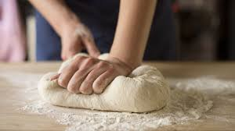

Slide 53
The yeast turns sugar into CO₂ and breaks down starch, protein, and fat into more basic molecules.

Slide 55
The CO₂ is trapped by the elastic gluten and the dough rises.

Slide 56
Give the yeast some time to grow and do its job and the dough will expand in size due to the air in it.

Slide 57
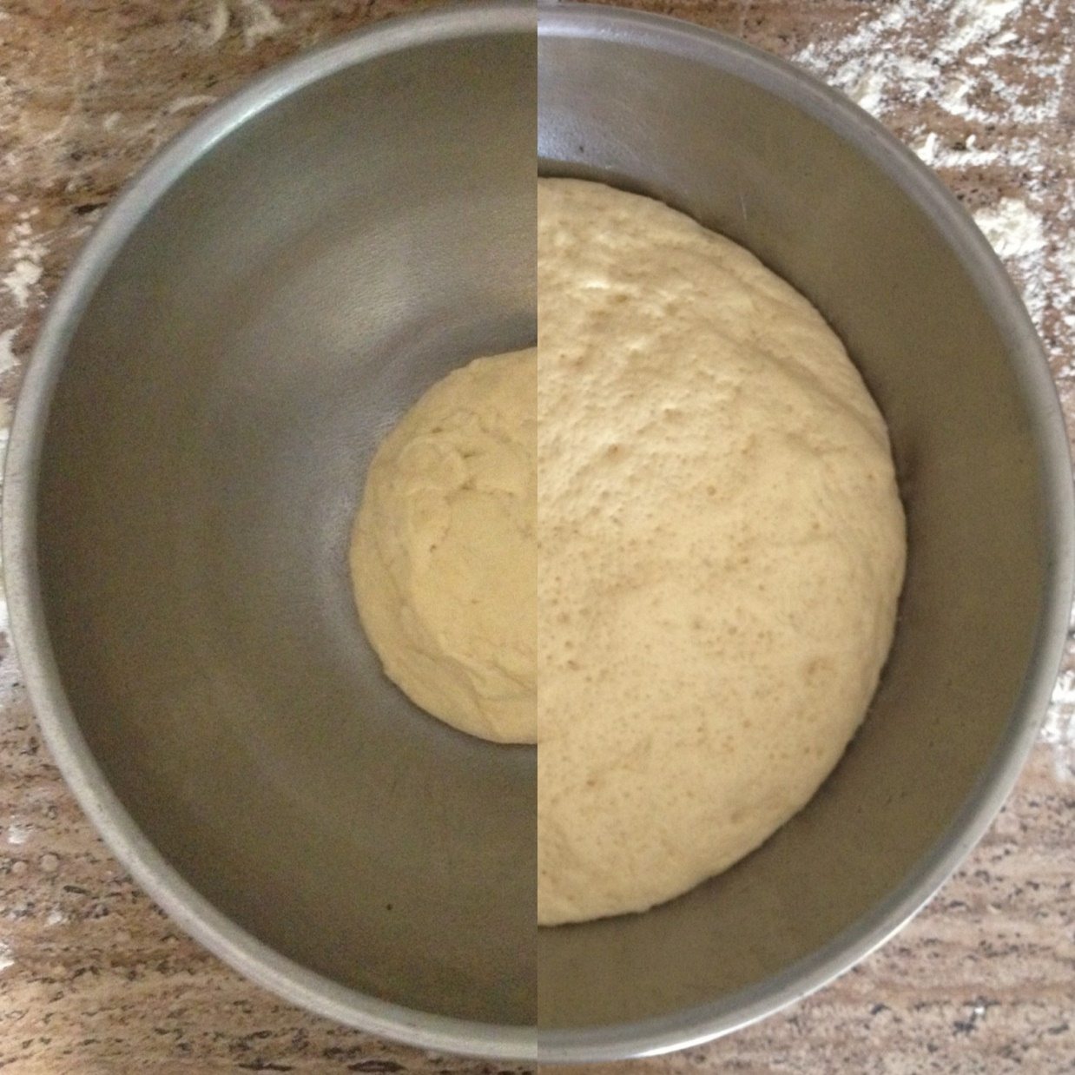

Slide 58
Then we divide up the dough into the right amounts and bake them into bread.

Slide 59
The dough becomes bigger and full of air because the yeast digests the sugar in the flour and releases CO₂.

Slide 60
The yeast also transformed the protein, starch, and fats into something different.

Slide 61
So different types of yeast would produce different types of bread.

Slide 62
What are the waste products of yeast and why do they make the breads taste good?

Slide 63
Yeast first makes CO₂. When oxygen is all used up, and then it uses anaerobic respiration and makes ethanol.

Slide 64
C₆H₁₂O₆ + 6O₂ →
6CO₂ + 6H₂O
Sugar + oxygen →
carbon dioxide + water

Slide 65
C₆H₁₂O₆ →
2C₂H₅OH + 2 CO
Sugar → ethanol +
carbon monoxide

Slide 66
In effect, we are eating the waste products of yeast!

Slide 67
CO₂ makes the bread fluffy. Ethanol gives it a bit of taste but are mostly evaporated during the baking process.

Slide 68
The baking process destroys the yeast and the ethanol but the bread tastes different as a result.

Slide 69
Similarly, while sin and suffering help make Christians better, they are then destroyed by God.

Slide 70
God uses sin and suffering to transform Christians but will destroy sin and remove suffering in due time.

Slide 71
Different kinds of yeasts, cooking methods, and slightly different ingredients will produce different kinds of bread.

Slide 72
Similarly, God uses different kinds of sins and sufferings to help produce Christians with different characteristics & gifts.

Slide 73
Yeast first makes CO₂ and then make ethanol. So by controlling the time we can control the amount of alcohol.

Slide 74
Some are hardy Christians able to fight. Some are soft and sweet who bring comfort to others.

Slide 75
So the yeast is a tool used by bakers to make different kinds of tasty bakery items.

Slide 76
Similarly, sin and suffering, though evil, are used by God to make us better Christians.

Slide 77
Also, in the parable Jesus said explicitly that the amount of flour is about 60 lbs.

Slide 78
That’s a lot of flour – can feed maybe 100 people. There’s a reason for him to tell us the amount.

Slide 79
The work of sin and the resulting Christian growth is never done in isolation.

Slide 80
The spread of sin and suffering usually comes from interaction with other people.

Slide 81
Yes, there’s sin and suffering among people in Church too. Don’t be surprised. But God is at work.

Slide 82
In the washing machine allegory, we talked about how the Church is like a washing machine.

Slide 83
And how the dirty cloths, which represent sinful Christians, help cleanse each other.

Slide 84
When we stay with God, He will bake us and the sin and suffering will be gone in due time.

Slide 85
Romans 8:28
And we know that in all things God works for the good of those who love him,
who have been called according to his purpose.

Slide 86
who have been called according to his purpose.

Slide 87
Are you struggling with sin or going through suffering? God is making you into good bread.

Slide 88
It may be a long and painful process but don’t give up!

Slide 89
In the end, you will turn into great bread. Those sin and suffering will be gone for good.

Slide 90
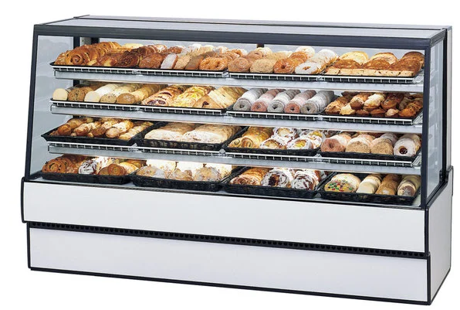
See you here!

